Slide 2
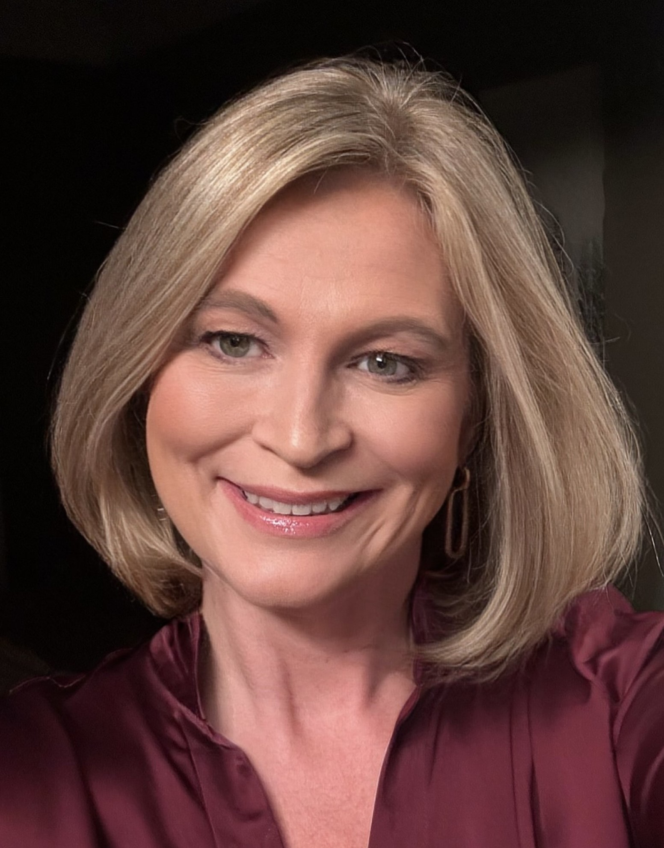
Stephanie McCoy, BBA, CPCS, CPMSM
Practice Administrator
Director at Large, NAMSS

Slide 3

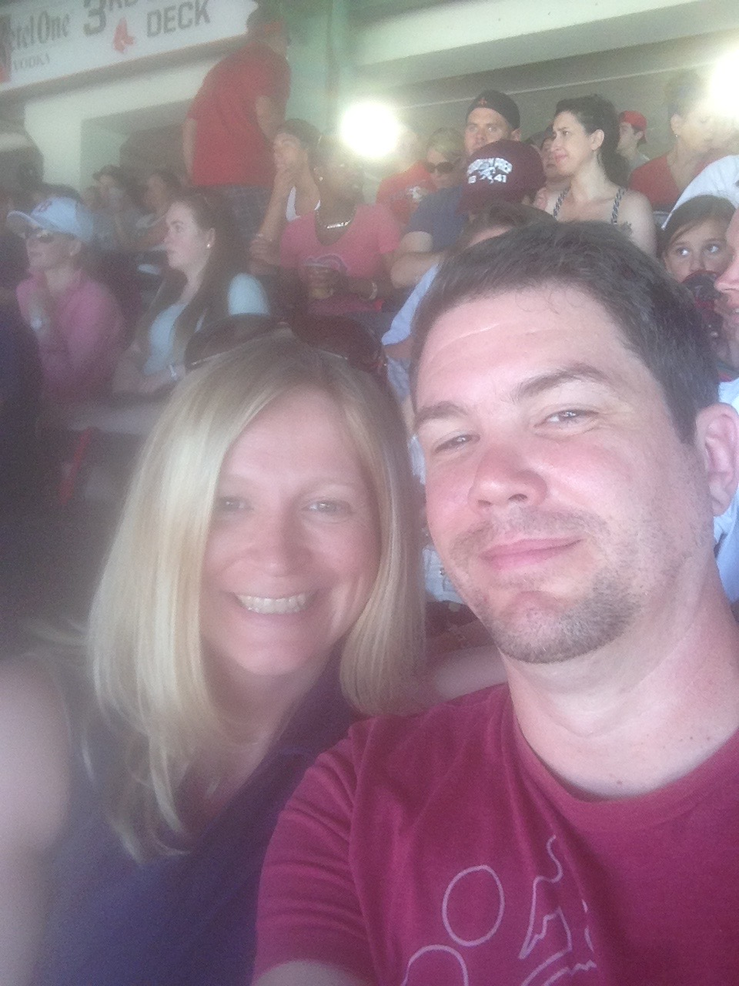
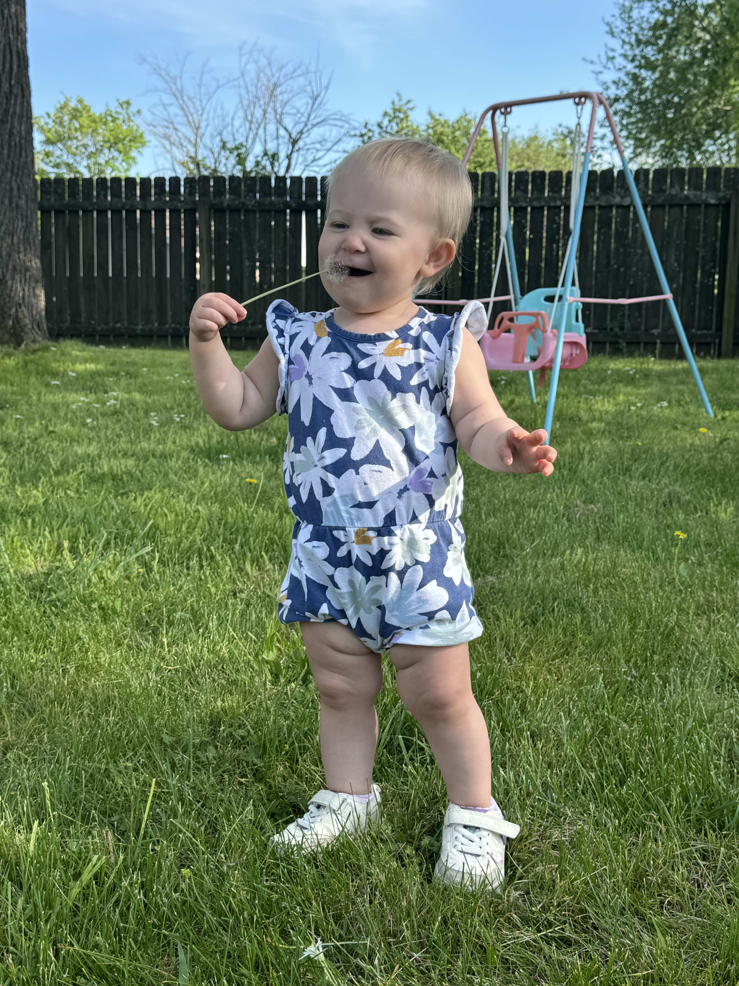
Introduction
Name: Stephanie McCoy
States: Connecticut, Maine, Massachusetts, Rhode Island, New York, New Hampshire
Email: smccoy@radsource.us

Slide 4

Recognition
Massachusetts State Leaders
  Karin Bernard – President
  Heather Clark – President-Elect
  Anne Leary – Immediate Past-President
  Natalie Arjune-Jones – Secretary
  Lori Mack – Media Coordinator
  Kathleen Lamagdeleine – Sponsorship & Events Services Manager
  Nancy Dunn - Treasurer

Slide 5




Fun Facts
Basketball invented in Springfield, MA
It’s illegal to make clam chowder with tomatoes
There is a state law that forbids snoring unless all your doors and windows are locked.
First Dunkin Donuts opened in Quincy, MA

Slide 6
Learning Objectives
Describe the history of NAMSS, strategic initiatives and impact on the industry.
Learn about opportunities for volunteering with NAMSS, understand the NAMSS leadership selection process, and explore the educational resources available to support your professional growth.
Discuss verification benchmarks and efforts NAMSS is supporting to improve credentialing efficiencies.

Slide 7

What Do You Hope To Take Away Today?

Slide 8
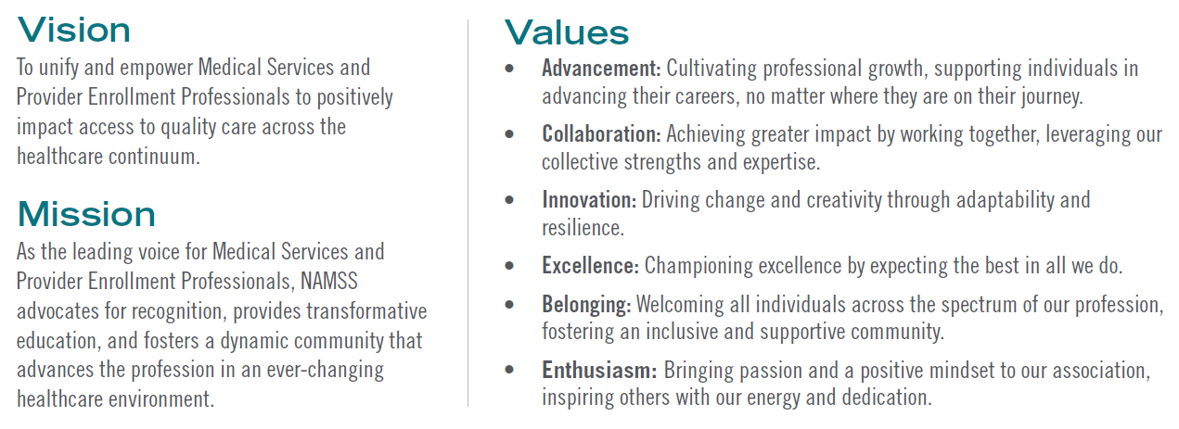
NAMSS Mission, Vision, and Values
8
Notes:
As of December 2024, NAMSS has:
Over 5,800 members
Over 3,000 Certified MSPs
In 2024 the NAMSS Board revised the mission and vision statements and we are pleased to not only roll out these new mission and vision statements, but also present the first ever set of NAMSS values.

Slide 9
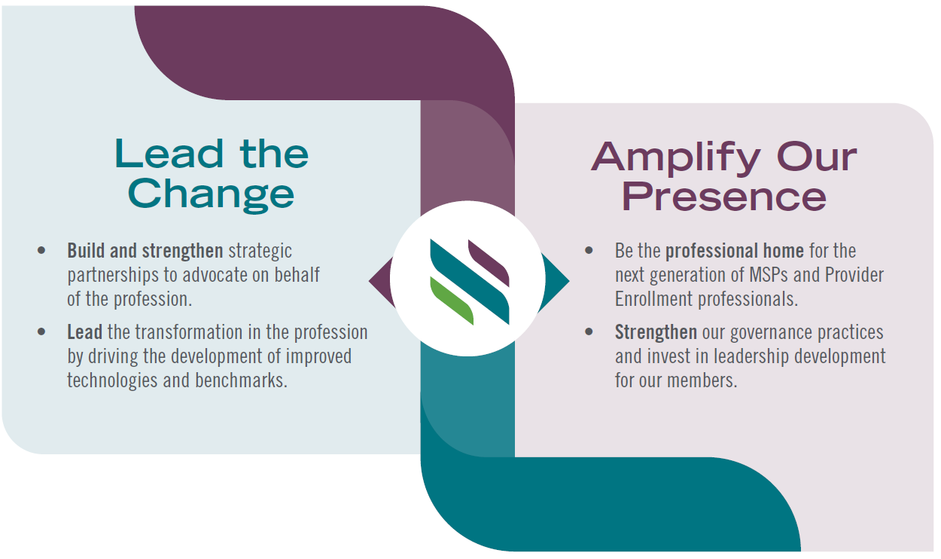
NAMSS 2025 – 2027 Strategic Plan
9
Notes:
The NAMSS strategic plan was recently updated with new objectives for 2025 through 2028. The plan lays out two main priorities for the organization, Lead the Change and Amplify Our Presence.

Slide 10

NAMSS Along the Way: Milestones & Moments
1971
1978
Formed in California
Medical Staff Secretaries Assoc.
Certification
Process Initiated
1972
1972 – Overview
(now Synergy)
was born
2016
Leadership
Certification introduced
1980
“NAMSS”
is adopted
2019
2024
Launched
Tomorrow's MSP®!
2013
48th Annual Conference
2026
NAMSS
PASS is born
50th Annual Conference
Notes:
NAMSS has been around since 1971, when it was formed as the Medical Staff Secretaries association in California by Charlotte Cochran and Joan Covell. In 1978 the process to establish certifications began, and in 1980, “NAMSS” was adopted as our official organization name. In 2013, NAMSS PASS was born. In 2024, we’ll celebrate our 48th annual conference, and in 2026 we’ll celebrate our 50th annual conference.

Slide 11
From Good to Great: How NAMSS Supports MSPs

Slide 12
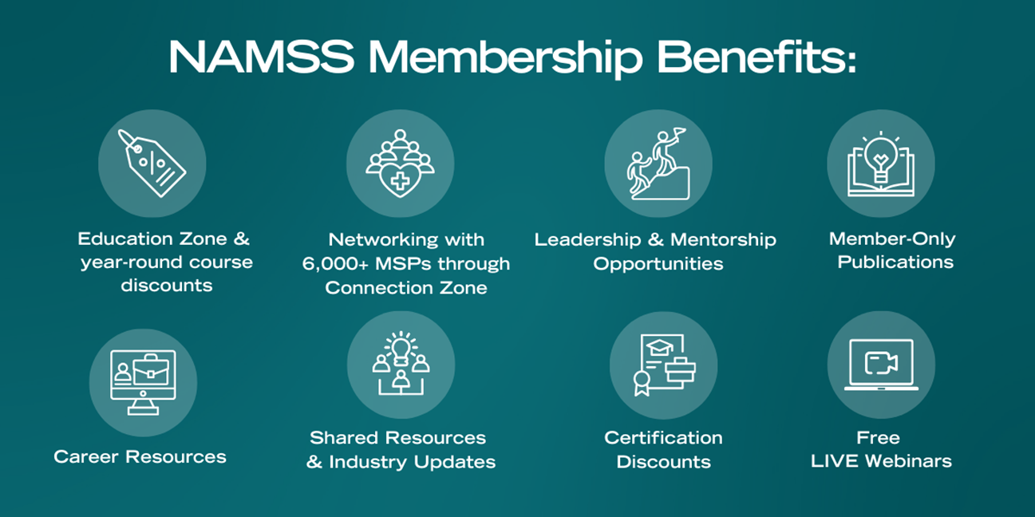
What’s Your Favorite Member Benefit?
Notes:
NAMSS has multiple membership benefits, which are seen here on the screen. Some highlights include access to 12 free webinars a year, networking with our almost 6,000 members, access to members-only articles on Gateway, multiple resources include our toolkits, and discounts for education, conference registration and certification.

Slide 13




NAMSS Growth: Powering Collaboration and Innovation
Expanding Membership
NAMSS has grown to 5,500+ members, reflecting the increasing value of its services and resources.
Massachusetts Members = 147
Building Partnerships
NAMSS is strengthening ties with accrediting bodies like AHA, AMA, and ABMS to enhance professional standards.
Advocacy
NAMSS advocates on behalf of MSPs nationwide, with initiatives such as the SOC Task Force, Ideal Credentialing Standards, Leadership Certification, Tomorrow’s MSP® Campaign, and the Annual Roundtable. NAMSS promotes best practices and aligns with industry leaders to ensure MSPs are supported by the latest standards.
Notes:
History of NAMSS Growth
Throughout the 1980s, the organization continued gaining national recognition, which led to increased membership, increased conference attendance, and flourishing state associations.
Educational programs have grown out of member type and member needs assessments to include new affiliate programs and designations.
Expanding Membership
NAMSS has grown to 5,500+ members, reflecting the value of our resources.
Strong engagement shows MSPs’ commitment to the profession.
[Insert state membership number] to highlight local growth.
Building Partnerships
Strengthening ties with AHA, AMA, and ABMS to elevate standards.
Aligning MSPs with best practices and regulatory expectations.
Enhancing recognition and credibility through collaboration.
Advocacy
NAMSS advocates nationally for MSPs through key initiatives:
SOC Task Force – Addressing scope of practice.
Ideal Credentialing Standards – Promoting consistency.
Leadership Certification – Advancing careers.
Tomorrow’s MSP® Campaign – Preparing for the future.
Annual Roundtable – Engaging industry leaders.
Ensuring MSPs stay supported and aligned with the latest standards.

Slide 14


NAMSS Growth: Powering Collaboration and Innovation
Educational Resources
NAMSS provides toolkits like the Hospital Merger and Acquisition Toolkit to support members' decision-making.
Strategic Impact
Collaborations with partners help strengthen networks, set industry standards, and offer more opportunities for members.
Notes:
Educational Resources
NAMSS provides valuable toolkits to help MSPs navigate complex industry challenges.
These tools ensure MSPs stay prepared and ahead of industry changes.
Strategic Impact
NAMSS' partnerships strengthen professional networks and create new opportunities for MSPs.
By collaborating with industry leaders, NAMSS helps set and maintain the highest standards.

Slide 15

NAMSS Connection Zone
Community Features
Discussions
  NAMSS members can participate in one of our 18 thriving community forums for discussion and questions specific to the medical services profession. Collaborate with professionals around the country to get answers to your questions and expand your industry knowledge.
Library
  The NAMSS Connection Zone allows members to create a library of professional resources dedicated to MSPs. Share and discover new information to stay up-to-date on your knowledge of the medical services industry.
Connect
  Build your network of MSPs by saving contacts in your community contact book. Send messages following up on discussions and build relationships with your fellow MSPs.
https://www.namss.org/NAMSS-Connection-Zone
Notes:
The NAMSS Connection Zone is a new member benefit that was rolled out in 2022. The connection zone offers the opportunity for discussion, file-sharing and building your network.

Slide 16
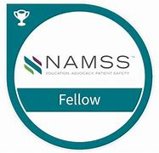

NAMSS Fellow & Hall of Fame
Fellow Program (Since 2016)
Recognizes MSPs for outstanding leadership, mentorship, and education
Total Fellows (2024): 53
2025 Applications: Spring
Massachusetts Fellows:
  Roxanne Chamberlain, MBA, FACHE, CPMSM, CPCS, CPHQ, FMSP, Senior Director of Medical Staff Services, Baystate Health System, Springfield, MA
  Mathieu Gaulin, CPMSM, CPCS, FMSP, Senior Director, Professional Medical Staff Services, Boston Children's Hospital, Boston, MA
Hall of Fame (Since 2016)
Honors MSPs for passion, dedication, and commitment
Total Inductees (2024): 14
Applications: February – March 2025
Maximum of 3 inductees annually
https://www.namss.org/Membership/NAMSS-Fellows
https://www.namss.org/Membership/NAMSS-Hall-of-Fame
Notes:
Fellows:
Acknowledgment and recognition for the MSP who has made outstanding contributions to the profession through service as a leader, mentor, and educator.
Eligibility and application criteria can be found on the NAMSS website.
Applications are accepted each Spring
Hall of Fame:
Eligibility and nomination criteria can be found on the NAMSS website. The nomination period for 2024 will be open from late January through early March

Slide 17
NAMSS Scholarships & Awards
NAMSS members are eligible to apply for the following scholarships and awards:
Scholarships
Charlotte Cochrane Scholarship
NAMSS Annual Conference or State/Local Annual Conference Scholarship
NAMSS Empowering Tomorrow’s MSP® Scholarship
Continuing Education Scholarship
Beginning in 2024, NAMSS has added additional conference scholarships to offer more members the opportunity to attend the annual conference.
Awards
Leadership Award
Certification Impact Award
Joan Covell-Carpenter Award
ICON Award
https://www.namss.org/Membership/NAMSS-Scholarships
Notes:
NAMSS offers a number of scholarship and awards designed to advance studies or to assist with attendance to NAMSS or State educational offerings.
NAMSS scholarships provide scholarship opportunities for NAMSS members to attend the National Conference & Exhibition and State/Local Conference, the NAMSS Education Summit, and/or to participate in other continuing education. Applications for scholarships are accepted twice a year.
NAMSS awards are presented to individuals that have shown dedication to the medical staff and credentialing services profession through their certification, leadership, and advocacy. Nominations for these awards are submitted in mid-June and the awards are presented at the annual conference.

Slide 18

Complete work history
Gap Analysis and Good Standing Letters
Resource for future initiatives
Disaster response credentialing
Over 675 participating entities and 1,000,000+ affiliations
Notes:
Secure, online database for verification of work history and gap analysis
Goal – to become the “go to” source for a complete affiliation work history
No more querying multiple hospital websites or faxing verification requests
Easily identify gaps in work history and unreported affiliations
Obtain verifications from closed facilities
Quick resource for credentialing practitioners volunteering during a disaster

Slide 19
No Charge to
  Create an account
  Contribute affiliation data
  Browse practitioners and hospitals
  Auto-response letters to other entities
Charged only for printing an affiliation letter
  Discount for contributing entities
  Discount for subscriptions of 11 - 99 or over 100
              https://www.namss.org/Membership/NAMSS-PASS
Notes:
Provides two legally-vetted “Letters of Good Standing” templates
Providers verification of affiliation dates for closed facilities
Cost $6/letter each or for purchase of 1-10
Purchase 11-99 letters $5/letter
Purchase 100 or more $4/letter

Slide 20
Volunteering with NAMSS

Slide 21

My Path As A Volunteer…
Notes:
Share your path as a volunteer story

Slide 22

NAMSS Call for Committee Volunteers

Slide 23
NAMSS Governance Structure
Board of Directors
Professional Development Council
Education Committee
Conference Committee
Membership Committee
Audit & Finance Committee
Ethics Committee
Gov’t Relations Liaison
SME Committee
Accreditation Committee
Courses Subcmte
Products & Resources Subcmte
SOC Task Force
Roundtable Task Force
DEI Committee
Leadership Selection Committee
Mentoring Committee
Certification Commission
Publications Committee
Notes:
Here you can see a brief overview of the structure of NAMSS. We have a number of committees, subcommittees, task forces, and work groups that all report to the Board of Directors.

Slide 24

Volunteering with NAMSS
Board Nomination process
  Opens in mid-March, closes in early May
  Candidates must self-nominate
  Application materials required:
    Candidate Statement
    Candidate Biosketch
    Signed NAMSS Volunteer Leader Agreement and Conflict of Interest Disclosure Form
    Signed Campaign Policy Agreement
    Completed Leadership Self-Assessment (Principles of Leadership)
    A high-resolution professional color headshot
Notes:
Call for Board Nominations Occurs in the Spring (late March/early April) of each year.
Candidates must self-nominate
Application materials required:
Candidate Statement
Candidate Biosketch
Signed NAMSS Volunteer Leader Agreement and Conflict of Interest Disclosure Form
Signed Campaign Policy Agreement
Completed Leadership Self-Assessment (Principles of Leadership)
A high-resolution professional color headshot

Slide 25
Volunteering with NAMSS
Additional application materials:
  References from:
    Peer
    State leader or NAMSS Committee Chair familiar with your volunteer leadership experience
    Supervisor

Slide 26
Volunteering with NAMSS
Eligibility – Secretary-Treasurer:
Dual certified (including CPES beginning January 2026)
Previously served as Committee Chair or member
No conflicts of interest
Cannot simultaneously serve on State board
Eligibility – Director at Large:
Either CPCS or CPMSM (CPES beginning January 2026)
Previously served as NAMSS committee member or state leader
No conflicts of interest
Cannot simultaneously serve on State board
Notes:
You can see the eligibility requirements listed here. Both positions require at least one NAMSS certification, and previous experience as a committee member or state board leader. Beginning in 2026, the CPES will also be acceptable for one of the required certifications.

Slide 27

Leadership Selection Committee
Focused on:
  Call for Board Nominations – Vetting Candidates
    Review of applications & references
    Interview with candidate
    Interview with supervisor reference
    Overall scoring of experience, contributions to NAMSS/the industry, references and interview
    Slate recommendation to Board of Directors
  NAMSS Hall of Fame program
  NAMSS Fellow Designation
Notes:
The Leadership Selection Committee is primarily responsible for identifying, evaluating and selecting qualified candidates for the election of Board positions and selection of Hall of Fame and Fellows designation
On this slide, you can see the overview of the work the Leadership Selection Committee completes to vet board candidates. These steps include:
Review of applications & references
Interview with candidate
Interview with supervisor reference
Overall scoring of past experience, contributions to NAMSS and in the industry, references and interview
Slate recommendation to Board of Directors
The slate of candidates put forth for election is ultimately determined by the Board of Directors based on the Leadership Selection Committee’s recommendation.

Slide 28
Mentoring Committee
Chair: Amy Ligocki, CPCS, CPMSM
Goals:
  Identify future NAMSS leaders
  Build a pipeline/database of potential volunteer leaders
  Mentor potential candidates for Board of Director and Committee roles
  Oversee Tomorrow’s Leaders Program
  Oversee Mentor Matching Program
  Oversee Speaker Development Program
https://www.namss.org/About/Volunteer-Leaders/Mentoring-Committee

Slide 29
Pop Quiz!
How many member types does NAMSS have?
Find fun state trivia!
Notes:
Answer: 4 – Active, Affiliate, Lifetime & Vendor

Slide 30
Growing Your Career with NAMSS Education

Slide 31
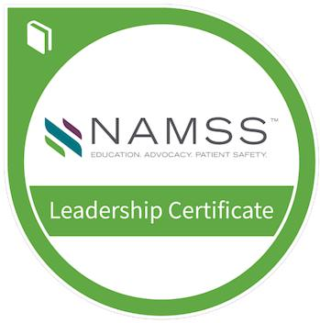
Leadership Certificate Program
Launched in 2016
Combination of online modules and live workshop
Ideal Participants:
  CPCS® and/or CPMSM® certification
  Minimum five years of experience in the industry
  Title of “Manager” or above
FREE Introduction course – 1.0 CE
*Online modules must be completed prior to live workshop participation
https://www.namss.org/Education/Become-a-Leader-with-NAMSS/Leadership-Certificate-Program
Notes:
If you are ready to take on a leadership role within your workplace, the NAMSS Leadership Certificate Program will get you there. Through a series of both live and online courses, this new program allows MSPs dedicated to the field to expand on their experiences and gain the skills, confidence, and industry understanding to be stronger leaders within the industry.
The NAMSS Leadership Certificate Program is an ideal option for MSPs with the CPCS or CPMSM credential and a minimum of five years’ industry experience with the title of Manager and above. However, the program is open to NAMSS members and non-members and all medical services professionals who are interested in advancing their role and responsibilities as leaders.
Online modules will be available through the NAMSS Education page. Users now can purchase the entire online program at once, or each course individually. We anticipate the online portion of the program taking between 15-20 hours to complete.

Slide 32
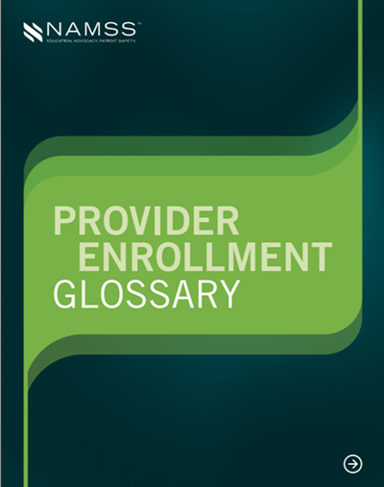
Provider Enrollment Resources
Provider Enrollment Series recordings
Quarterly webinars (free to members)
Provider Enrollment Glossary
Articles/content
Conference Recordings
Coming in 2025:
  CPES Preparation Course
  CPES Study Guide
https://www.namss.org/Join-NAMSS/Provider-Enrollment-Resources-2

Slide 33
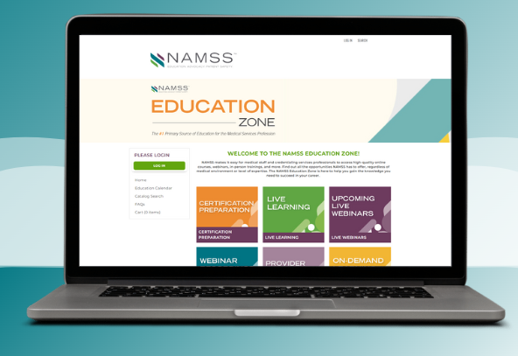
NAMSS Education Spotlight
Unlock Your Potential with NAMSS Education!
Flexible On-demand & In-person Courses
Engaging Webinars for Every Level
CPCS® & CPMSM® Practice Tests & Study Guides
Comprehensive Accreditation Standards Comparison Grid
Essential New Hire Checklist
Complete NAMSS Glossary of Terms
Key Insights in NAMSS Provider Enrollment Glossary
Credentialing 100 (on-demand), Credentialing 101 and 201 (virtual, instructor-led)
Notes:
NAMSS Educational Resources
Certification: CPCS®, CPMSM®, and CPES
Virtual & On-Demand: Webinars and Courses (ex. Cred 101 and 201)
Resources:
Accreditation Standards Comparison Grid: Compare accreditation standards from major organizations (TJC, NCQA, DNV, etc.)
Glossary of Terms
MSP Onboarding Checklist

Slide 34
State Trivia!
In what State was NAMSS founded?
Find fun state trivia!
Notes:
What state founded NAMSS
Answer: California

Slide 35
NAMSS Advocacy: Elevating the MSP Profession

Slide 36

Standard Occupational Classification (SOC) Task Force
MSPs are currently categorized as HR Personnel
NAMSS is attempting to obtain a classification code for MSPs with the Department of Labor’s Bureau of Labor Statistics
SOC code enables official entities to collect, calculate, and publish MSP workforce data
SOC will help the future of the profession
The Task Force submitted a request to obtain an SOC code
from Dept. of Labor in August, 2024.
Results of request will be available in 2026.
  https://www.namssgateway.org/Article/namss-requests-standard-occupational-classification-code-for-msps
Notes:
MSPs are currently categorized as HR Personnel
NAMSS is attempting to obtain a classification code for MSPs with the Department of Labor’s Bureau of Labor Statistics
SOC code enables official entities to collect, calculate, and publish MSP workforce data
SOC will help the future of the profession
The Task Force submitted a request to obtain an SOC code
from Dept. of Labor in August, 2024.
Results of request will be available in 2026.
You can see a copy of our submission at the link on the slide.

Slide 37

NAMSS Annual Roundtable
Collaboration between NAMSS leaders and industry partners
  2021 – Focused Revision: Moving to a Three-Year
  Practitioner Reappointment Cycle and Enhancing
  Continuous Monitoring
  2022 – Standardizing Quality: Best Practices for Measuring Practitioner Competency
  2023 – The Role of Physician Measurements in Guiding Performance
  2024 – Guiding Quality Performance for Practitioners via Continuous Monitoring
  https://www.namss.org/Advocacy/NAMSS-Roundtable-Reports
Notes:
Includes representatives from government agencies and leading industry experts
Provides a platform for leaders to discuss current credentialing systems and ways to standardize the process
Past roundtable participants have included groups such as:
-American Board of Medical Specialties (ABMS)
-American College of Physician Executives (ACPE) – Now known as the American Association for Physician Leadership
-American Hospital Association
-AMA-OMSS
-American Society for Healthcare Risk Management (ASHRM)
-Council for Affordable Quality Healthcare (CAQH)
-CMS
-Federation of State Medical Boards (FSMB)
-Healthcare Facilities Accreditation Program (HFAP)
-HRSA
-Medical Group Management Association (MGMA)
-National Association for Healthcare Quality (NAHQ)
-National Patient Safety Foundation
-The Joint Commission
-URAC
-NCQA

Slide 38
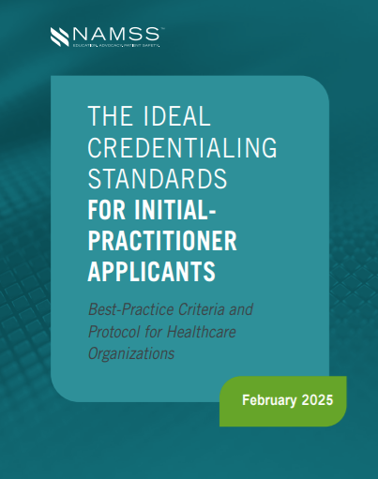
Ideal Credentialing Standards
Updated February 2025
https://www.namss.org/Advocacy/Ideal-Credentialing-Standards
Notes:
The Ideal Credentialing Standards (ICS) provides guidance to healthcare organizations on the primary-sourced essential data elements necessary to initially credential practitioners. The ICS identifies 13 essential criteria for credentialing an initial-practitioner applicant and provides red flag and primary-source examples for each criterion. By identifying and focusing the credentialing process on these 13 criteria, organizations can make their credentialing processes more streamlined and effective. Each healthcare organization should establish specific qualifications for medical-staff membership and/or clinical privileges that reflect practitioner competency for an initial applicant. Organizations should also incorporate the ICS’ 13 criteria into their rules and regulations, credentialing policies and procedures, and other governance documents to ensure that their credentialing processes are objective, systematic, and without discrimination or bias.
Our most recently released version includes some updates to Language was added to Element 10: Health Status and Element 13: Professional and Peer References to provide additional guidance for complying with various national standards regarding a practitioner’s health status. This is a free resource and available on the NAMSS website.

Slide 39
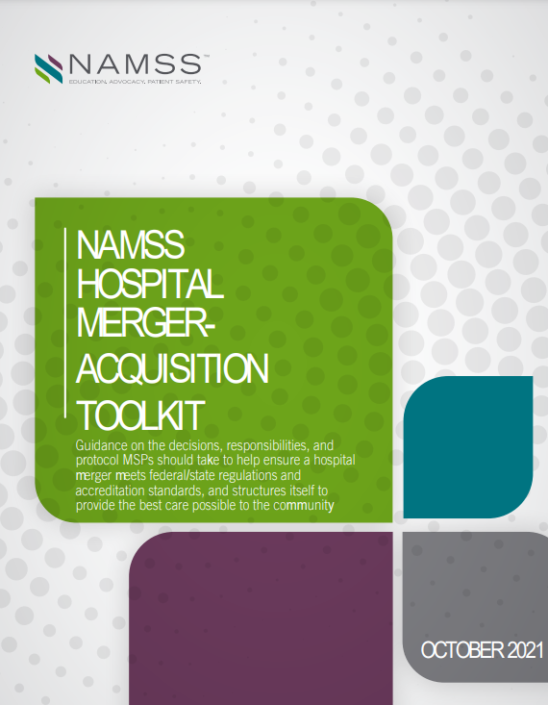
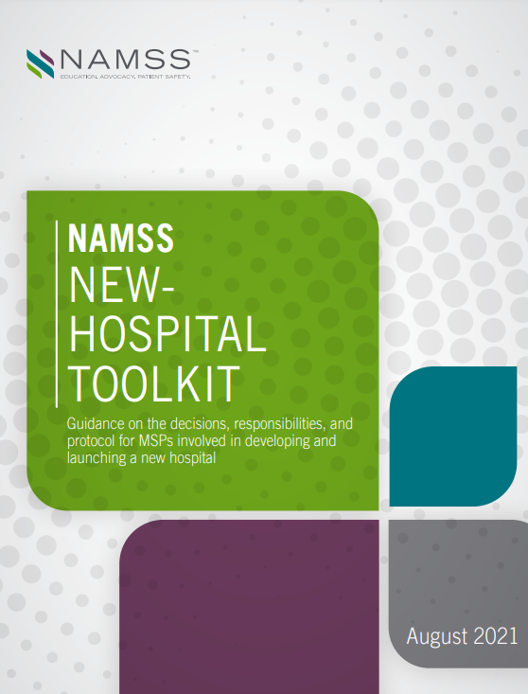
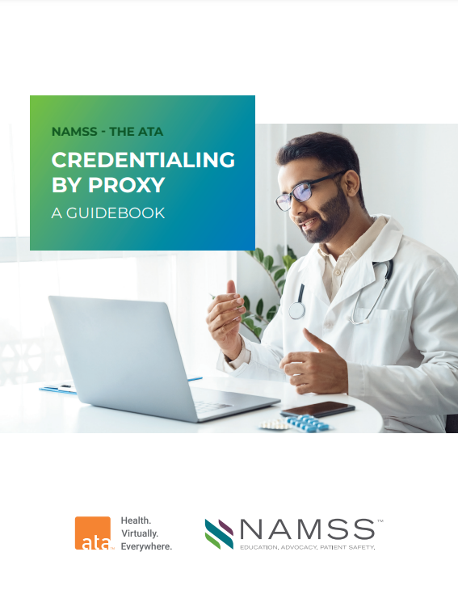
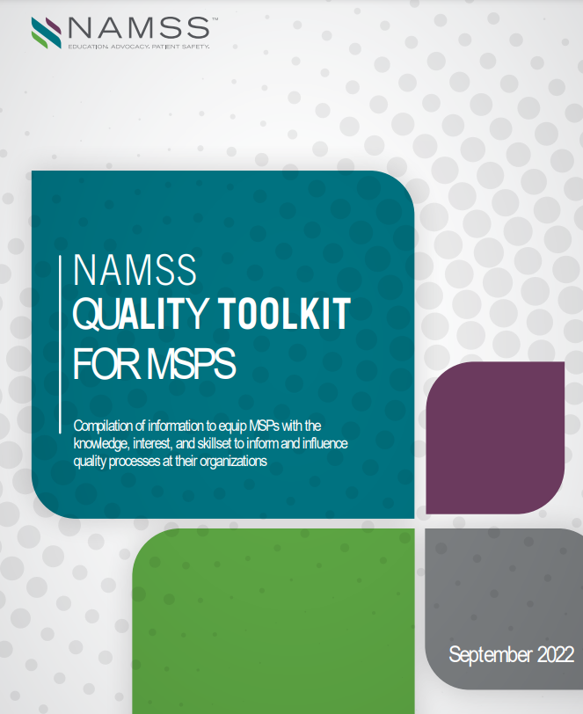
NAMSS Toolkits
https://www.namss.org/Advocacy/MSP-Resources
Notes:
The NAMSS GR team has also created several resources for NAMSS members, including the credentialing by proxy guidebook in collaboration with the American Telemedicine Association, the Quality Toolkit, the New Hospital Toolkit and the Hospital Merger & Acquisition toolkit. These are all free resources available to NAMSS members.

Slide 40
State Trivia/Pop Quiz!
What is NAMSS’ most well-attended course? (both virtual and in-person)
Find fun state trivia!
Notes:
What is NAMSS’ most well-attended course? (both virtual and in-person)
-Answer: CPCS Prep-Course

Slide 41
Get Certified, Get Ahead: NAMSS Certification

Slide 42
Certified MSPs in Massachusetts
CONGRATULATIONS, 79 MSPs that are certified!!
CPCS - 43
CPMSM - 16
Dual Certified - 20

Slide 43
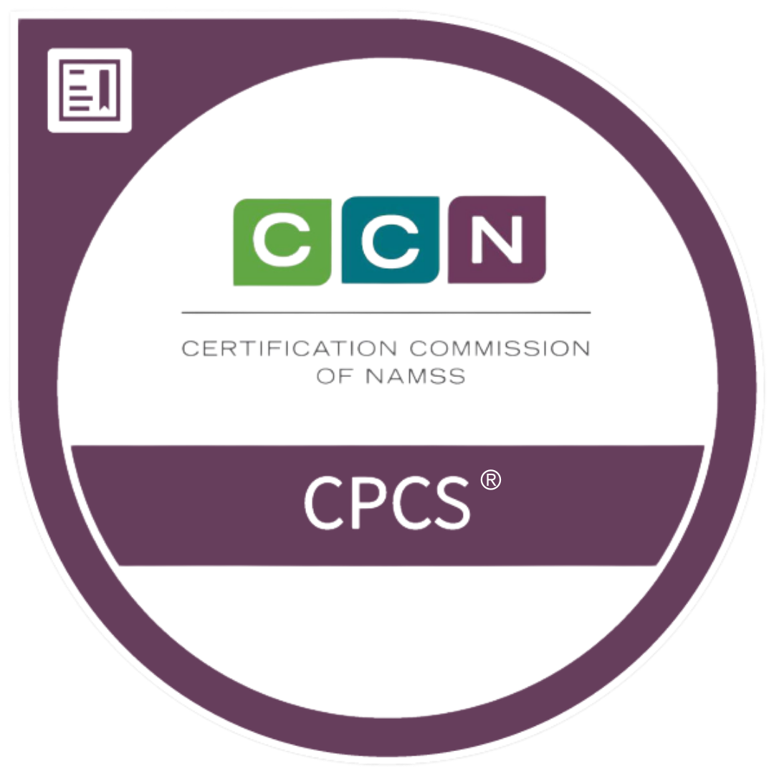
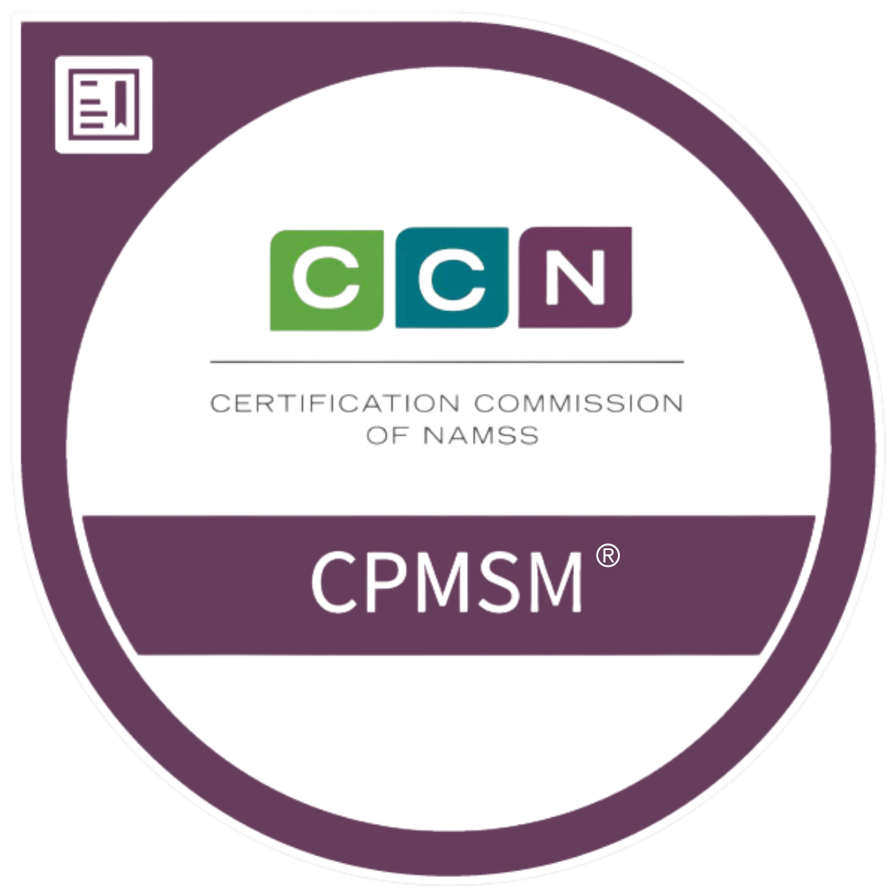
CERTIFICATION
  Currently
  3,500+ CPCS® Certificants
  1,600+ CPMSM® Certificants
  Multiple Choice Exam – 3 options
  Practice Exam
  Official results follow within eight weeks of the closing of the testing window
  Certification is for 3 years
  Recertification required every 3 years
Notes:
Answers are multiple choice with 3 options
Virtual proctoring application was made available starting in the Summer 2020 testing window to accommodate at-home testing due to COVID-19
Exams are administered via computer, with 3 hours to complete the CPCS and 4 to complete CPMSM
A practice exam is available (see certification tab of the website) written to the same standards as the actual exams
Certification is issued for three years
Recertification every three years (for dual certificants, the cycle will follow the recertification due date of the initial certification earned)

Slide 44
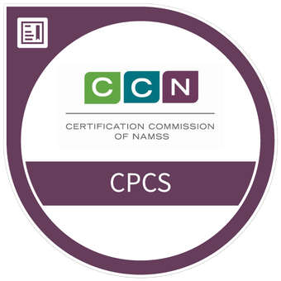

CERTIFICATION
  Why?
More than 27% of current certificants received a salary increase due to their certification by NAMSS.
By achieving your CPCS® designation, you gain confidence and demonstrate professional competence in applying your knowledge.
CPCS® certificants cite recognition and respect from peers and supervisors as a top value of certification.

Slide 45
Certification Eligibility
Certified Provider
Credentialing Specialist (CPCS®)
  Currently employed in the medical services profession for at least the past 12 months AND three years experience in the medical services profession within the past 5 years
  150 Questions, 3 hours
  Recertification every 3 years
  30 CEUs (of which 15 NAMSS approved)
Certified Provider Medical
Services Manager (CPMSM®)
  Currently employed in the medical services profession for at least the past 12 months AND five years of experience in the past eight years*
  175 Questions, 4 hours
  Recertification every 3 years
  30 CEUs (of which 15 NAMSS approved)

Slide 46
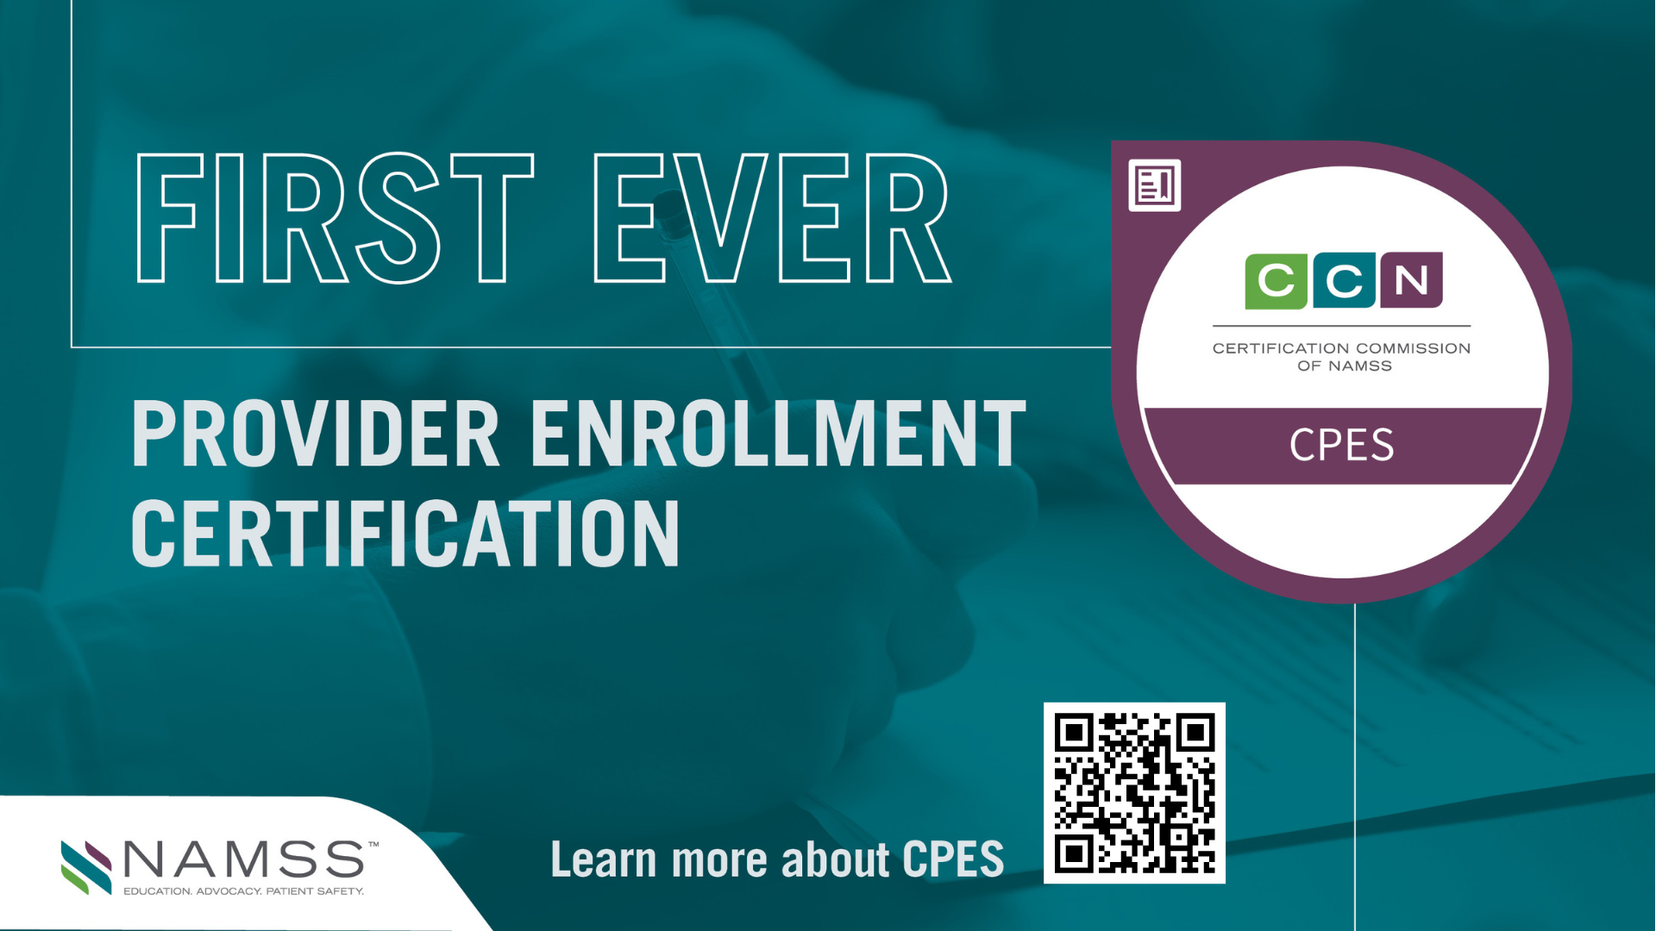
Notes:
Hopefully you’ve heard this already, but we are VERY excited to announce that in the fall of 2025, NAMSS will launch the first exam for the new Certified Provider Enrollment Specialist! This certification, the CPES, is designed to meet the growing demand for expertise in this area. To help MSPs prepare for the certification exam, NAMSS will be rolling out exam prep resources, including a virtual prep course available in the summer. The 2025 Candidate Guide will be released in December and will include the CPES exam content outline, testing windows and much more.
This certification, offered by the Certification Commission of NAMSS (CCN), is the first and only true Provider Enrollment certification in the industry. What does this mean? Certification is meant to test knowledge of the industry and the job role. Like CPCS and CPMSM, our new provider enrollment certification has used industry-accepted best practices in the development of the exam content. This includes a needs assessment, a job task analysis, multiple levels of item writing and exam development and validation. This is not a certificate, and not an ‘open book test’ – it will be a tough exam designed to evaluate competence in the field.
Becoming certified is a powerful way to demonstrate expertise, increase credibility, and position yourself for career growth. By this time next year, we hope many of you will be well on your way to becoming CPES certified.
Scan this QR code for more information or visit Namss.org

Slide 47
CPES
Who is a CPES Certificant?
A Certified Provider Enrollment Specialist is typically employed or contracted by healthcare organizations including, but not limited to hospitals (health systems), ambulatory care settings, group practices, revenue cycle management or billing agencies. Those professionals employed at the level to which the title of Provider Enrollment Coordinator, Provider Enrollment Specialist and Credentialing Coordinator would appropriately apply. Responsibilities include:
  Knowledge of practitioner and organizational enrollment terminology and documents required for enrollment.
  Delegated and non-delegated payor enrollment with health plans, meeting health plan requirements, and knowledge of health plan accreditation standards.
  Maintaining compliance with Medicare enrollment, revalidation, reassignment of benefits, and ongoing enrollment management.
  Collecting and maintaining an accurate practitioner database.
  Setting-up and maintaining CAQH practitioner profiles, organization profiles, and practice manager accounts.
https://www.namss.org/Certification/CPES
Notes:
Who is a CPES Certificant?
A Certified Provider Enrollment Specialist is typically employed or contracted by healthcare organizations including, but not limited to hospitals (health systems), ambulatory care settings, group practices, revenue cycle management or billing agencies. Those professionals employed at the level to which the title of Provider Enrollment Coordinator, Provider Enrollment Specialist and Credentialing Coordinator would appropriately apply. Responsibilities include:
Knowledge of practitioner and organizational enrollment terminology and documents required for enrollment.
Delegated and non-delegated payor enrollment with health plans, meeting health plan requirements, and knowledge of health plan accreditation standards.
Maintaining compliance with Medicare enrollment, revalidation, reassignment of benefits, and ongoing enrollment management.
Collecting and maintaining an accurate practitioner database.
Setting-up and maintaining CAQH practitioner profiles, organization profiles, and practice manager accounts.

Slide 48
CPES
Who is eligible to sit for the CPES examination?
At the time of application, a candidate must have been or currently be employed or contracted in the profession of provider enrollment for at least 12 consecutive months in the last 24 months and have a total of three years’ experience within the past five years.
What will the Examination Content be?
  Enrollment 60%
  Ongoing Monitoring and Compliance 22%
  Supporting Departmental Operations 19%
The exam content outline and references used to write exam questions are available in the 2025 Candidate Handbook.
Notes:
Who is eligible to sit for the CPES examination?
At the time of application, a candidate must have been or currently be employed or contracted in the profession of provider enrollment for at least 12 consecutive months in the last 24 months and have a total of three years’ experience within the past five years.
What will the Examination Content be?
Enrollment 60%
Ongoing Monitoring and Compliance 22%
Supporting Departmental Operations 19%
The exam content will also be listed in the 2025 Candidate Handbook, which will be available in December.

Slide 49


NAMSS 2025 Certification Exam Dates & Deadlines
  Spring Testing Period:
Application Opens: November 11, 2024
Application Deadline: January 22, 2025
Final Application Deadline (with late fee): February 12, 2025
Testing Window: March 5 – April 2, 2025
Summer Testing Period:
Application Opens: April 7, 2025
Application Deadline: May 7, 2025
Final Application Deadline (with late fee): May 28, 2025
Testing Window: June 18 – July 16, 2025
Fall Testing Period:
Application Opens: July 21, 2025
Application Deadline: August 20, 2025
Final Application Deadline (with late fee): September 10, 2025
Testing Window: October 1 – October 29, 2025
For more information, visit the NAMSS Exam Dates & Deadlines page.
CPCS® Application: https://www.namss.org/Certification/CPCS
CPMSM® Application: https://www.namss.org/Certification/CPMSM

Slide 50
Save the Date! NAMSS Events You Can’t Miss

Slide 51

NAMSS 49th Educational Conference & Exhibition
Notes:
Save the date! The NAMSS 49th Educational Conference & Exhibition will be held in Portland, Oregon from September 28– October 1, 2025. We have some fun new plans for 2025, so we hope to see you there.

Slide 52
NAMSS 49th Educational Conference & Exhibition
New for 2025:
  Portland tours available as an add-on at registration
  Lunch provided in exhibit hall on Monday
  Buses from hotels
  Other fun surprises!
Notes:
New for 2025:
Portland tours available as an add-on at registration
Lunch provided in exhibit hall on Monday
Buses from hotels
Other fun surprises!

Slide 53
NAMSS #MSPWeek® – November 1-8, 2025
Promote #MSPWeek®
For #MSPWeek®, NAMSS offers a variety of resources, including a video about the role of MSPs, a downloadable poster, celebration ideas, and a fact sheet for colleagues. Additional resources include the "Defining Tomorrow’s MSP" report and banners for email signatures and social media. These materials are designed to help promote and celebrate #MSPWeek® and raise awareness for the profession.
#MSPWeek® Email Signature
What Is Medical Staff Management Video
7 Steps for a Successful Celebration
Facebook, LinkedIn and Twitter Banners
#MSPWeek® Poster
#MSPWeek® Zoom backgrounds
https://www.namss.org/Tomorrows-MSP/-MSPWeek

Slide 54



More Networking Opportunities
Join the discussion on the NAMSS Connection Zone!
https://community.namss.org/home
Visit the NAMSS website for the Gateway Hub:
https://www.namssgateway.org/
Follow us on LinkedIn
https://www.linkedin.com/company/namss---national-association-medical-staff-services
Notes:
Networking – Connect with over 5,500+ members who can help answer your questions that you face on the job. Visit the NAMSS Connection Zone and post your questions online or look up contact information on the online directory.
linke

Slide 55

NAMSS Will Continue to…
Serve as the voice of the profession, advocating on behalf of MSPs across the nation
Provide educational and professional development opportunities that meet the ever-changing health care environment we navigate through today
Support state affiliates and associations on the local level
Inform and connect the network of medical services professionals and credentialing services professionals
But we will be doing this in ways that create the most value and help members be the most successful in their ever changing and challenging health care roles!
Notes:
While NAMSS supports both members and non-members, you can see there are many benefits to being a NAMSS member. The ongoing information on government updates, advocacy, synergy and discounted annual conference fee is worth the cost of the annual membership. I encourage all of you who are not currently members to evaluate all of the benefits of membership and to consider joining NAMSS in the future.

Slide 56
What did you take away today?

Slide 57
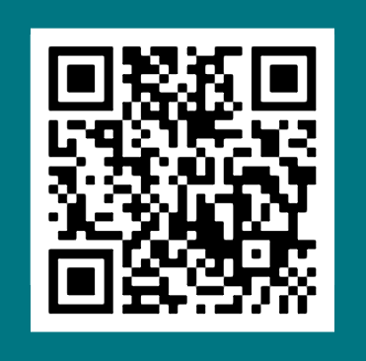
Scan the QR Code to Provide Feedback on this Presentation!

Slide 58




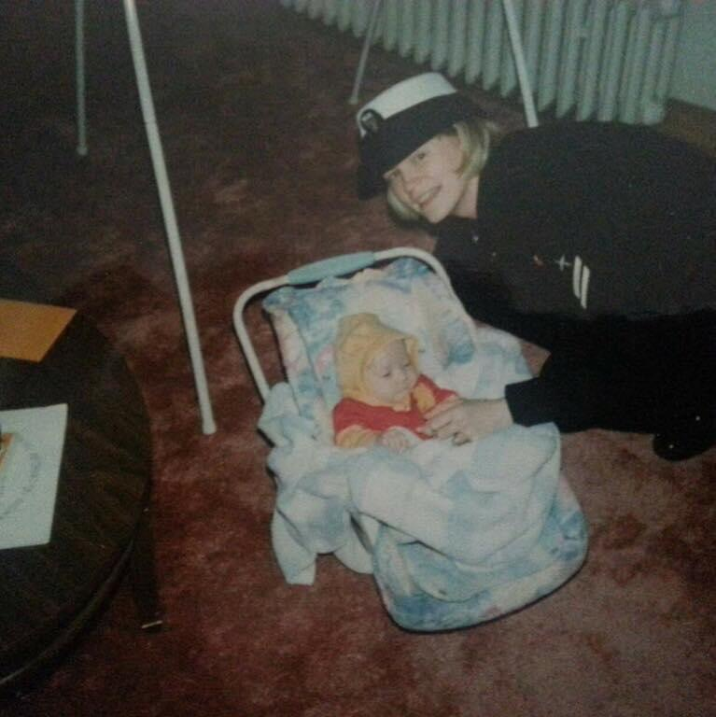
Final Photo Humor

Slide 59
Questions?
NAMSS Executive Office
2001 K Street NW, 3rd Floor North
Washington, DC 20006
(202) 367-1196 | info@namss.org
Director at Large:
Stephanie McCoy
smccoy@radsource.us
Connect on LinkedIn
Notes:
Add DAL contact information

Slide 60
Addendum

Slide 61
NAMSS Rules of Ethics & Code of Conduct
Use this link https://www.namss.org/About/Ethics-Resources to obtain information on the Rules of Ethics and the Code of Professional Conduct. From this page, you can also access:
Ethics Committee Description & Responsibilities
NAMSS Ethics Complaint Form
Professional Ethics Self-Assessment Tool
NAMSS Ethics Policy
Ethics Resource Center
Knowledge Leader (subscription based website that provides audit programs, checklists, tools, and training.
Ethics complaints must be submitted using the Ethics Complaint Form, found on the NAMSS website.
The complainant is responsible for providing as much information as possible in order for the Ethics Committee to review.
Ethics complaints, investigations, findings and actions/recommendations are confidential, even to the Board of Directors.
NAMSS is not in a position to evaluate claims related to professional competency/job performance. Evaluating professional competency and job performance is the responsibility of the employer/supervisor.
61
Notes:
The NAMSS Rules of Ethics are also available on the NAMSS website and dictate what can be reported as an ethics violation.
Again, I won’t read every bullet, but I encourage you to review and get familiar with the rules of ethics.

Slide 62

History of NAMSS
2024 – 48th Conference
In-Person
2019 – Launched
Tomorrow's MSP®!
2013 – NAMSS
PASS is born
1978 – Certification
Process Initiated
2020 -Pandemic
Going Virtual
1972 – Overview
(now Synergy)
was born
2016 – Leadership
Certification introduced
1980 – “NAMSS”
is adopted
1977 – First National
Conference, Chicago
1971 – Formed in California
Medical Staff Secretaries Assoc.
Notes:
History of NAMSS In The 1970s:
Charlotte O. Cochrane along with Joan Covell spearheaded the formation of the Medical Staff Secretaries Association with 20 members, as a forerunner to NAMSS.
18 months later the groups official publication, Overview was born.
The first national conference was held in 1977 in Chicago, Illinois.
In 1978, the certification process was instituted, and the articles of incorporation were filed.
The Committee on Continuing Education worked diligently to provide a basis for recognition and achievement for the profession.
The new name, “National Association Medical Staff Services” was officially adopted in 1980. Throughout the 1980s, the organization continued gaining national recognition, which led to increased membership, increased conference attendance, and flourishing state associations.

Slide 63
NAMSS Leadership Career Path
Element | Entry Level | Experienced | Leadership
Experience | •0 – 4 Years | •5-14 Years | •15 and above
Education | •Associates or Undergraduate Degree | •Undergraduate Degree | •Masters or Doctorate Level
Certifications | •CPCS® | •CPCS® and/or CPMSM® | •CPCS® and CPMSM® and other healthcare related certifcations (Quality, Risk Management)
Training/Ongoing Education | •Medical Services Professional Education | •NAMSS Leadership Institute •Education on Accreditation/Regulations •Patient Safety and Quality •Risk Management •Six Sigma •Budgets •Finance •Legal •Leadership | •Participate in NAMSS Virtual Round Table
Skills, Knowledge and Responsibilities | •Credentialing •Meeting Preparation | •Liaison between Administration and Medical Staff Leaders •Supervision of Employees •Meetings Management •Education and Training of Staff •Onboarding Process •Meets Regulation and Accreditation Standards •Quality and Peer Review •Leadership | •Governance and Org Structure •Human Resources •Finance •Collaborate with Legal Counsel •Healthcare Technology and •Information Management •Quality and Performance Improvement •Laws and Regulation •Professionalism and Ethics •Healthcare Industry •Team Development •Vision •Contract Management •Business Planning
Notes:
Like the Volunteer Path is the Leadership Career Path, which looks at your personal career path as an MSP. The NAMSS Leadership Certificate Program is a great tool to help you progress on this path.
We’ll learn more about the Leadership Certificate Program toward the end of this presentation

Slide 64
NAMSS Leadership Career Path (Continued)
Element | Entry Level | Experienced | Leadership
Skills, Knowledge and Responsibilities (Continued) |  |  | •Marketing •Compliance •Recruitment •Service Line Development •Project Management •Shared Services •Affiliation Agreement – Medical Institutions, Corporate Responsibilities •Product Development •Culture Change
Servant Leadership | •Volunteer in Community •Volunteer in Local Chapter or State Association | •Volunteer in Local Chapter, State Association and National Association Medical Staff Services | •Volunteer in Healthcare Related Associations and Community Services
Professional Contributions | •Local Chapter Medical Staff Services Newsletter •Medical Staff Newsletter | •State or national medical staff services publication or web content •Editor of Newsletter •Peer Review Publications •Book Contributor •Serve as an Expert Witness •Presentations for Professional and/or Healthcare Organizations | •Serve on National Healthcare Related Interest Groups •National Association Medical Staff Services Publication and/or other Healthcare Organizations •Fellow designation in NAMSS and/or related professional organizations

Slide 65
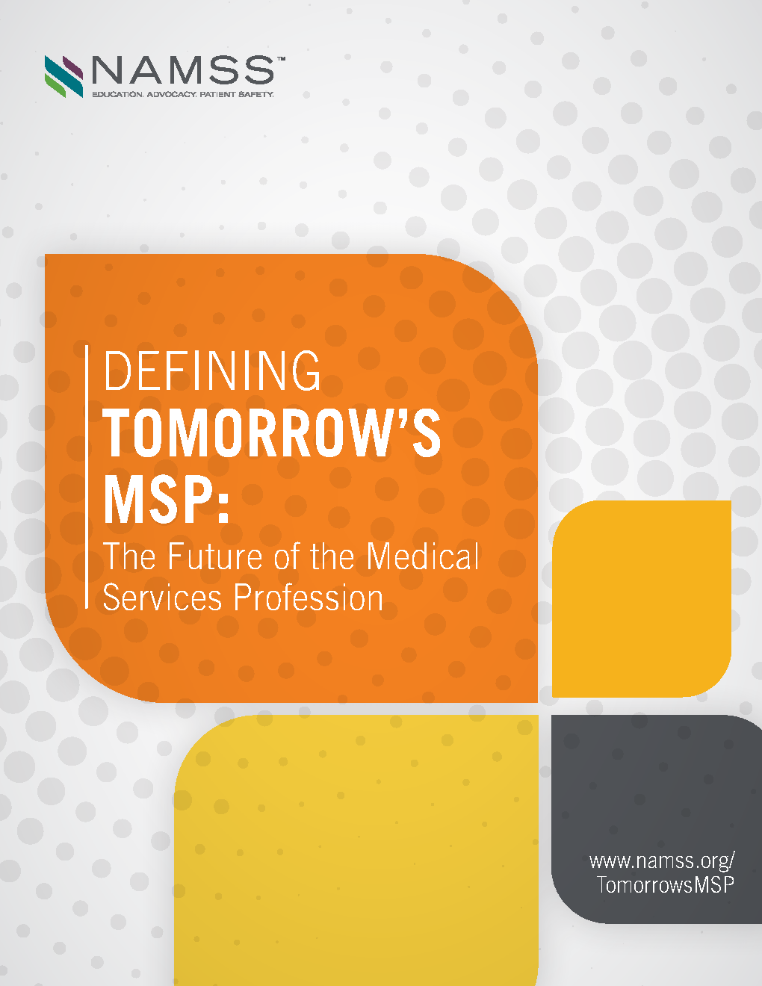
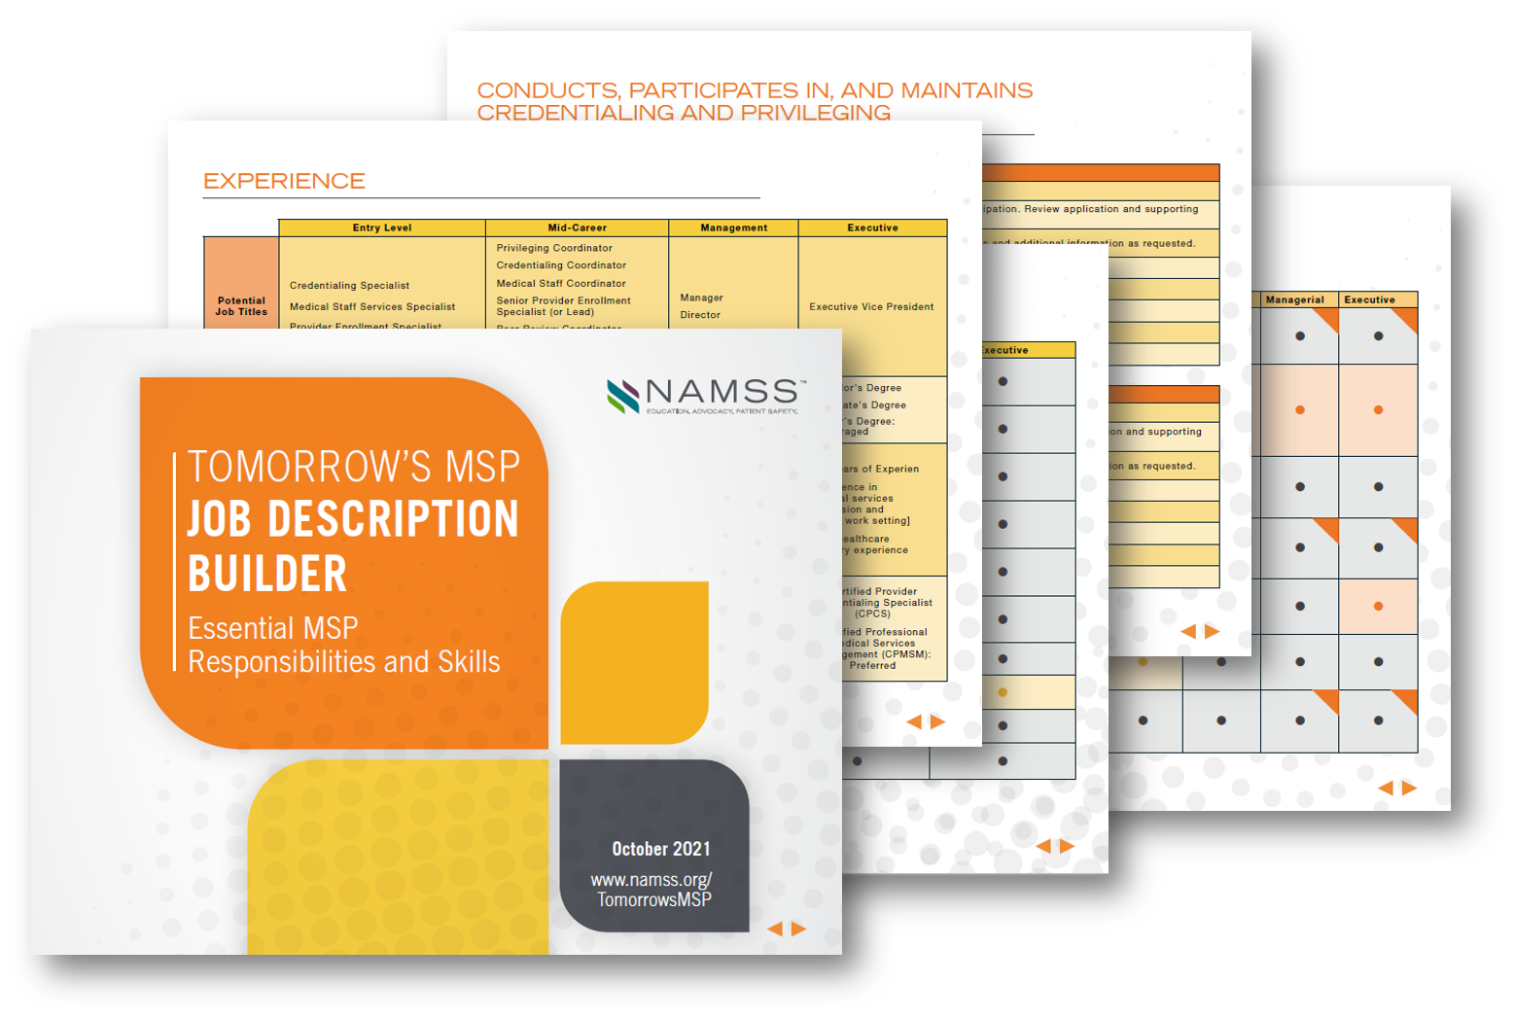
Defining Tomorrow’s MSP®: The Future of the Medical Services Profession Report
  https://www.namss.org/Advocacy/Tomorrows-MSP
Notes:
In 2021, NAMSS continued building on the work done in 2019 and 2020 to provide MSPs the resources they need to stay current in this ever-changing environment. NAMSS was pleased to release two new resources in 2021. The Job Description Builder is an exclusive members-only resource featuring suggested years of experience, qualifications, responsibilities by core function, and knowledge areas to help you create a job description that matches the level you need, and articulates role expectations and responsibilities. The new Defining Tomorrow's MSP: The Future of the Medical Services Profession Report was also released in October 2021 to include updated information on how MSP’s roles have expanded to account for remote processing, managing remote employees, overall staff professionalism and wellness, and much more. The report provides fresh insights on core functions, and features new sections on the landscape’s drivers of change and professional goals of MSPs.

Slide 66



The MSP of Tomorrow Starts Today
Tomorrow’s MSP®
https://youtu.be/jzsv-MA80SM
Notes:
In 2020, NAMSS launched a new Tomorrow’s MSP Podcast and MSP Minutes. NAMSS has continued to release Podcast episodes and I now on season 4. All previous episodes are available on NAMSS Gateway. Podcast topics have covered topics such as Diversity, Equity and Inclusion in the workplace, managing up and advocating for women in the profession, and more! Each podcast episode offers CE opportunities, providing you a quick and easy way to continue your education.
There will be new episodes monthly, so be sure to check out the NAMSS website.

Slide 67
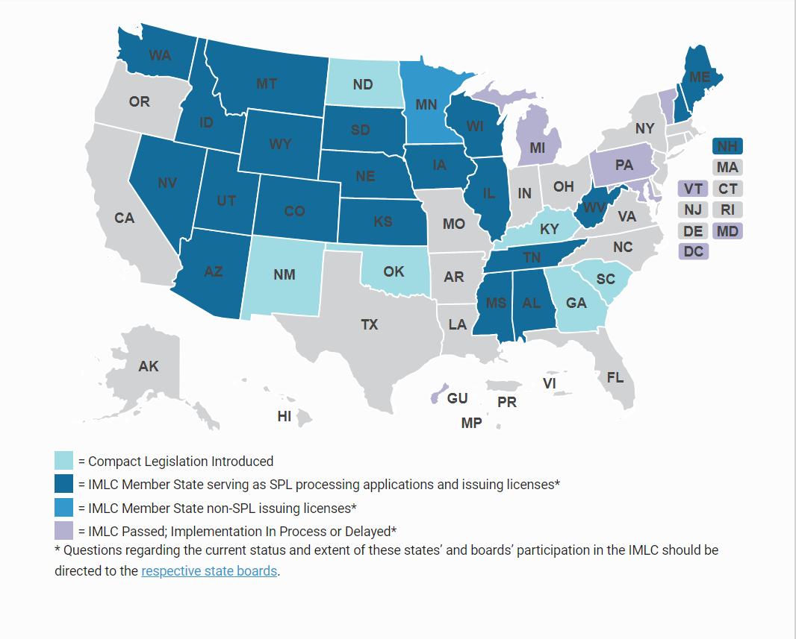
FSMB Interstate Medical Licensure Compact (IMLC)
Mission: To increase access to health care for patients in underserved or rural areas. IMLCC.org
Makes it easier for physicians to obtain licenses to practice in multiple states.
Strengthens public protections by enhancing the ability of states to share investigative and disciplinary information.
NAMSS official position on FSMB Interstate Medical Licensure Compact available at the end of presentation or on the NAMSS site.
https://www.imlcc.org/participating-states/
Notes:
The Compact provides an additional, expedited pathway to licensure for physicians with exemplary practice histories.
Participation in the Compact for medical licensure is voluntary for both physicians and state boards.
Any physician from a Compact state who meets the qualifications of the Compact will be eligible for licensure in any other Compact state.

Slide 68

NAMSS-ATA Credentialing by Proxy Guide
Credentialing by Proxy Guide – Telemedicine – updated in 2022
Joint Work Group with American Telemedicine Association (ATA)
  Glossary of Terms
  The Existing Credentialing Process
  Current Laws & Regulations
  Setting Up a Credentialing by Proxy Program
  Overcoming Hurdles
            https://www.namss.org/Advocacy/NAMSS-ATA-Credentialing-by-Proxy-Guide
Notes:
In 2019, the GR team also worked with the American Telemedicine Association to develop a credentialing by proxy guide. The Guidebook includes a standardized Glossary of Terms, an overview of the existing credentialing process with a focus on telemedicine providers, a review of existing laws and regulations around telemedicine credentialing, a set of guidelines for creating a credentialing by proxy program, and a review of hurdles and potential solutions institutions often encounter with credentialing by proxy.

Slide 69
NAMSS Volunteer Path
Notes:
The NAMSS Volunteer Path is a great tool to help you get started on a path to volunteer leadership. Each element has a level; starting with entry level, moving to intermediate, then to advance.
Within each level of each element is a list of activities to help you progress on your path.

Slide 70
NAMSS Volunteer Path (cont.)

Slide 71
NAMSS Volunteer Path (cont.)

