Slide 1
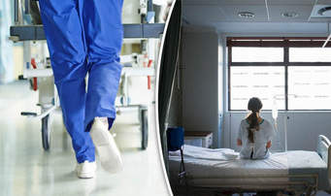
Healthcare Serial Killers
The Monster No One Sees Coming

Slide 2
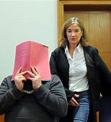
German nurse charged with 97 more murders at hospitals
German nurse serving a life sentence for two murders has been charged with killing 97 additional patients, prosecutors said Monday.
The new indictment against Niels Hoegel was expected after officials said in November he may have killed more than 100 patients in total.

Slide 3
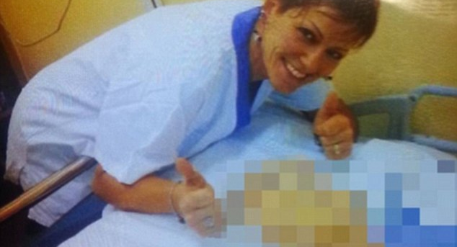
Nurse in Italy Accused of murdering 38 Patients

Slide 4
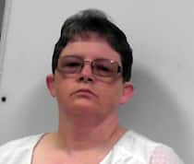
‘You’re the monster that no one sees coming’: Former VA nursing aide sentenced to seven life terms for killing West Va. veterans with insulin
Reta Mays was sentenced on May 11 to seven consecutive life terms plus 20 years. (West Virginia Regional Jail and Correctional Facility/AP)

Slide 5


British Nurse Is Charged With Murder of Several Babies in Her Care
Lucy Letby, 30, faces eight counts of murder and 10 of attempted murder as part of a three-year investigation into infant deaths at a hospital in northwestern England.

Slide 6
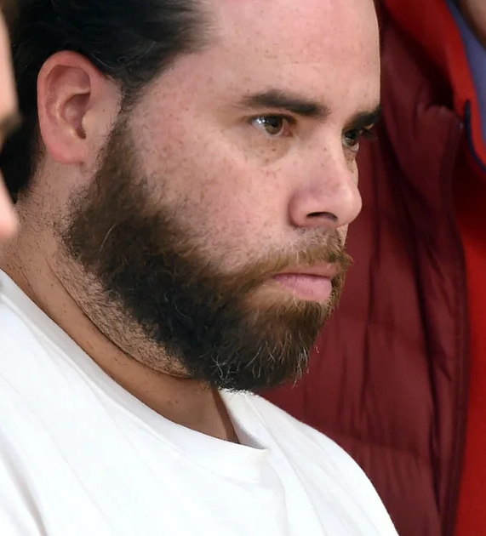
Palliative Care Doctor Is Charged With Serial Murder of 15 Patients in Germany APRIL 2025
The Berlin doctor, who was not named because of privacy laws, is also accused of setting fire to some of the patients’ homes to hide evidence.
The doctor charged on Wednesday, a 40-year-old man whose name was not released, in keeping with Germany’s strict privacy laws, is accused of having killed the patients from 2021 to 2024 by giving them a powerful narcotic and then a muscle relaxant — essentially sedating them before stopping their breathing. He has not admitted to the charges, prosecutors said.
In some cases, he is accused of setting fire to the patients’ apartments to hide the evidence.

Slide 7
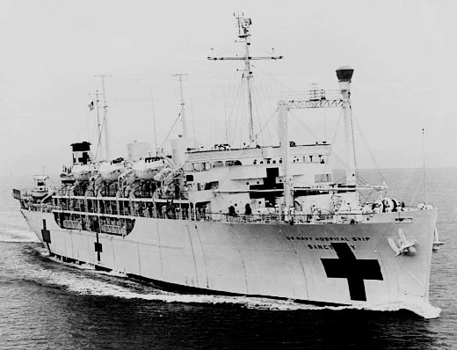

USS Sanctuary

Slide 8
SANCTUARY-A shelter from danger or hardship – a place of refuge and comfort and security

Slide 9
Choose a Profession for Murder
Power of life and death over someone
Take an oath to protect and serve
Victim & family trust you
Strong and assertive become meek and mild
A shortage of skilled workers and a willingness to overlook past indiscretions.

Slide 10
Choose a location for Murder
Death is a common everyday occurrence
Work alone at night, draw a curtain around you and the victim.
Environment that police are unfamiliar with. Very easily challenged, scientifically, administratively and legally.
Victim’s cries for help ignored.
Murder weapons provided by employer

Slide 11
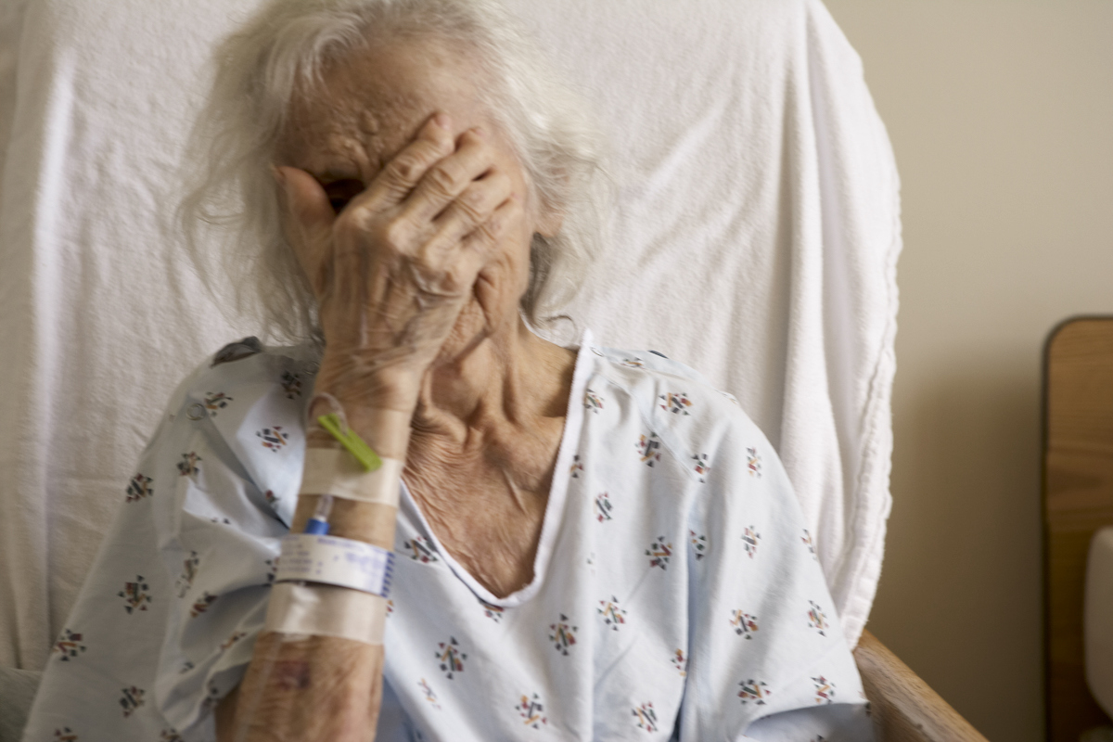
Hallucinations in Hospital Pose Risk to Elderly
By PAM BELLUCK
Published: NY Times June 20, 2010
No one who knows Justin Kaplan would ever have expected this. A Pulitzer Prize-winning historian with a razor intellect, Mr. Kaplan, 84, became profoundly delirious while hospitalized for pneumonia last year. For hours in the hospital, he said, he imagined despotic aliens, and he struck a nurse and threatened to kill his wife and daughter.
Mr. Kaplan’s hallucinations lifted as doctors treated his pneumonia. But hospitals say many patients are experiencing such inexplicable disorienting episodes. Doctors call it “hospital delirium,” and are increasingly trying to prevent or treat it.

Slide 12
Julian Gill, Staff writer Houston Chronicle May 31, 2022 | Updated: June 1, 2022 6:07 p.m.
What is ICU delirium? Houston doctors grapple with mystery diagnosis that affects survival
Up to 80 percent of ICU patients are diagnosed with some form of delirium, which is defined by the American Psychiatric Association as a “disturbance of consciousness and cognition” that develops quickly and fluctuates over time. It can present itself through a wide range of temporary or long-lasting states of confusion, from hallucinations to forgetting a family member’s name to more generalized disorientation. Post-traumatic stress disorder and depression are also common symptoms.

Slide 13
Choose a location for Murder
Huge Obstacles For Whistleblowers

Slide 14
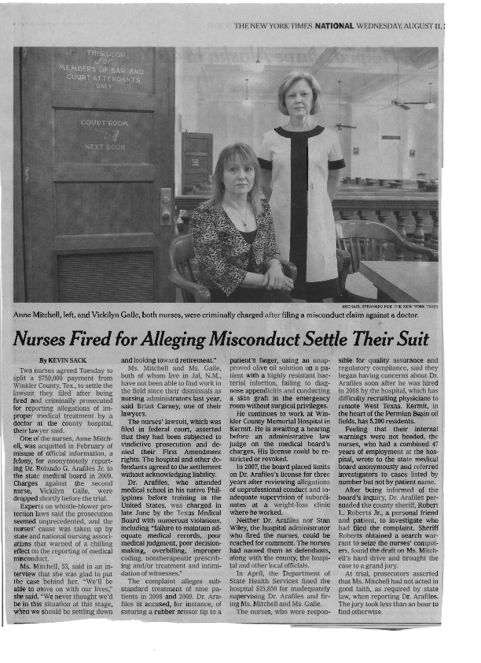
Nurses Criminally Prosecuted for Alleging Physician Wrongdoing

Slide 15
Choose a location for Murder
Hospital peer review finds no evidence of crime
Hospital supports accused medical professional

Slide 16
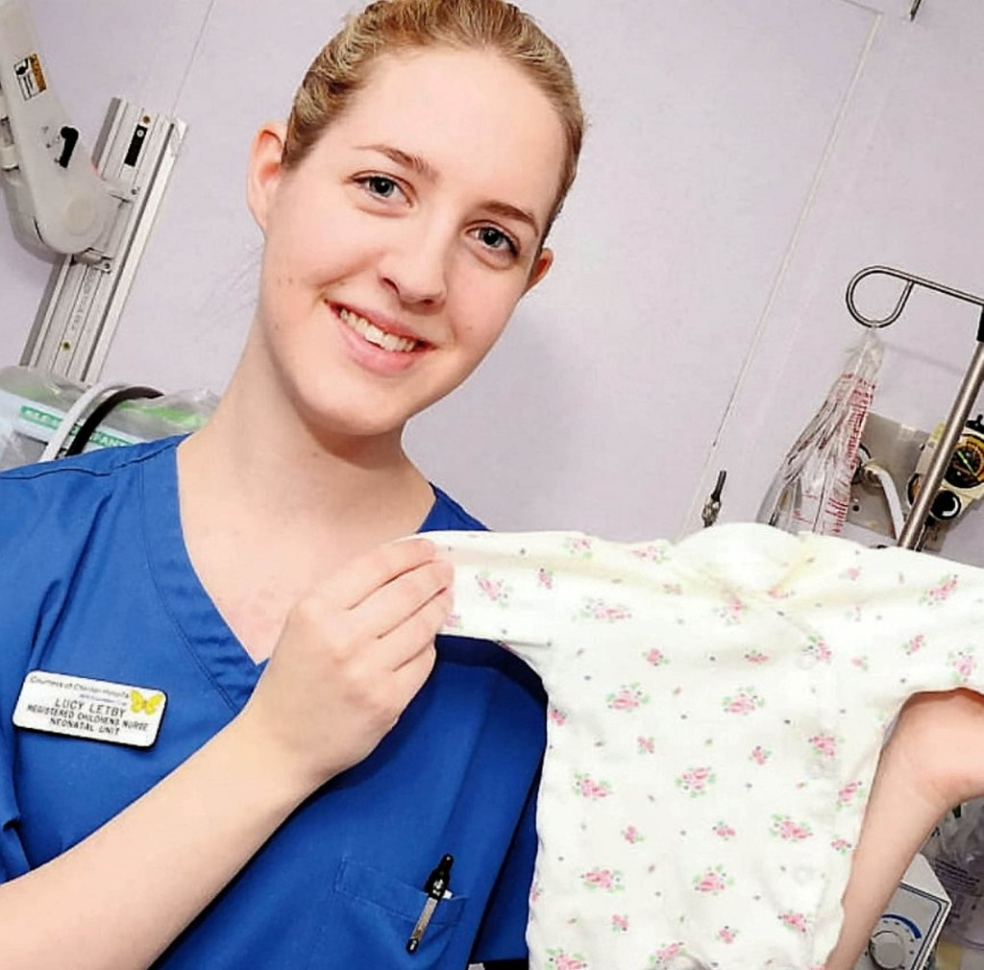
Colleagues of convicted ‘Killer Nurse’ Lucy Letby had to apologize for warning hospital about dead babies on her watch: report
By Dana Kennedy
Published Aug. 19, 2023 NY POST
Updated Aug. 19, 2023, 2:12 p.m. ET

Slide 17
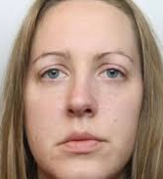
Lucy Letby hospital consultant warns of another big scandal if whistleblowers aren't protected
Dr Ravi Jayaram has described a "culture of cover-up" he believes has major implications for all institutions, not just the health service, and said many employees are too scared to speak out for "fear of personal harm and retribution".

Slide 18

How Columbia Ignored Women, Undermined Prosecutors and Protected a Predator For More Than 20 Years
Bianca Fortis and Laura Beil | ProPublica | September 12, 2023 | 8,522 words
For more than two decades, patients of an OB/GYN named Robert Hadden warned Columbia University that he was sexually inappropriate and abusive. One woman even called the police and had him arrested, but Hadden was allowed to return to work days later.. Over the years, Hadden’s superiors failed to take action. To date, more than 245 patients have alleged that the obstetrician abused them, and Columbia—a prestigious institution committed to “the highest standards of ethical conduct”—continues to aggressively fight new lawsuits from his victims.

Slide 19
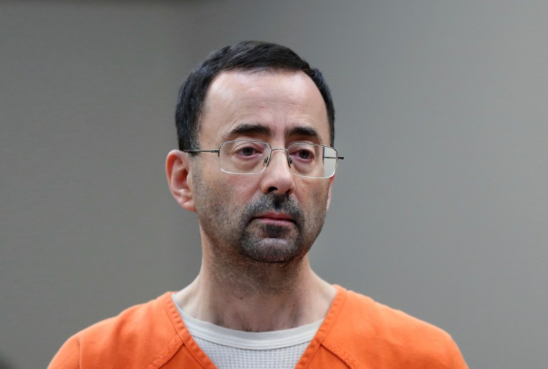
Larry Nassar's Gymnastics Victims to Receive Nearly $139 Million from DOJ for Botched FBI Investigation
“These allegations should have been taken seriously from the outset," Acting Associate Attorney General Benjamin
Nassar, who pleaded guilty to several counts of sexual assault in 2018 and was sentenced to 175 years in prison, was accused by more than 150 women and girls of sexually abusing them under the guise of medical treatment.

Slide 20
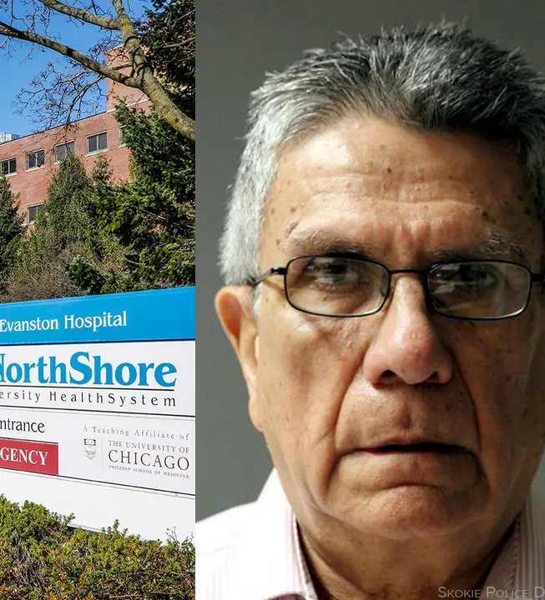
Illinois Ob/Gyn Gets 3 Years in Prison for Sexual Assaults
— Dozens of patients allege Fabio Ortega, MD, abused them while hospital system turned a blind eye
"The sexual abuse is the tip of the iceberg," said Tamara Holder, the attorney representing 36 women -- in civil lawsuits against Ortega and former employer NorthShore University HealthSystem -- who have accused the physician of sexually assaulting them under the guise of medical care.
"Not only did NorthShore refuse to believe its female patients ... it also billed them for Ortega's abuses," one complaint reads.

Slide 21
I Feel So Violated': Over 200 Patients Accuse Doc of Sex Abuse, Unnecessary Exams
— Alleged victims included women and several men
More than 200 women and several men who have joined a consolidated lawsuit against Dr. Derrick Todd in Massachusetts' Suffolk Superior Court.
It alleges that Todd -- a former rheumatologist at Brigham and Women's Hospital whose specialty involves treating inflammatory conditions of the muscles, joints, and bones -- began abusing patients in 2010.
The lawsuit, combining several filed last year, accuses Todd of performing unnecessary pelvic floor therapy, breast examinations, testicular examinations, and rectal examinations on patients.
"The other thing that strikes me about this case is how could this have been going on at the hospital, at the practice group for so long without somebody recognizing ... that something suspicious was going on," he continued. "Yet, they allowed him to continue to do this week after week, month after month, year after year, to more and more victims."

Slide 22
DARVO
Deny, Attack, Reverse Victim and Offender
In 1997, Jennifer Freyd, PhD, identified the "DARVO" reaction -- deny, attack, reverse victim and offender -- among sexual offenders who face accountability. DARVO is additionally seen in institutional betrayal where institutions reactively harm people dependent on them.

Slide 23
Choosing a location for murder
Hospital autopsy confirms patient could have expired as a result of one or more of his underlying disease processes
Death Certificate may list inaccurate cause of Death

Slide 24
Autopsy
The word autopsy means “to see for oneself”
Only 5% of hospital deaths result in Autopsies, down from 50% in 1960.
1998 AMA issued a report stating that cause of death is wrong 40% of the time
40% of hospitals in the US do not perform autopsies at all

Slide 25
Cause of death investigations often dead wrong
By THOMAS HARGROVE and LEE BOWMAN, Scripps Howard News Service
national
Hundreds of thousands of death certificates filed every year in the United States are wrong, meaning we don't really know what's killing Americans.
The erroneous death certificates cause medical researchers to look at the wrong health threats, and mislead people to the real diseases that run in their families.
More than 2.4 million Americans die each year, and each one has an official cause of death on a death certificate. But medical experts think that about one third of them are incorrect, fraudulent or even just guesses.
"I've been preaching for years to anyone who will listen that death certificates are worthless," said Dr. Stephen Geller, former chief of pathology at New York's Mount Sinai Medical Center.
The most common error is blaming some form of heart disease for other kinds of deaths. Every day, overburdened doctors and coroners routinely stamp "cardiac arrest" or one of a variety of heart diseases onto death certificates for people they've not examined or even seen.

Slide 26

When the Death Certificate Omits the True Cause of Death
Having accurate death records saves lives.
https://www.nytimes.com/by/jane-e-brody

Slide 27
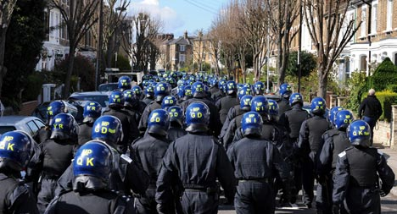
Police Arrive

Slide 28
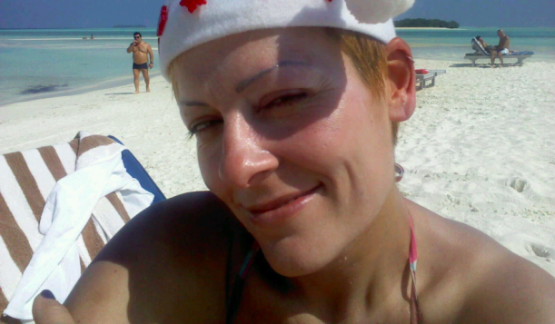
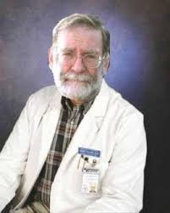
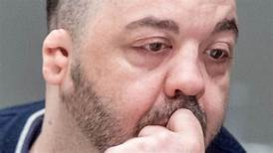
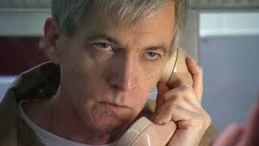

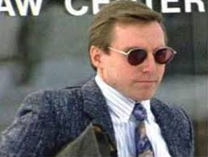
The Faces of Accused Medical Serial Killers

Slide 29
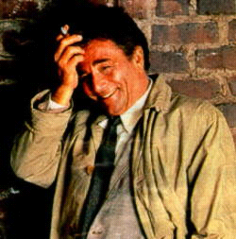
Our man on the scene.

Slide 30
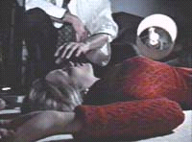

Slide 31


Slide 32
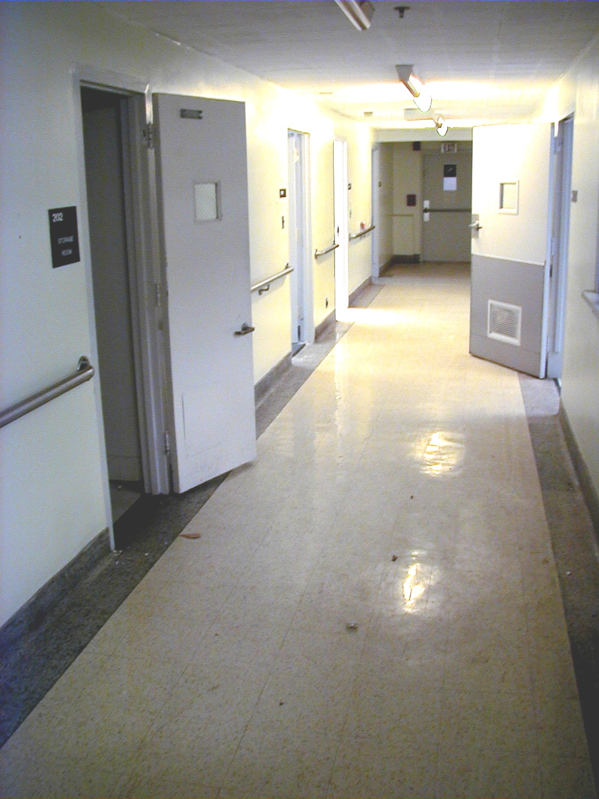
Medical Ward Photo

Slide 33
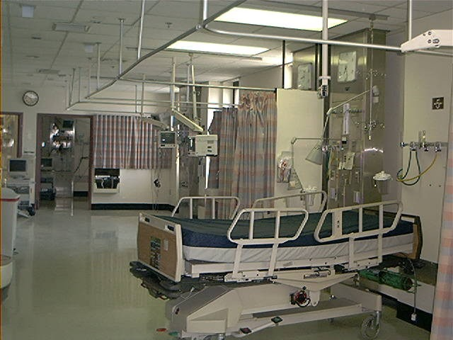

Slide 34

PROFILE OF A HOSPITAL SERIAL KILLER
Red Flags
for
Health Care
Inspectors

Slide 35
Red Flags - From A - Z
A. Statistically, a patient’s risk of “harm” (injury or death)
is significantly greater when treated by the subject
B. Subject worked the “graveyard shift,” was alone with
the patient, or patient was “screened off” from others.
C. Subject is uncommonly accurate in predicting patients’
demise.
D. Patient deaths were unexpected by staff or family.
Family not at the patient’s bedside.

Slide 36

Nurse accused of killing at least 13 patients at state-run Italian hospital by giving them deadly doses of blood thinner NEW YORK DAILY NEWS
Thursday, March 31, 2016
A probe was launched last year after statistical anomalies were flagged in the anesthesia and intensive care department of the hospital in Piombino, a coastal city approximately 40 miles from Florence. A nurse is accused of killing at least 13 patients at a state-run Italian hospital by giving them deadly doses of the blood thinner Heparin.
Most of those who died at the Piombino facility suffered severe hemorrhaging while undergoing relatively safe procedures. Each of the patients was given 10 times the normal limit of the drug, according to the Guardian.

Slide 37
Red Flags
E. Death certificate cites patient’s last illness as cause of death, or a catchall (e.g. cardiopulmonary arrest, cardiac arrest).
F. Initial review usually finds insufficient evidence to pursue the case -- protective management buys in quickly.
G. Subject often continues patient care during investigation, and removed only after allegations become public knowledge.

Slide 38
Red Flags
H. Fellow employees often report allegations to investigators. not management.
I. High Probability of no eyewitnesses to the crime.
J. Witnesses testify they saw the subject with the patient
shortly before the patient died
K. The weapon of choice is usually a “sudden death”
chemical readily available on the ward, and often considered “non-detectable” or generally not checked on autopsy. (Forty sudden death “injectables” are available on Truman VAMC wards).

Slide 39
D

Slide 40
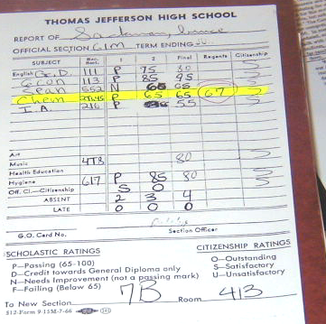
My High School Report Card

Slide 41
Red Flags
L. Syringes, IV lines and feeding tubes are the most likely
portals of entry if a poison is used.
M. If a code is called, EKG strips should be in the chart.
Their absence should raise suspicions.
N. Subject performed best in emergency situations.
O. Subjects are often charming and friendly, yet have
difficulty with close personal relationships.

Slide 42
Red Flags
P. Subject displays questionable dress code or mannerisms.
Q. Good written reviews from supervisors.
R. Prior employment records show questionable incidents and recommendations.
S. Subject given nicknames by staff, even while still
employed (e.g. Dr. Death, Angel of Death).

Slide 43
Red Flags
T. Drugs, poisons and related books found in subject’s home.
U. Killing is non-confrontational (poisoning).
V. Subject insists patients died of natural causes.
W. Subjects never show remorse for their victims.

Slide 44
Red Flags
X. Other patients complain about the subject, but their
complaints are ignored.
Y. Subjects crave notoriety.
Z. Evidence exists that the subject killed, or attempted to
kill, off duty as well as on duty.

Slide 45
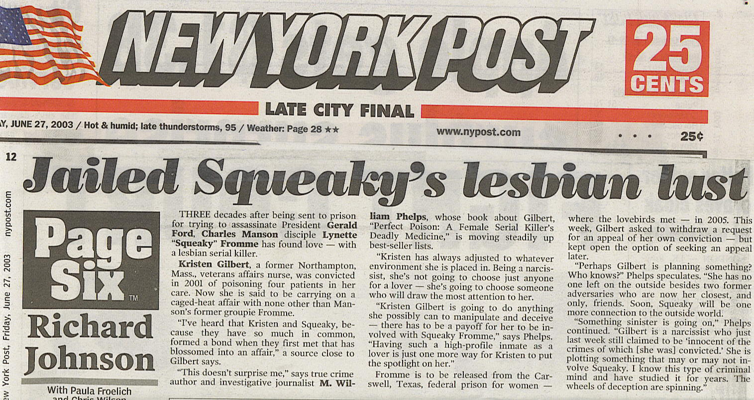

Slide 46
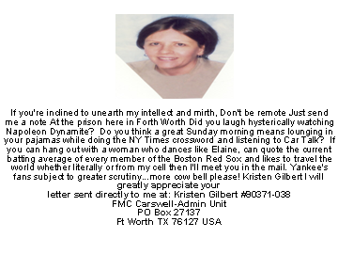

Slide 47

Medical Professionals Who Commit Murder
“When a doctor goes wrong he is the first of criminals. He has the nerve and he has the knowledge”

Slide 48
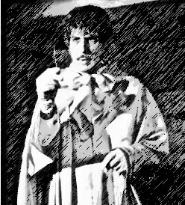
Why Do Medical Professionals Kill?
Munchhausen Syndrome by Proxy also know as Factitious Disorder
Power of Life and Death over someone
Eliminating demanding and/or unruly patients
Rare instances, profit motive
Angry at management and coworkers

Slide 49
Homicidal hospice CEO in Texas ordered nurses to execute patients by overdosing medication in cruel cost-saving plan: FBI
BY Laura Bult
NEW YORK DAILY NEWS
Updated: Thursday, March 31, 2016
Brad Harris, 34, the owner and founder of Novus Health Services, Inc. in Frisco, Tex., directed nurses to execute helpless patients who had overstayed their welcome by upping their medications to four times the maximum allowed, according to an FBI warrant affidavit
Hospice care facilities are subject to an “aggregator cap,” which limits Medicare and Medicaid payments based on the average length of stay for a patient.
If patients live longer than the average, the provider may be forced to pay back part of the payments, giving them an incentive to prefer patients who die sooner, the Dallas Morning News reported.

Slide 50
German police arrest doctor accused of killing 2 coronavirus patients
A German doctor is accused of killing two seriously ill coronavirus patients with lethal injections, according to Reuters. German police arrested the 44-year old doctor, who worked at University Hospital in the western city of Essen, after suspecting he killed two men, ages 47 and 50. Authorities said the doctor confessed to one of their deaths, saying he wanted to spare his and his family’s suffering.

Slide 51
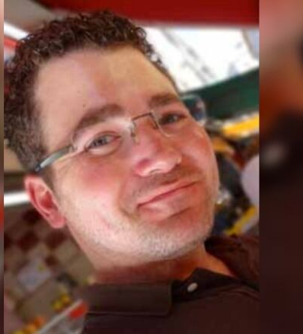
Canada doctor facing 3 more murder charges in patient deaths
TORONTO (AP) — A Canadian doctor accused of killing a patient last year was charged Wednesday with three more counts of first-degree murder.
Ontario Provincial Police said the new charges against Dr. Brian Nadler relate to the deaths of 80-year-old Claire Briere, 79-year-old Lorraine Lalande and 93-year-old Judith Lungulescu.
“All four patients died of COVID-19”

Slide 52
Why Do Medical Professionals Kill?
“She is obsessed with the need to control those who are completely dependent on her. Some like Genene Jones, are also motivated by a need for attention. While they appear to be going about their routines, they are making decision about who should live and who should die. What happens to the patent does not matter to the caretakers; what matters is what the incident does for them”

Slide 53
Why Do Medical Professionals Kill?
Why did you kill (Donald Harvey)
“ Well, people controlled me for 18 years, and then I controlled my own destiny. I controlled other people’s lives, whether they lived or died. I had that power to control”
“After I didn’t get caught for the first 15, I thought it was my right. I appointed myself judge, prosecutor and jury. So I played God”

Slide 54

Weapons of the Medical Serial Killer
Drugs not prescribed to the patient but found during autopsy
Insulin
Succinylcholine
Epinephrine
Injecting Air into Arteries
Heart Medication Digoxin
Tampering with existing equipment and medication

Slide 55
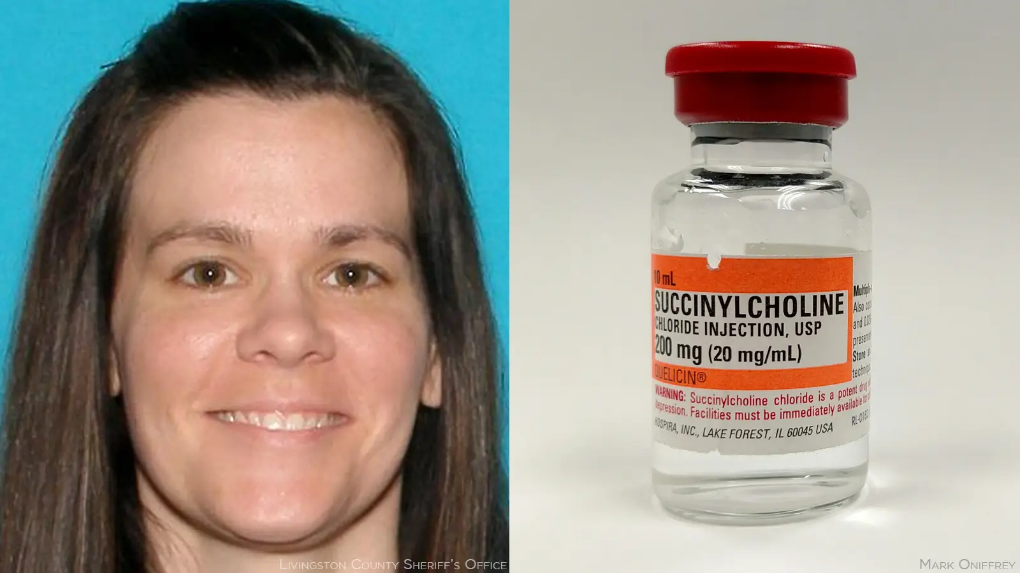
Respiratory Therapist Charged With Murder 20 Years Later
— Prosecutors allege a spate of odd deaths while Jennifer Anne Hall was employed at the hospital

Slide 56
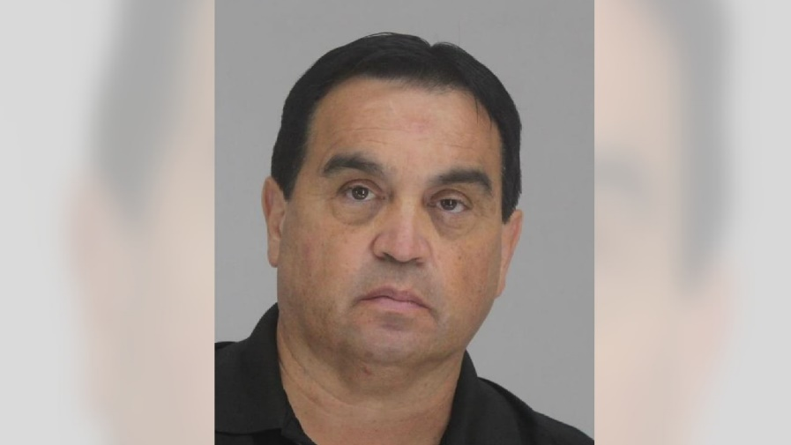
Feds Reveal Possible Motive of Texas Doc Accused of Putting ‘Heart-Stopping Drugs’ in IV Drips
Dr. Raynaldo Rivera Ortiz Jr. was arrested Wednesday after allegedly tampering with IV drugs, leaving one colleague dead and putting at least 11 other patients in grave danger.

Slide 57
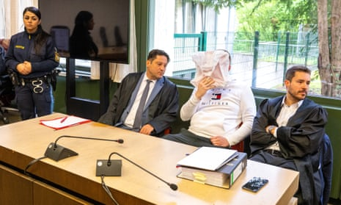
Nurse in Germany murdered two patients so he could be ‘left in peace’
Mario G convicted of two murders and six attempted murders after admitting injecting unprescribed drugs
A Munich court has sentenced a 27-year-old nurse to life in prison for murdering two patients by deliberately administering unprescribed drugs so he could be “left in peace”.

Slide 58
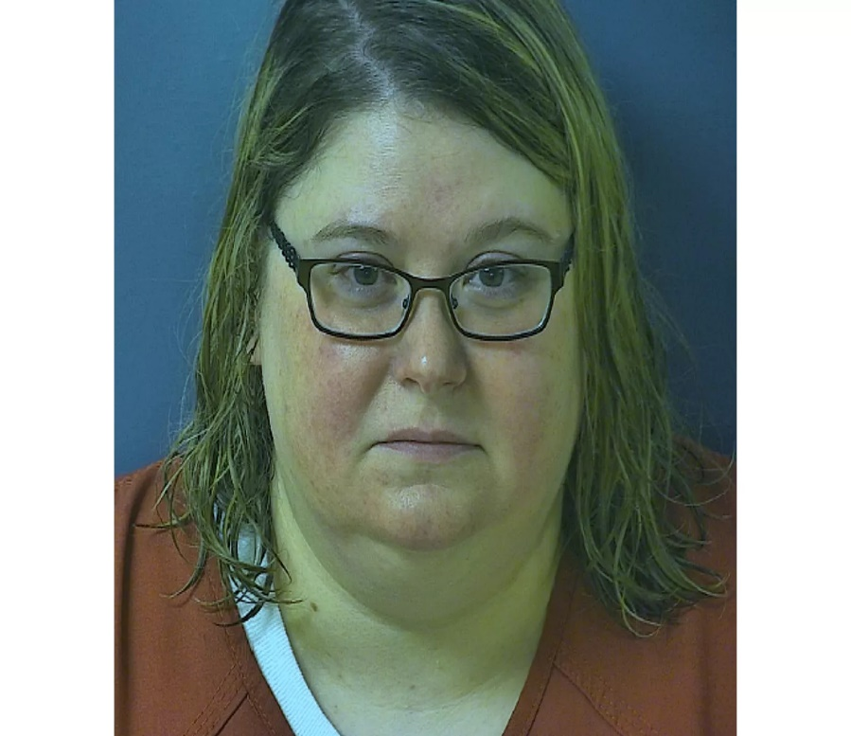
Pa. Nurse Accused of Killing Patients with Excessive Insulin, Saying Man Was 'Better Off Dead'
Since 2018, Pressdee has worked brief stints as a nurse at about 11 facilities, including Quality Life Services, per the complaint. Authorities claimed they “identified a pattern of Pressdee being disciplined for abusive behavior towards patients and/or staff at each facility resulting in her resigning or being terminated.”

Slide 59
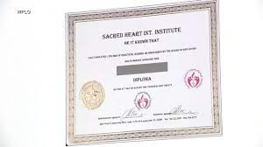
Feds announce massive takedown of fraudulent nursing diploma scheme
The crime ring allegedly sold more than 7,600 bogus nursing certificates.
By
Sasha Pezenik
January 25, 2023, 8:27
Feds announce takedown of fake nursing diploma scheme Authorities are warning health care facilities nationwide after taking down a massive, coordinated operation that sold more than $100 million worth of fake nursing diplomas

Slide 60
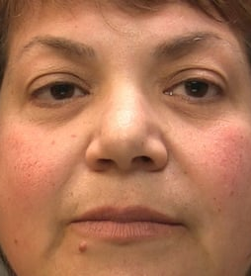
Fake doctor who worked in NHS for 20 years found guilty of fraud
Zholia Alemi practiced as psychiatrist without necessary qualifications after forging medical degree certificate
Zholia Alemi, who is believed to be 60, worked in hospitals across England, Wales and Scotland and received income and benefits of more than £1m across her career, Manchester crown court heard.

Slide 61
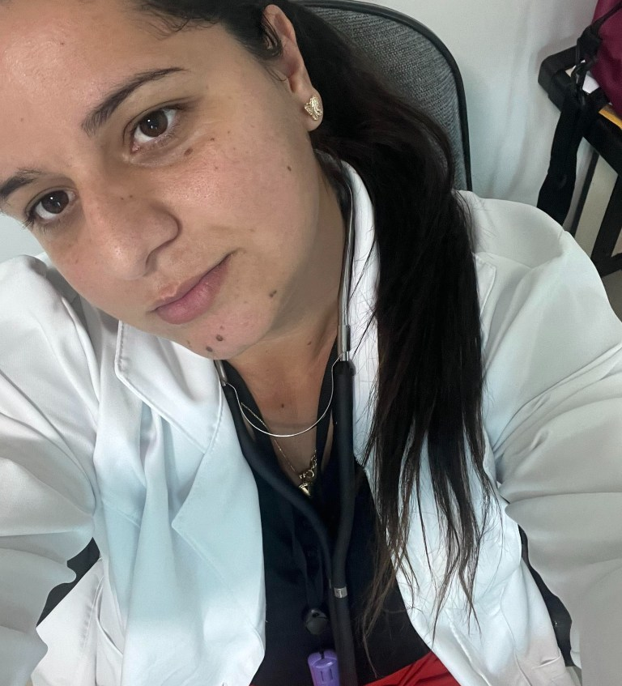
Fake Brazilian doctor treated 30 patients at hospital before revealing she bought $8 degree online
A Brazilian woman pretending to be a doctor treated nearly 30 patients at a hospital before she revealed she purchased an online degree for $8.
Mirian Santana, 27, was arrested Monday — her first day on the job at a facility in Coroados, São Paulo.
By the time she was placed in cuffs, she had already treated 30 adults and children, according to G1.
Other health care professionals became suspicious and checked her registration number, which belonged to an actual doctor.
Santana’s diploma — which she purchased online for $8 — said she completed her coursework in 2022, but the degree program did not even begin until that year, G1 reported.

Slide 62
The Future of Healthcare Homicide
Drug infusion pumps–for delivering morphine drips, chemotherapy and antibiotics–that can be remotely manipulated to change the dosage doled out to patients; Bluetooth-enabled defibrillators that can be manipulated to deliver random shocks to a patient’s heart or prevent a medically needed shock from occurring; X-rays that can be accessed by outsiders lurking on a hospital’s network; temperature settings on refrigerators storing blood and drugs that can be reset, causing spoilage; and digital medical records that can be altered to cause physicians to misdiagnose, prescribe the wrong drugs or administer unwarranted care.

Slide 63
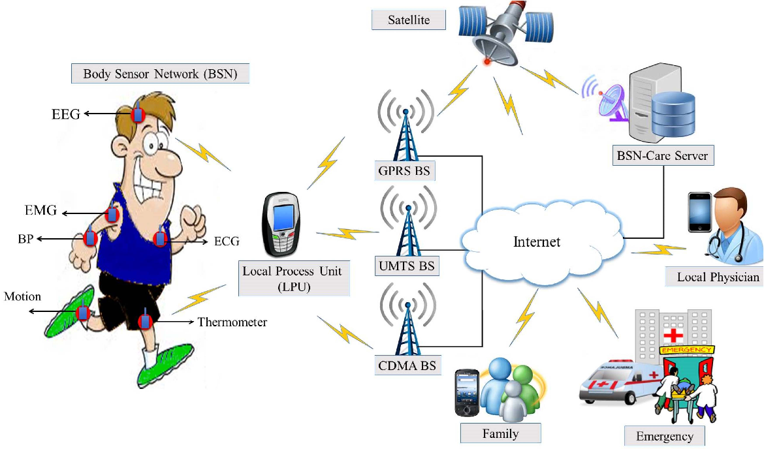
Internet of Bodies

Slide 64
Internet Murders
Can Hackers Commit the Perfect Murder By Sabotaging an Artificial Pancreas?
“Deliberately wrong (high) glucose data sent to an unprotected mobile computing platform may cause the algorithm to deliver excessive insulin, whereas incorrect low glucose values could cause it to deliver too little,” the researchers write.
Make the machine administer too little insulin, and the blood-glucose level may rise high enough to send the patient into a ketoacidosis coma. Make it administer too much, and the glucose falls until the brain fails causing the to patient faint, or even die. It might seem to bad guys like the way to commit the perfect murder.

Slide 65

Ransomware leads to death in
Germany 9/18/20

Slide 66
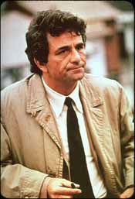
Just one more thing...

Slide 67
“No body, No forensics, No murder weapon, No bloody clothes, No fingerprints, No brain matter, No body parts.”
--Stephen Saracco, Assistant District Attorney’s opening statement in the case of State of New York vs. Dr. Robert Bierenbaum.

Slide 68
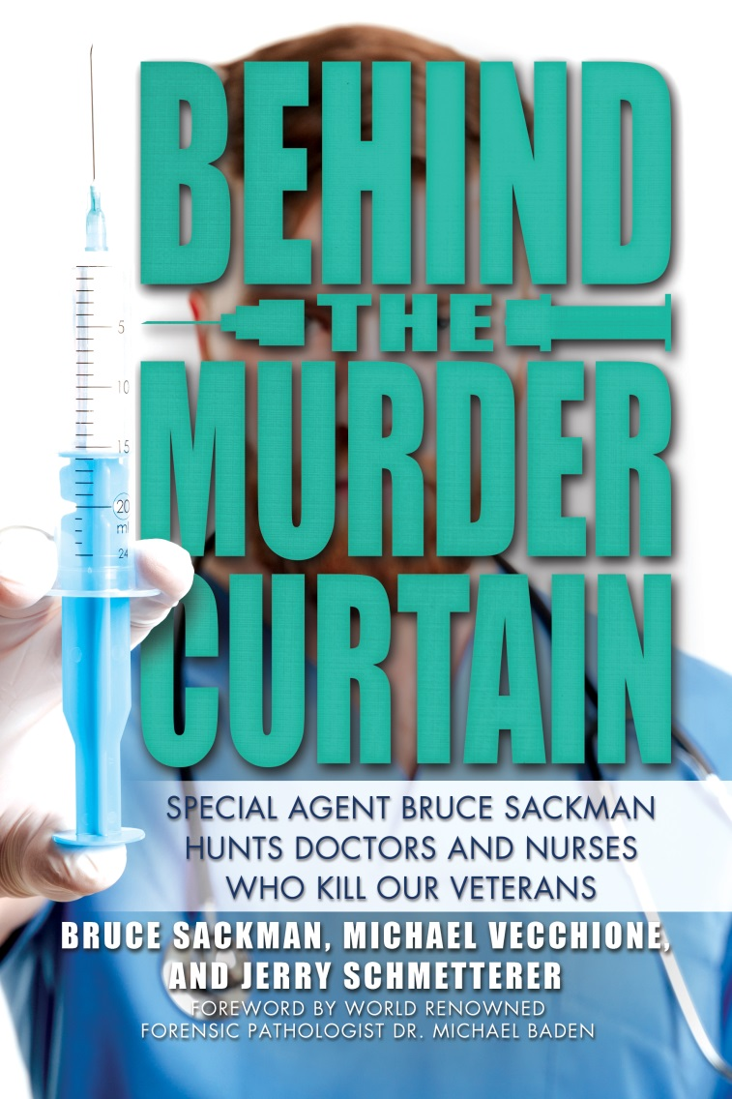
www.BehindTheMurderCurtain.com

Slide 69

Dr. Death Michael Swango

