Slide 1
NCQA Credentialing Accreditation Pathway to Success
October 2025

Slide 2


Welcome!
Alexis E. Williamson, MPH
Executive Director
Central Credentialing Office
Mass General Brigham
Michelle Butler, MS, CPCS, CPMSM, FSMP
Director of Medical Staff Services
Central Credentialing Office
Mass General Brigham
Notes:
Good afternoon and thank you to MAMSS for the opportunity to share our NCQA credentialing accreditation journey.
And thank you for joining us today.
We hope our experience will help you to develop your own roadmap if you are contemplating NCQA Credentialing Accreditation.

Slide 3


Mass General Brigham
Mass General Brigham is the largest integrated health care delivery network in Massachusetts. MGB includes 16 member institutions including: two AMCs Brigham and Women’s Hospital and Massachusetts General Hospital, specialty hospitals, community hospitals, a rehabilitation network, a health insurance plan, and multiple ambulatory care site locations across Massachusetts and New Hampshire.

Slide 4
In this session, you will learn about:
Why did we pursue NCQA accreditation?
Preparing for accreditation
Payer contracting
System controls (now credentialing information integrity) and reporting
Final results!
Notes:
NCQA Credentialing Accreditation Pathway to Success
Learning Objectives for NAMSS CEU Credit Request
By the end of this session, participants will be able to:
1. Explain the strategic rationale behind pursuing NCQA accreditation and its relevance to credentialing and payer relationships.
2. Identify key preparatory steps and organizational requirements necessary to initiate and sustain NCQA accreditation efforts.
3. Analyze the impact of NCQA standards on payer contracting processes and how accreditation influences network participation.
4. Evaluate reporting mechanisms that support compliance, data integrity, and continuous quality improvement.
5. Interpret post-accreditation outcomes, including operational efficiencies, stakeholder engagement, and measurable improvements in credentialing workflows.

Slide 5
Why?
Increased revenue
Reduce payer write-offs
Focus time on value-added work
Reduced (or removal!) of multiple delegated payer audits
Notes:
Our CFO previous organization pursued NCQA accreditation
March 2022 - begin the discovery process of achieving Accreditation for the CCO
October 2022 – hired consultant

Slide 6
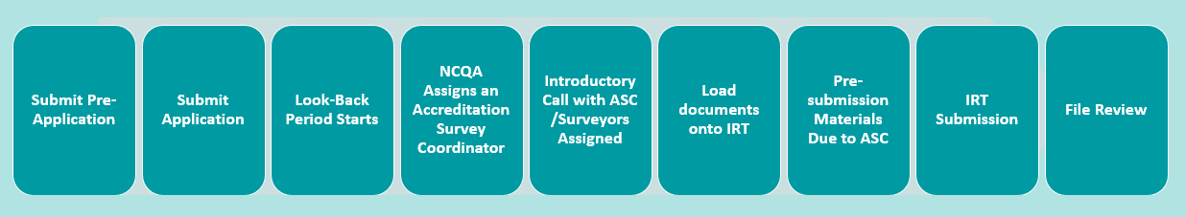
Timeline
Phase 1 Readiness and Gap Assessment | Phase 2 Develop Workplan to Address Gaps | Phase 3 Implement changes | Phase 4 Survey submission | Phase 5 File Review and Survey Results
2 months
1 month
(Varies)
1 month
1 month
Notes:
Lookback period = 6 months; all changes need to be incorporated prior to lookback period
April – September 2023
File Review submission in October 2023
Phase 3 – 5 months
Minimum Implementation Timeframe Recommendation: 15 months

Slide 7
Readiness and Gap Assessment
Identify stakeholders
Identify dedicated project management and/or external consultant
Orient to NCQA standards, terminology, and timelines
Gather all internal policies, procedures, and documentation
Conduct initial assessment of readiness including policies, procedures, documentation, evidence review, and reports
Document additions and/or changes to:
  Policies
  Workflows
  Checklists
  Reports
.
Notes:
Timeline
November – March 2023 – readiness/gap analysis
Stakeholders
Credentialing, Provider Enrollment, Finance
Terminology example:
Provider = Hospital
Practitioner = Provider

Slide 8
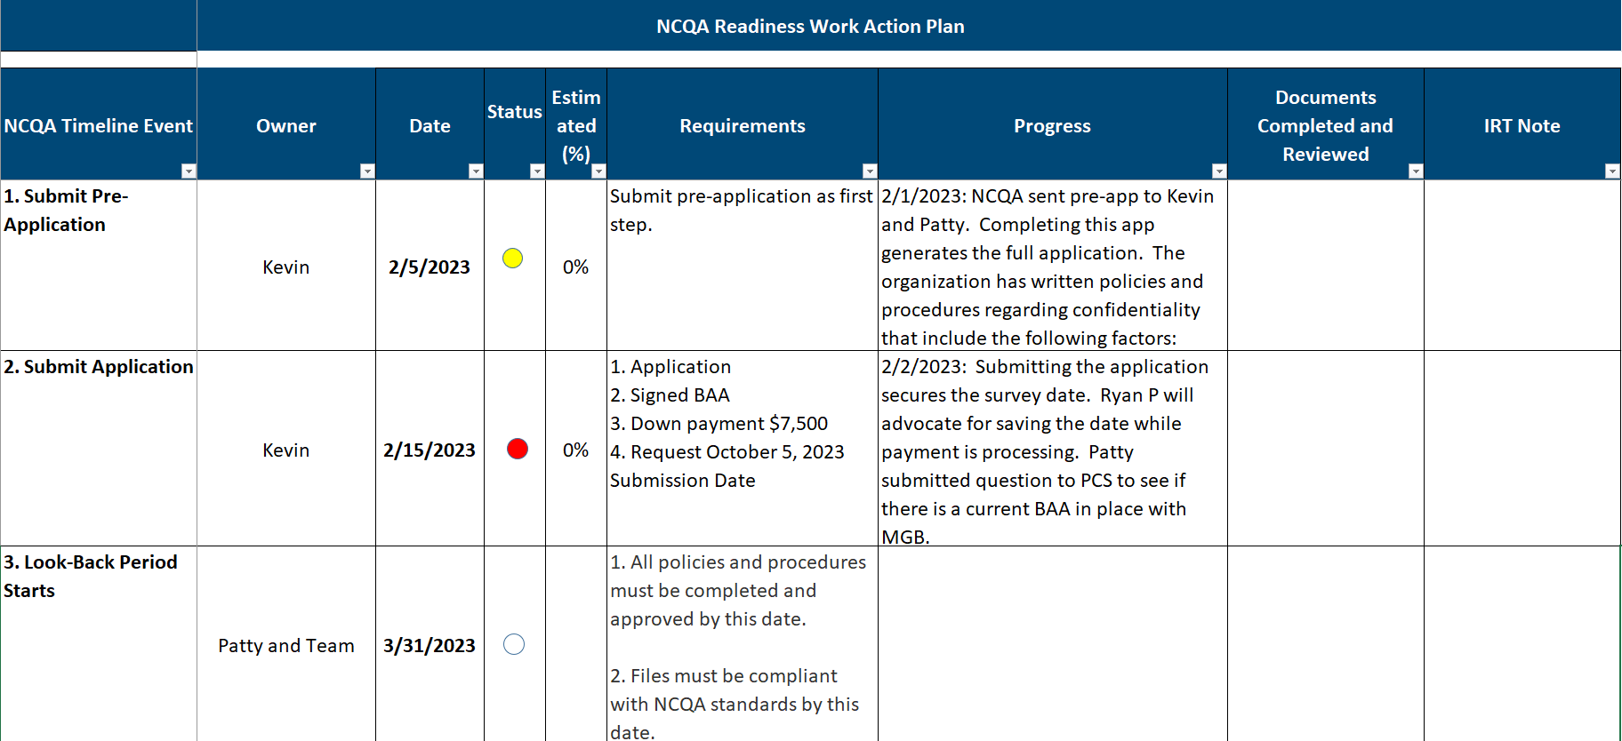
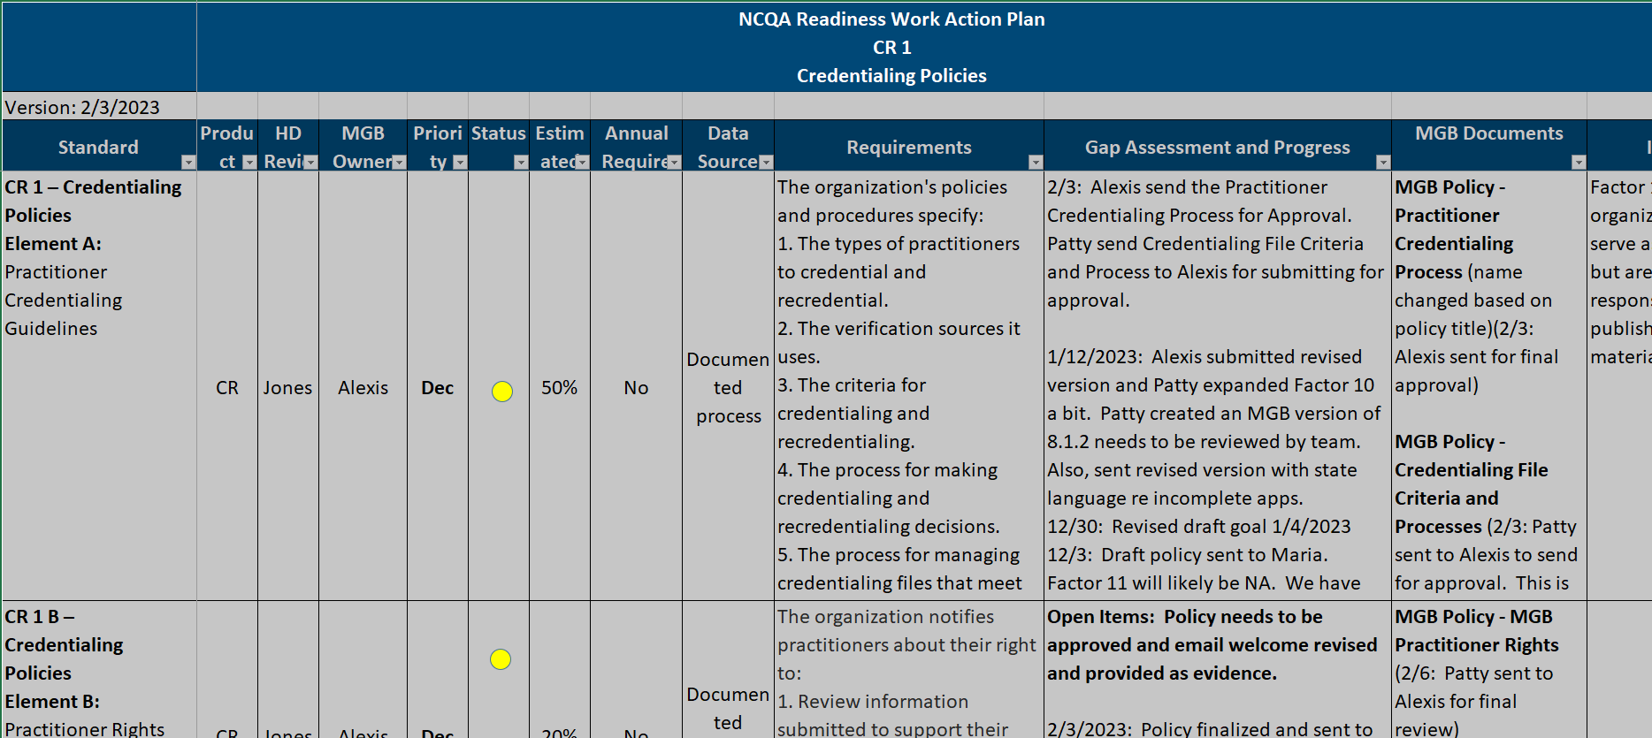
Develop Workplan to Address Gaps
Workplan: organize by factor
Policies: naming conventions use NCQA standards language
Folder structure: save documentation using NCQA standards language
Checklists: add NCQA standards to checklist items

Slide 9
Examples of Pre-submission Materials
Credentialing policies
Organization and ASM security policies
Facility types and organizations background
Staff confidentiality agreements
Credentials Committees minutes and reports
MD-Staff Checklists
MD-App
Staff orientation and training materials
Complaint and adverse event tracking
Minutes
Delegation agreements
Notification of practitioner rights
Notes:
3 sets of minutes in the look-back period
3 examples of notifications of practitioner rights
4 delegation agreements
4 MGB Cooperation with Client Oversight Requests – essentially proving that we are responsive to payer auditing requests

Slide 10
MD-App – updated instructions
Notes:
Added language to instructions to meet CR1B Factors 1 – 3 Provider Rights – notification of practitioner rights example

Slide 11
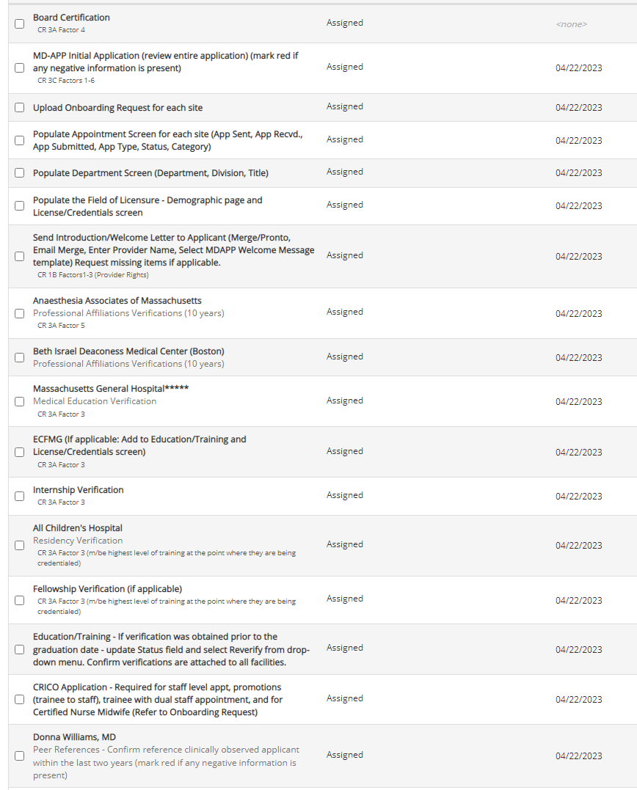


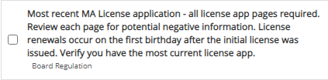

Credentialing Specialist Checklist
Updates
Notes:
Link checklist item to standard
Added intro/welcome letter to meet CR1B Factors 1 – 3 Provider Rights
Also added language to our MD-App
Change professional affiliation to work history
Not a finding- but a point of discussion
Checklist item: CV (represented our review of work history)
Recommended to add specific checklist item: Reviewed 5 years of work history

Slide 12
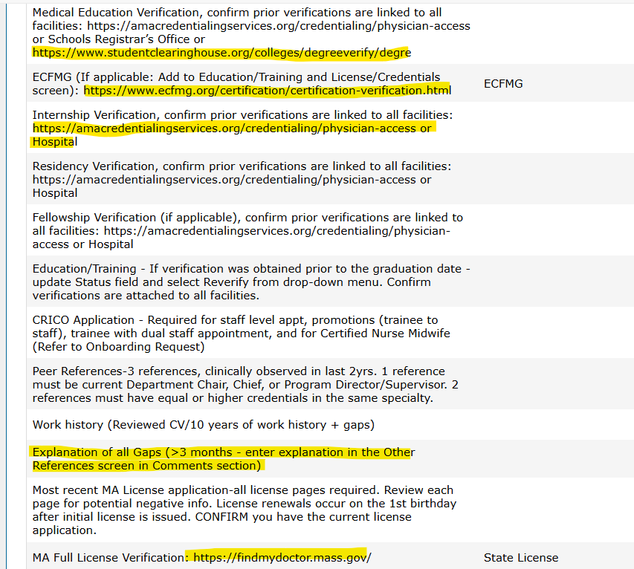
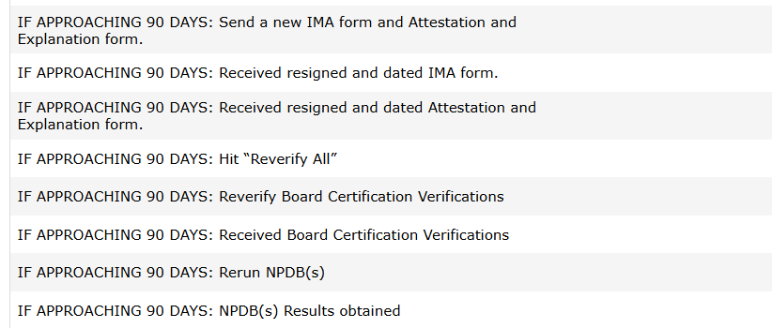
Credentialing Specialist Checklist Updates - 2025
New Tasks to heighten awareness of the 120-day TAT
Notes:
To address any challenges with meeting the July 1 2025 new standards to reverify specific documents. Web sources listed to achieve compliance with some delegated plans.
CR3:
The organization verifies that the following are within the prescribed time limits:
1.A current and valid license to practice. (120 days)
2.A valid DEA or CDS certificate, if applicable. (prior to CC)
3 Education and training as specified in the explanation. (prior to CC)
4.Board certification status, if applicable. (120 days)
5. Work history. (120 days) 5 yrs work history – documents review of work hx.
Gaps in work history. The organization documents its review of the practitioner’s work history and any gaps on the application, CV, checklist or other identified documentation methods (i.e., signature or initials of staff who reviewed the history and the date of review).
6. A history of professional liability claims that resulted in settlement or judgment paid on behalf of the practitioner. The organization obtains confirmation of the past 5 years of malpractice settlements from the malpractice carrier or queries the National Practitioner Databank (NPDB). The 5-year period may include residency or fellowship years. The organization is not required to obtain confirmation from the carrier for practitioners who had a hospital insurance policy during a residency or fellowship

Slide 13
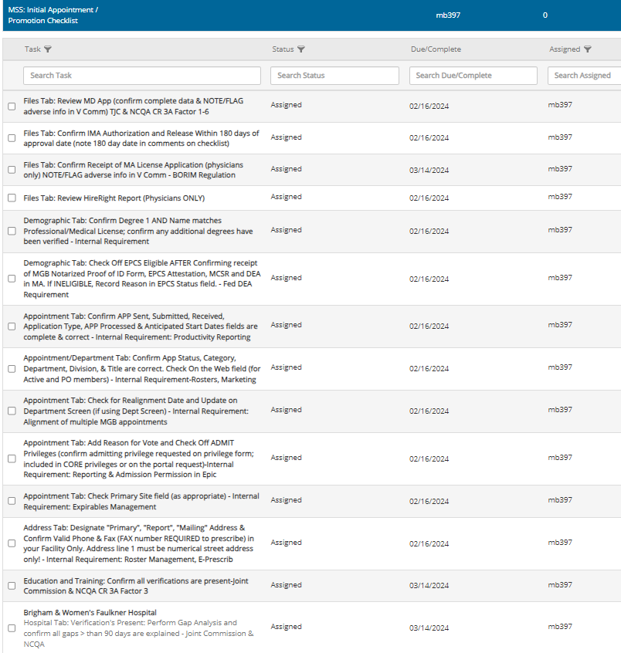




Medical Staff Specialist Checklist
Updates
Notes:
Link checklist item to standard
Staff training
Consistently meeting standards
Also since added an

Slide 14
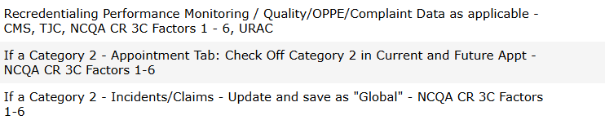
Medical Staff Specialist Checklist Updates - 2025
Added new MSS tasks to improve compliance with performance monitoring requirements
Notes:
CR 3 Includes the verification timeframes; Sanctions and Exclusions monitoring, Attestation questions (drug use, malpractice claims, license and privilege issues) all items that may make an application a category 2 and therefore s/be included in the performance monitoring

Slide 15
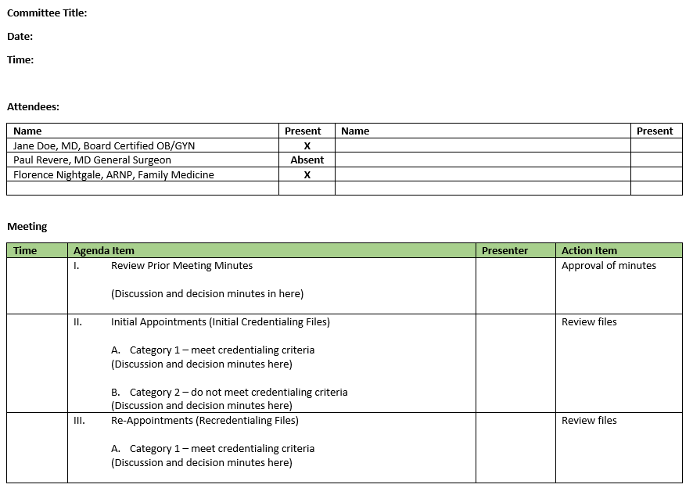
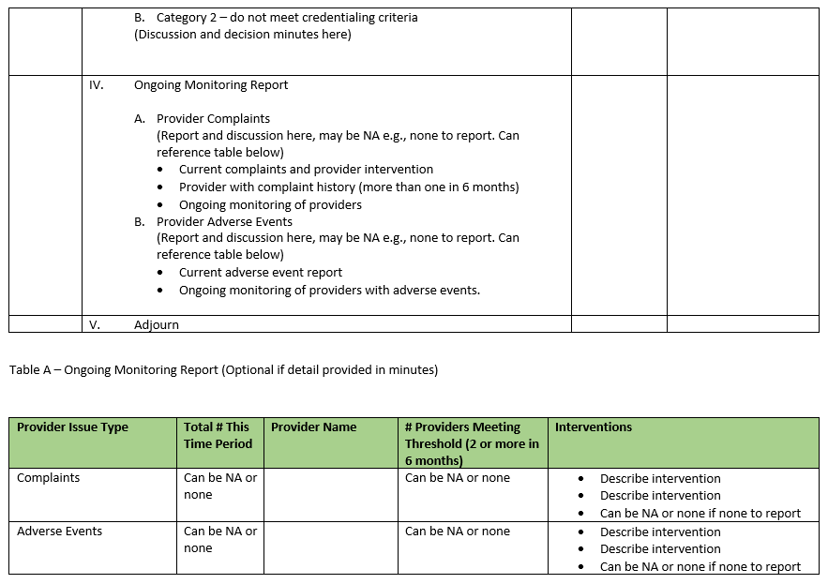
Credentials Committee Agenda

Slide 16
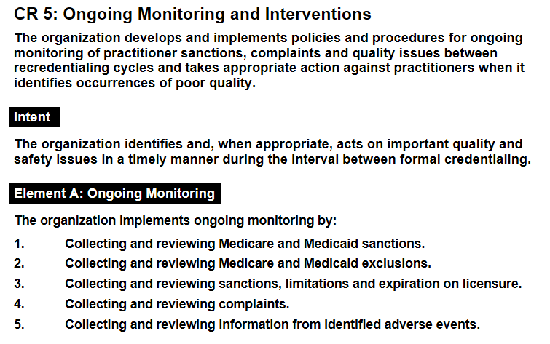
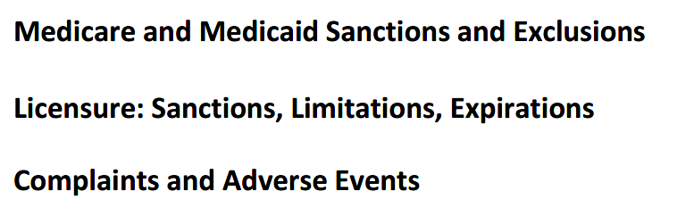
Credentials Committee Agenda Updated - 2025
New Credentials Committee Standing Agenda Items:

Slide 17
Credentials Committee Agenda and Minutes - Update
CR 2 Credentialing Committee
Factor 2: Committee review
The Credentialing Committee:
Reviews the credentials of practitioners who do not meet the organization’s criteria for participation in the network.
Gives thoughtful consideration to credentialing information.
Documents discussions about credentialing in meeting minutes.
Meetings and decisions may take place in real-time, virtual meetings (i.e., through video conference or web conference with audio), but may not be conducted only through email.
Change:
Following meeting agenda item: “Ratification of Email Vote on Category 1 Applications on “Date”
Following meeting minutes include “Motion Made and Seconded to Approve the Motion to Ratify the Credentials Committee vote to Approve Category 1 application on XXX Date”

Slide 18
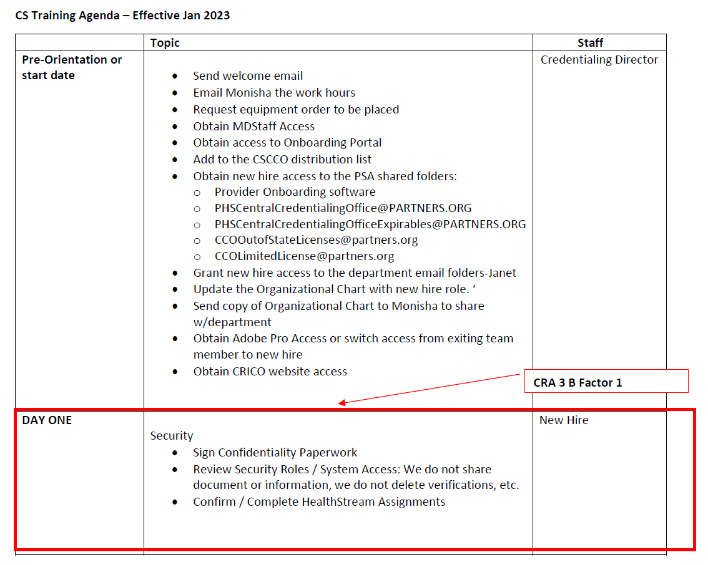
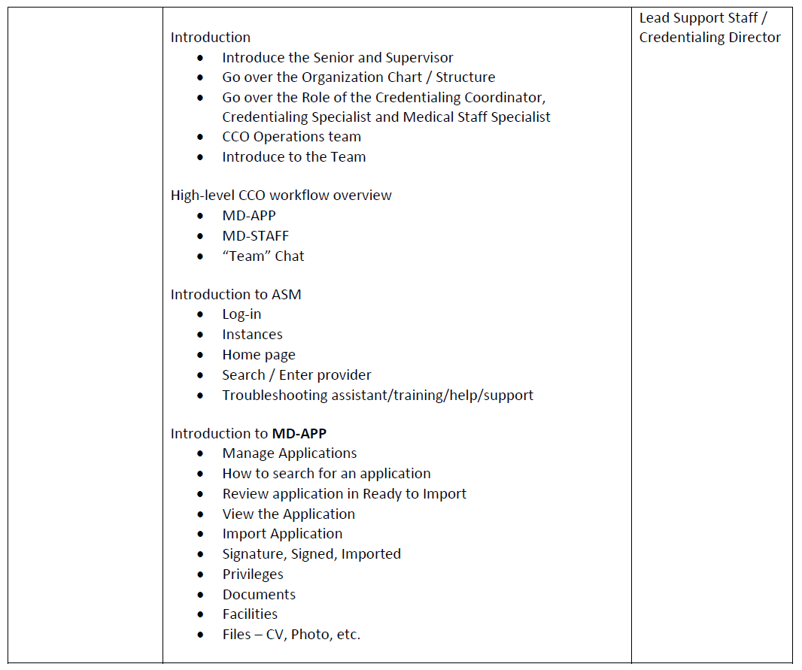
Staff Training Agenda
Notes:
CRA 3 B Factor 1

Slide 19
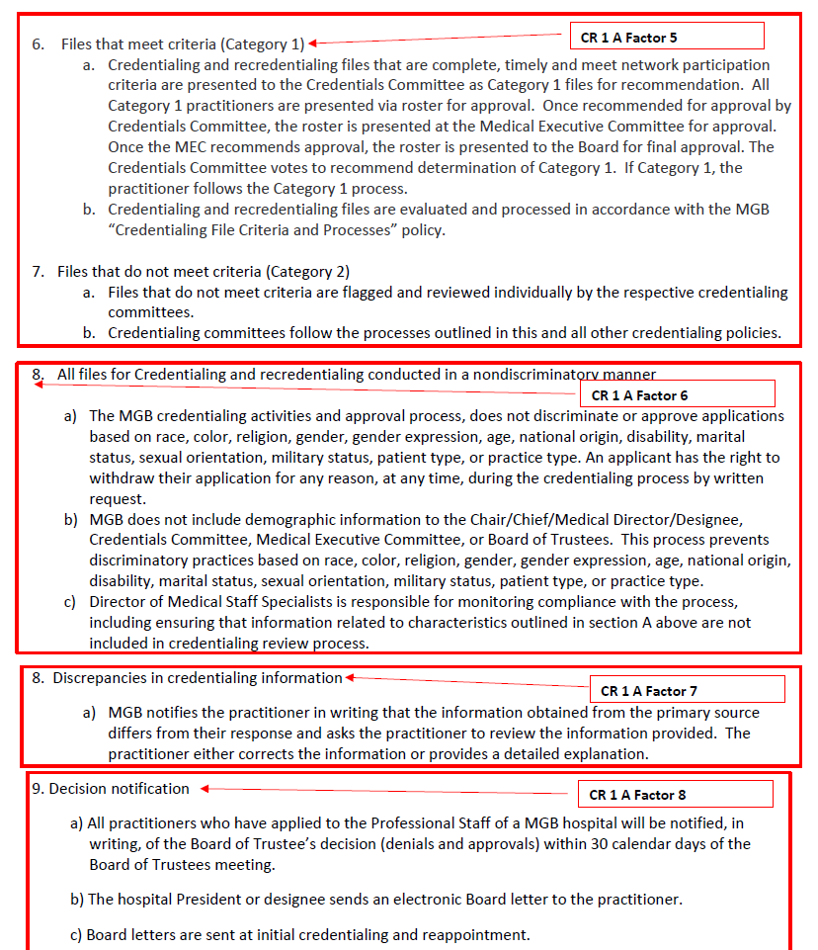
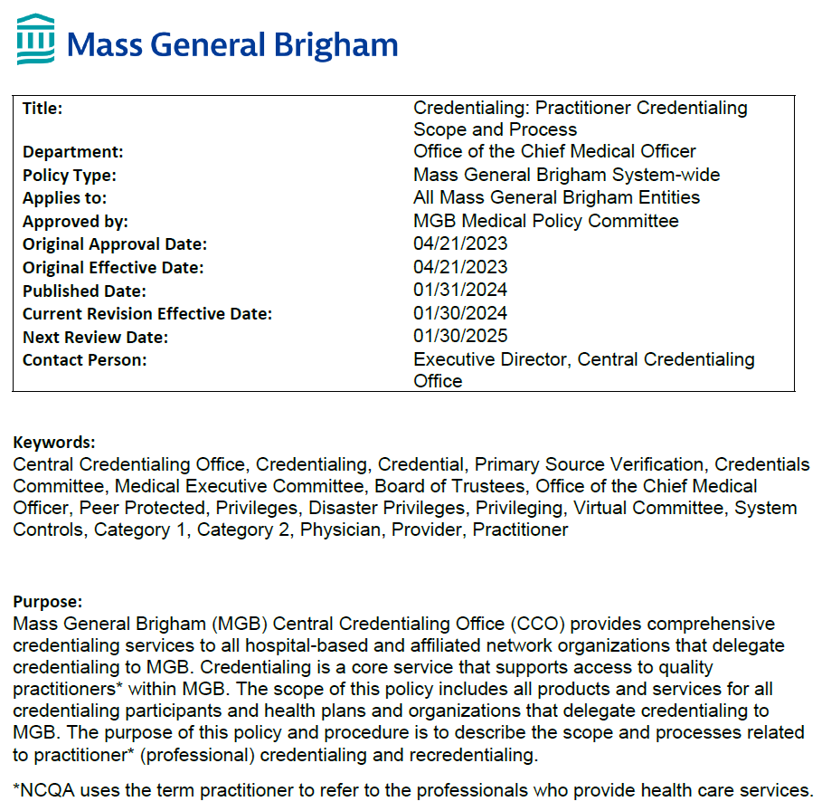
Policies
Standard | Element | Factor | Policy Name
CR 1 | A | 1 - 11 | Practitioner Credentialing Scope and Process
CR 1 | A | 1 - 11 | Credentialing File Criteria and Processes
CR 1 | B | 1 - 3 | Practitioner Rights
CR 1 | C | 1 - 6 | Credentialing System Controls
CR 2 | A | 1 - 3 | Credentialing Committee
CR 3 | A | 1 - 6 | Credentialing Confidentiality
CR 5 | A | 1 - 5 | Credentialing Ongoing Monitoring
CR 6 | A | 1 - 2 | Credentialing Provider Actions
CR 7 | A | 1 - 3 | Organizational Provider and Review and Approval

Slide 20
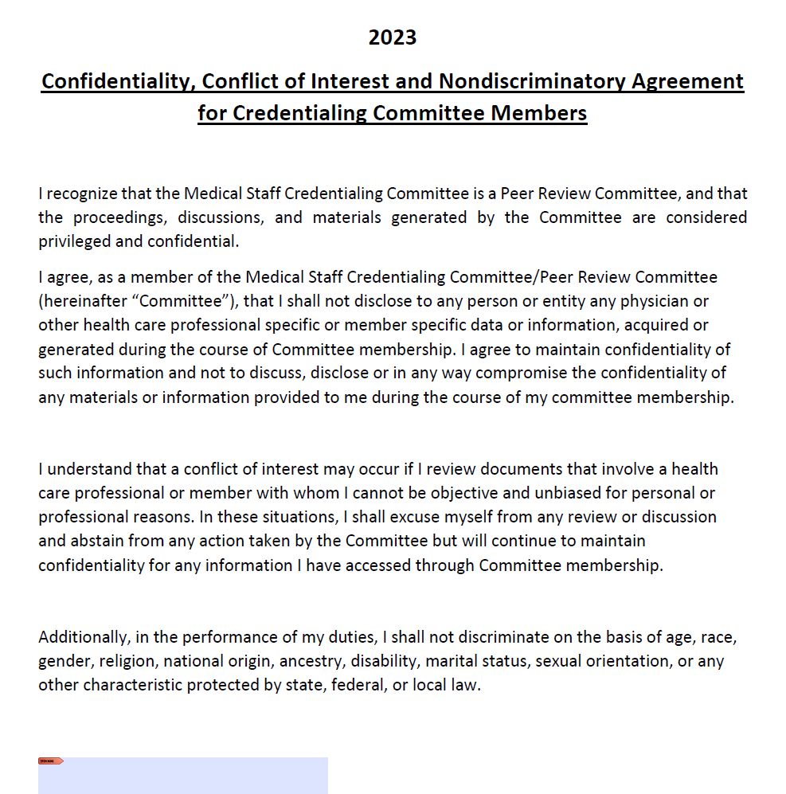
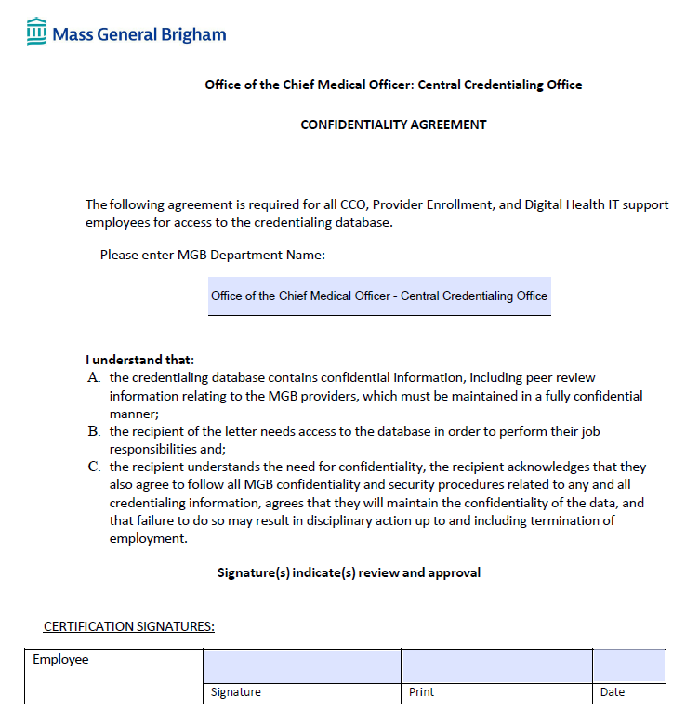
Confidentiality Agreements
Notes:
Credentials Committee and Staff
Annually

Slide 21
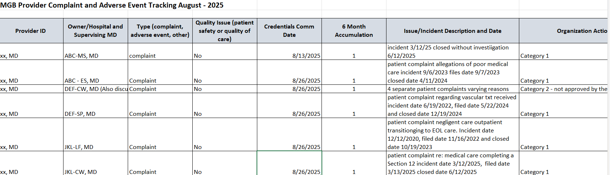
Complaint and Adverse Event Tracker – Updated 2025

Slide 22
Pre-Submission Materials Overview
Upload documentation into IRT
Organization uploads all documentation to IRT
Documentation reviewed and issues documented
NCQA reviews and compares materials to standards
Review issues
Organization reviews, addresses, and responds to issues
Develop Agenda for Survey Conference Call
Organization sends agenda and conference call details
Conduct Survey Conference Call
Joint discussion
Notes:
3 days to upload additional information

Slide 23
File Universe Criteria
Six-month look-back period
IRT format roster (Cred / Re-Cred)
Follow specific identification criteria of practitioners
NCQA selects 80 files and notifies you 2 weeks before the File Review
Notes:
Only include practitioners who practice independently
Specific format to upload into IRT – one tab Cred, one tab Re-Cred
LastName; FirstName; Degree; Specialty; Initial Credentialing Date; Delegate Name; Cred/Recred
We included PAs incorrectly
Remove PAs and Nurse Midwifes
Physicians
Nurse Practitioners
Psychologists
LICSW

Slide 24
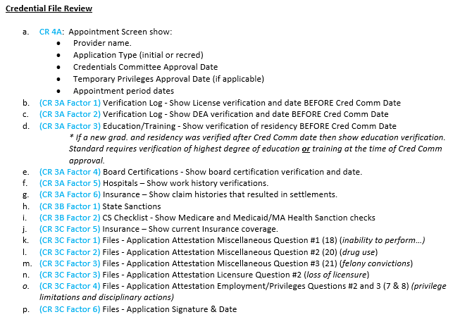
File Review Day
Virtual file review
Minimum 4 hours
Once your reach the minimum requirement of the factor, the Surveyor stops reviewing the factor
IRT – transparent, real-time scoring
Notes:
All evidence/documents must include the following:
Date the document was verified before the Credentials Committee date
Initials or signature of the credentialing staff member who reviewed the verification. CS checklist is acceptable
Primary Source Verification (PSV) source is listed
Expiration date is listed for all primary source verifications

Slide 25
Payer Contracting

Slide 26
Contractual Requirement with the Payers
Focused on operational issues and administrative simplification to impact revenue
  MGB has advocated for delegated credentialing for 20 years
  Consolidate provider enrollment functions within the Revenue Cycle to work hand in hand
  Consolidate file reviews and selection process across the system for existing contracts
Payers requiring NCQA accreditation to:
  Implement new delegation agreements (BCBS)
  Consolidate existing agreements into a single MGB

Slide 27
System Controls* and Reporting
*New:
Credentialing Information Integrity

Slide 28
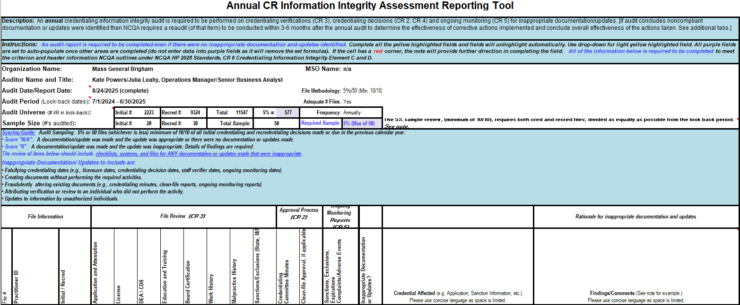
Audit Tool and Parameters
Purpose is to meet the NCQA requirements regarding monitoring credentialing information integrity (formerly security controls) and ensuring the integrity of the credentialing data and process
Intent is to look for modifications to credentialing files and determine if those modifications were appropriate
A modification is any change to credentialing information after it is initially created/documented
Randomly select a sample of 5% or 50 records with modifications and assess whether the modifications were appropriate.
    Minimum standards: at least 10 Initials and at least 10 Reappointments
Select enrolled providers only
Notes:
MD-Staff Change Audit tool → Set-Up → Security Logs → Change Audits Randomly

Slide 29
Annual Credentialing Information Integrity Annual Report
Objectives
Quantitative Analysis
Background
Approach and Methodology
Results
  Review of Credentialing Security Compliance
  Audit and Analysis of Credentialing Modifications
  Quantitative and Qualitative Analysis
Recommendations and Corrective Action
Credentialing Information Reviewed | Noncompliant Initial Credentialing Files | Noncompliant Recredentialing Files | Percentage of Noncompliant Modifications
Application and Attestation | 0 | 0 | 0%
License | 0 | 0 | 0%
DEA/CDS | 0 | 0 | 0%
Education and Training | 0 | 0 | 0%
Board Certification Status | 0 | 0 | 0%
Work History | 0 | 0 | 0%
Malpractice History | 0 | 0 | 0%
Sanction Information | 0 | 0 | 0%
Credentialing Committee Minutes | 0 | 0 | 0%
Clean-File Approvals | 0 | 0 | 0%
Ongoing Monitoring Reports | 0 | 0 | 0%
Notes:
Even 0 inappropriate modifications found must be formally documented in the audit report
You’ll need an annual copy of your vendor’s SOC report.
A System and Organization Controls (SOC) report is a formal, independent audit report that evaluates how a service organization manages data—particularly around security, availability, processing integrity, confidentiality, and privacy.

Slide 30
Post Survey

Slide 31
Lessons Learned
Organization is key
Pre-Survey
Standard Credentialing Committee minutes, agenda, profiles, reports
Crosswalk policies to standards and bookmarking
Day of File Review
Create credential file order review checklist
Include multiple MSS for file review day
Miscellaneous
CR 3 Element C Factor 2!
File universe – do not include Physician Assistants or Certified Nurse Midwives
Checklists - more granularity, the better
Document and plan for your future accreditation
Notes:
If you’re having trouble standardizing areas, it is an external reason to drive standardization
Surveyor requested PDF documents of files; IRT was down during our file review
CR3 Element C Factor 2 - Physician Health Services – evaluation, treatment, monitoring – reduce mental health reporting stigma
“Are you currently using illegal drugs which has or could affect your judgement or the ability to practice medicine?
Work history example (CV and work history)
Change professional affiliation to work history
Add checklist item: Reviewed 5 years of work history
Future - Timeline
Accreditation Effective: January 2024
Renewal: January 2027
Documents and Reports Lookback: January 2025 - January 2027
Files Lookback: January 2023 - January 2027
Outlook calendar reminders for policies etc.
Look-back periods (representative materials from the look-back period - don't just give the most recent in the next survey) Example: committee meeting minutes for the 1st and 2nd year of lookback period
Review and create a schedule of the monthly items to complete (starting the Fall of 2024)
e.g.; Security Audit

Slide 32
Post Survey Overview
Executive review
Preliminary report shared in IRT post closing presentation
Organizational comments
Organization responds and sends supporting documentation that applies to the elements in question (no new documentation is accepted)
Incorporation of comments
Preliminary report shared in IRT post closing presentation
Review Oversight Committee
Responsible for final decision and status
Final Report and Certification
Receives final decision letter and certificate
Notes:
December 2023 = Final Report January 2024
Executive Review: 10 – 14 days
Organizational Comments: 10 days
Incorporation of Comments 10 – 14 days
Final Report and Certification 34 days

Slide 33
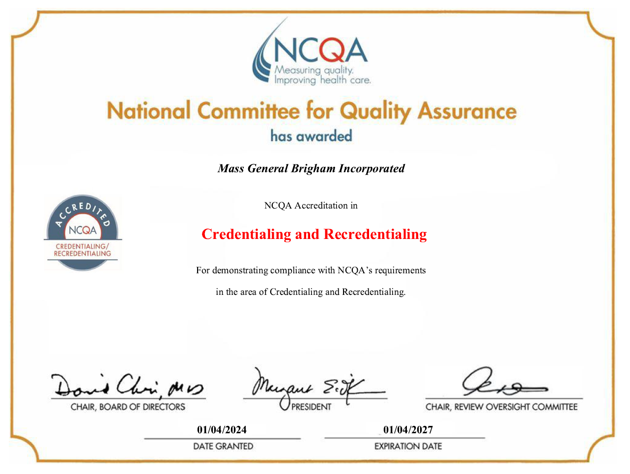
Notes:
Final results! Achieved highest 3-year accreditation. Thank you for your time. We appreciate your attendance and hope we were helpful!
Education & Training: 93%
Lack of Present Illegal Drug Use: 0%
All other factors: 100%

