Slide 1


Moving into the future with AI
Joseph Travagline MS, RHIA, CPMSM
Senior Director of Practitioner Credentialing (CVO)
MedStar Health System

Slide 2

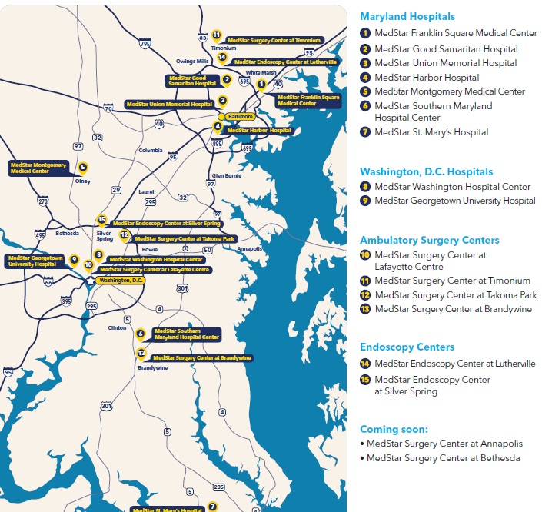
Located in Maryland and Washington DC region,
MedStar Health has more than 300 care locations.
10 Hospitals
  MedStar Georgetown University Hospital (Academic)
  MedStar Washington Hospital Center (Academic)
  MedStar Franklin Square Medical Center
  MedStar Good Samaritan Hospital
  MedStar Harbor Hospital
  MedStar Montgomery Medical Center
  MedStar National Rehabilitation Hospital
  MedStar Southern Maryland Hospital Center
  MedStar St. Mary's Hospital
  MedStar Union Memorial Hospital
  CVO
  Currently, Manages all hospital credentialing and recredentialing ~5700 practitioners

Slide 3

Notes:
HAL Space Odessy

Slide 4
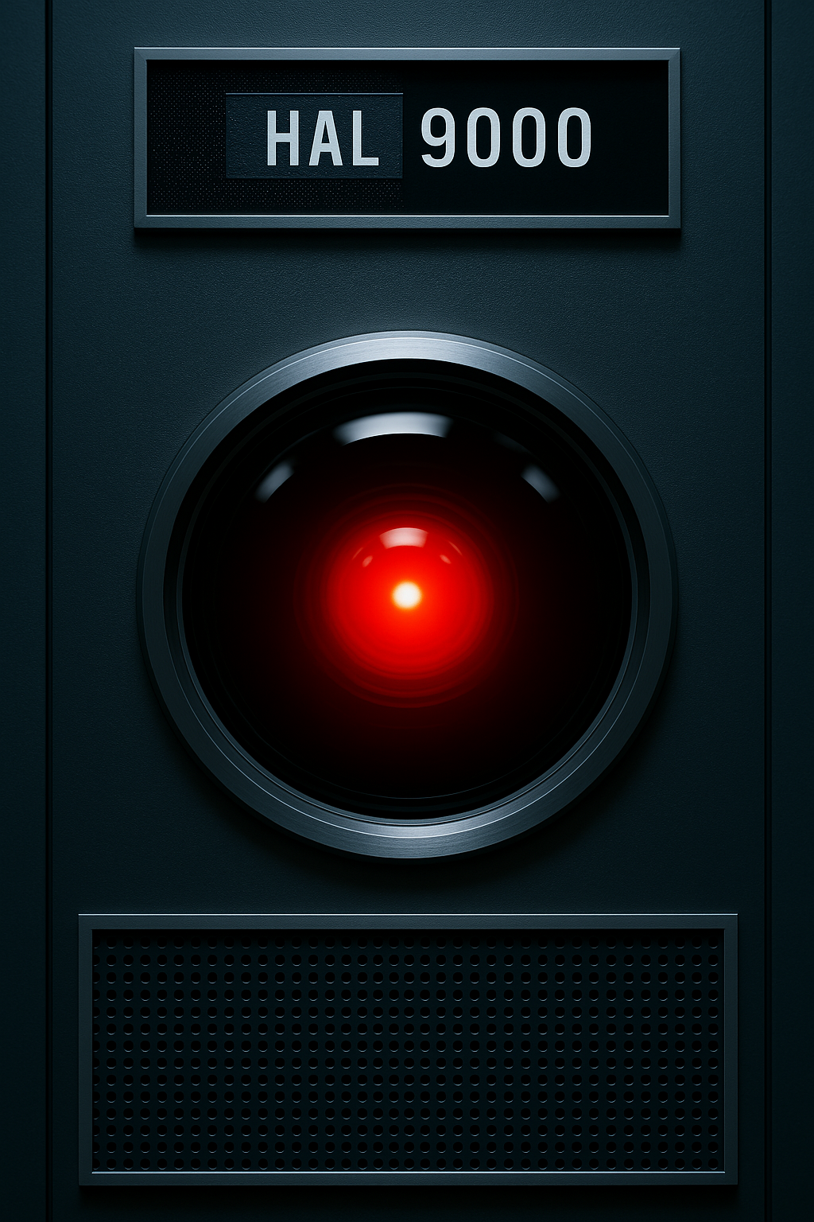
2001: A Space Odyssey
2001: A Space Odyssey is a 1968 science fiction film directed by Stanley Kubrick. It's considered one of the most influential and groundbreaking films in cinema history.
Theme of the Movie
  Human evolution
  Artificial intelligence
  Space exploration
  Relationship between humanity and technology
Hal Malfunctions
Beings to take over the spaceship and sees humans as a threat.
Dave says: “Open the pod bay doors, Hal”
Hal says: “I’m sorry Dave I’m afraid I can’t do that.”

Slide 5
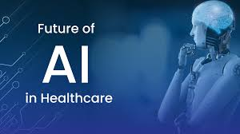

Slide 6


Slide 7
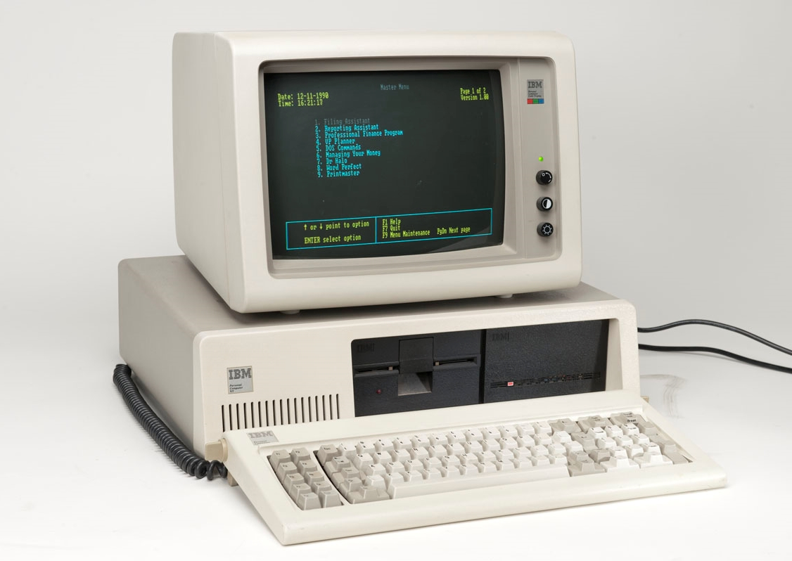
Introduced: August 12, 1981
IBM PC
Twelve months of development Pricing started at $1,565 with 16 KB RAM
5Mb Hard Disk
Color Graphics Adapter and keyboard
MY COMPUTER

Slide 8
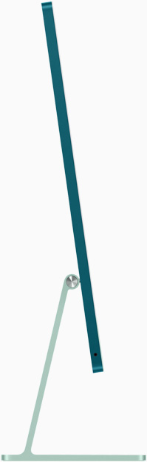
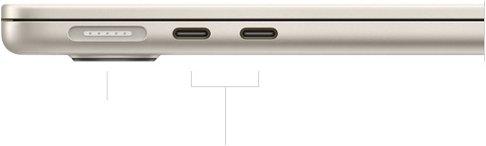

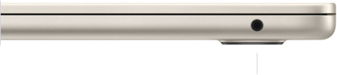
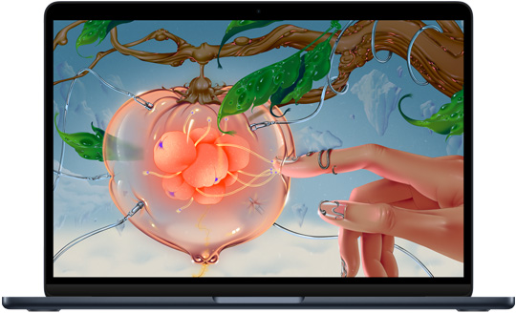
TODAY’S COMPUTER

Slide 9
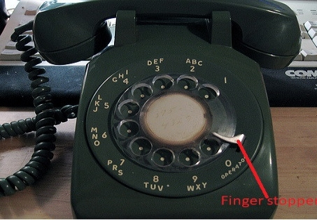
MY PHONE
Invented:
1877: Bell Telephone Company is founded.
1878–1890s: Telephone exchanges are established in cities, allowing multiple users to connect via operators. Manual switchboards were used to route calls.
1890s: Candlestick telephones and rotary dials appear. Long-distance calling begins improving with better lines and amplifiers.

Slide 10
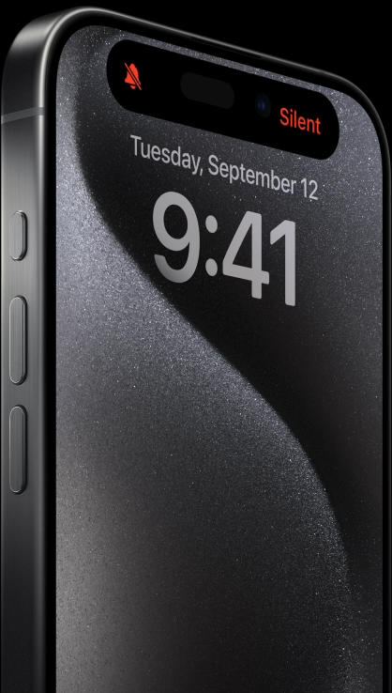
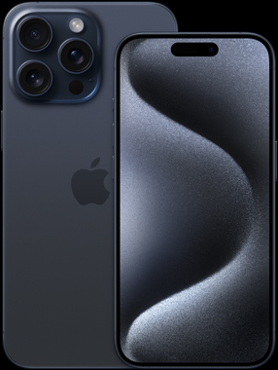
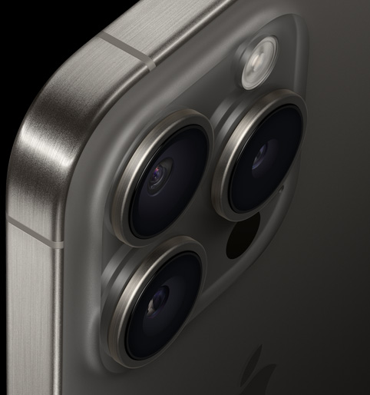
TODAY’S PHONE
Modern Era
2007: The iPhone launches, initiating the smartphone era. Phones now include apps, internet access, cameras, and more.
Today: The telephone is now a multi-functional device (smartphone) central to communication, business, and daily life.

Slide 11
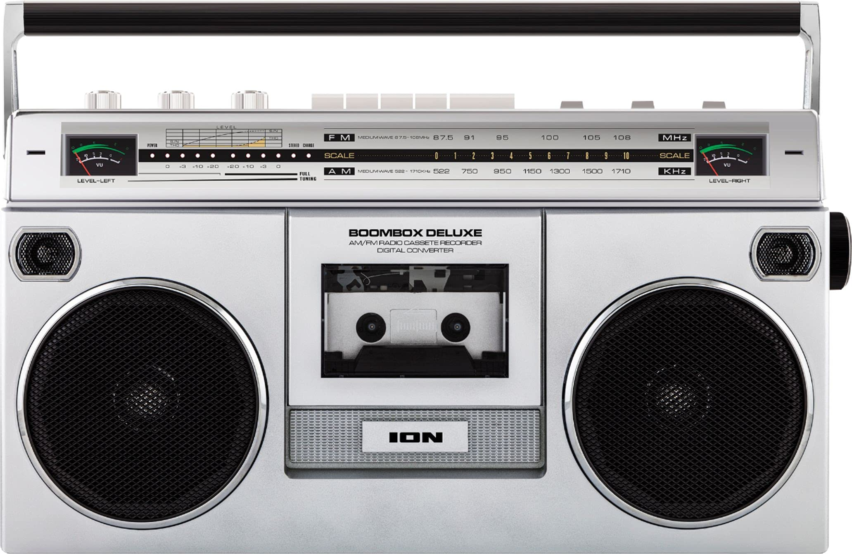
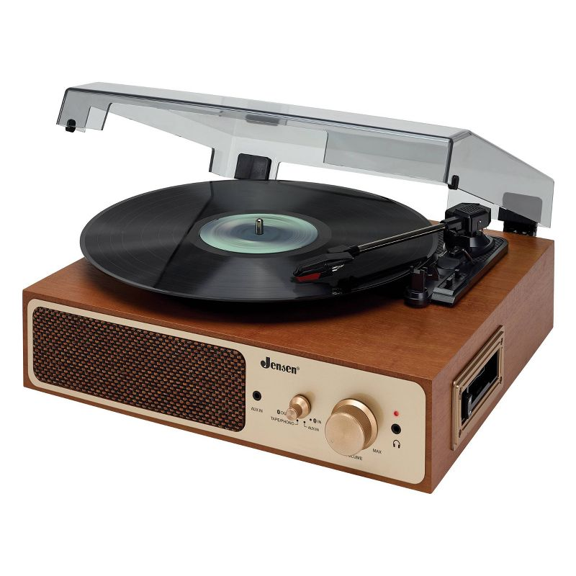
My Streaming Music

Slide 12
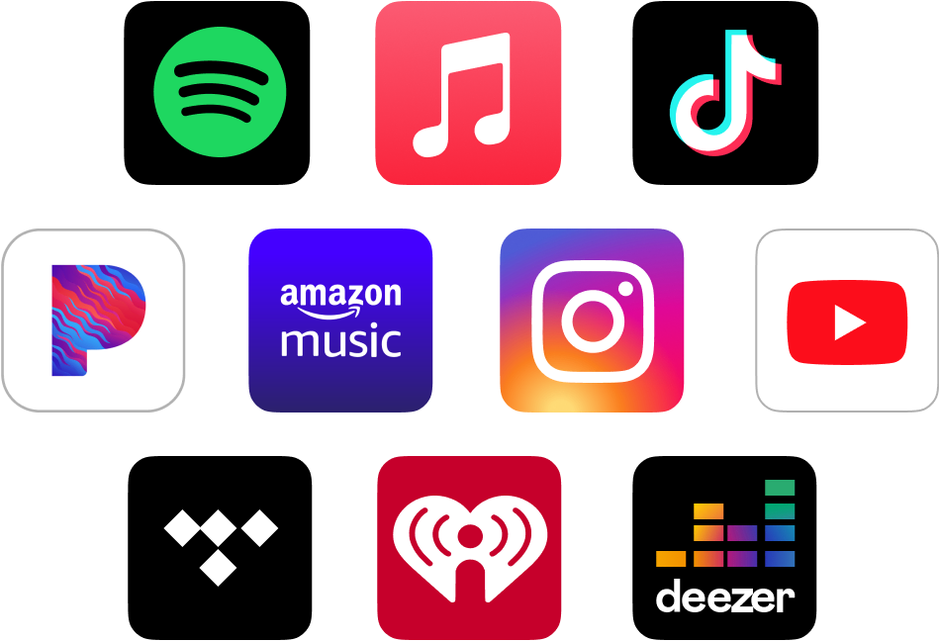
TODAY’S STREAMING MUSIC

Slide 13



Slide 14
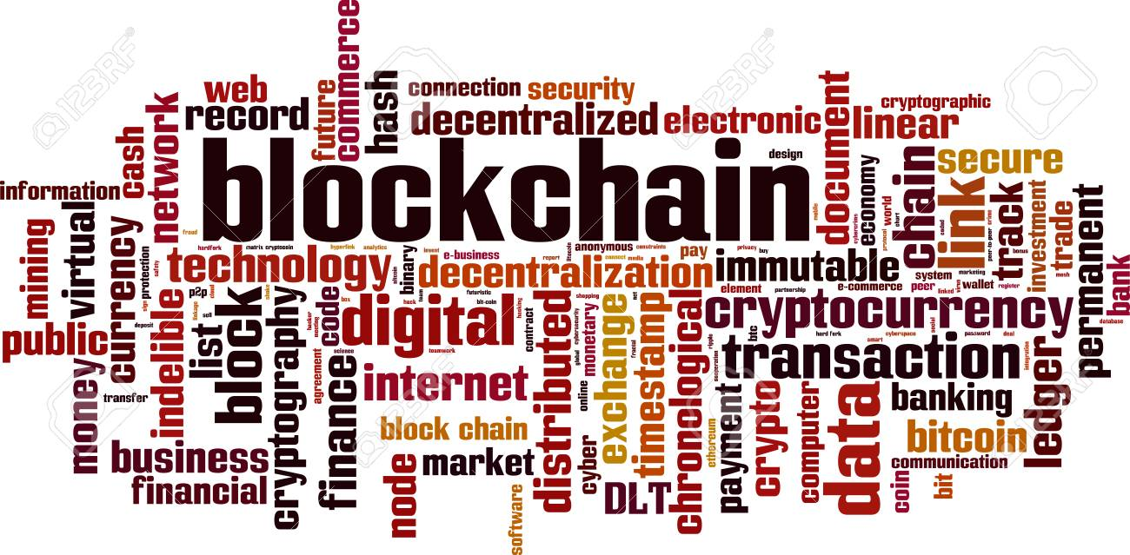

Notes:
Blockchain and artificial intelligence (AI) are two distinct technologies, but they can complement each other in various ways.
Here are some key points about the relationship between blockchain and AI:
Data Security and Privacy, Data Quality and Trust, Decentralized Data Marketplaces, AI in Blockchain Analytics, Smart Contracts and Automation, Decentralized AI Networks:, Tokenization and Incentives, Challenges and Scalability, Regulatory Considerations, Emerging Use Cases

Slide 15
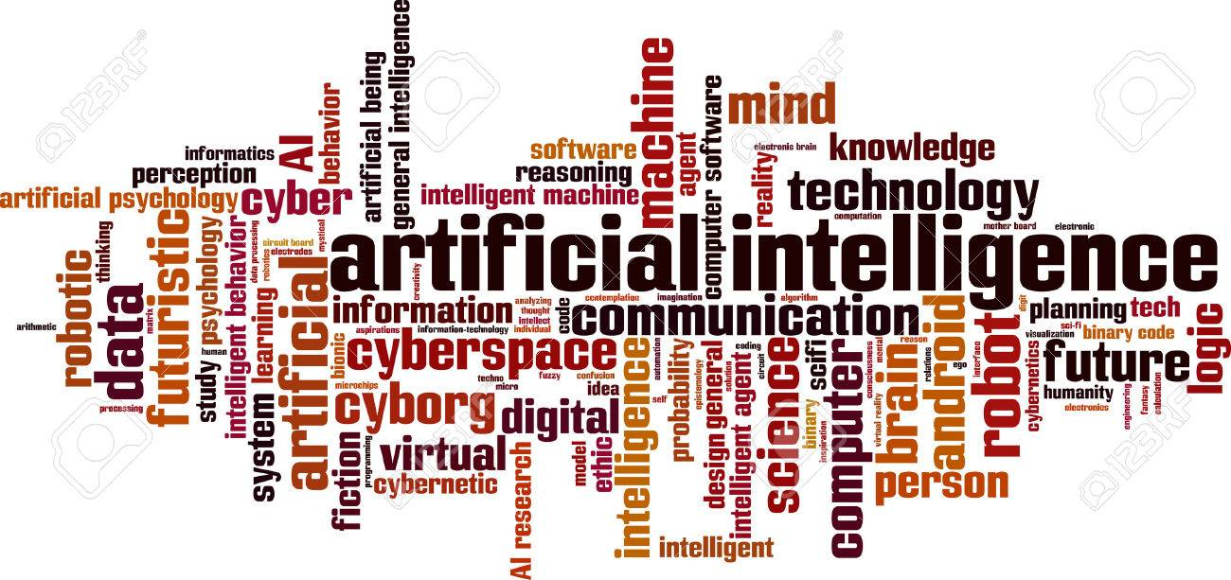

Notes:
While blockchain and AI can complement each other, it's essential to note that combining these technologies can be complex, and their successful integration depends on specific use cases and the goals of the application. Additionally, both blockchain and AI have their own challenges and limitations that need to be considered when using them together.

Slide 16
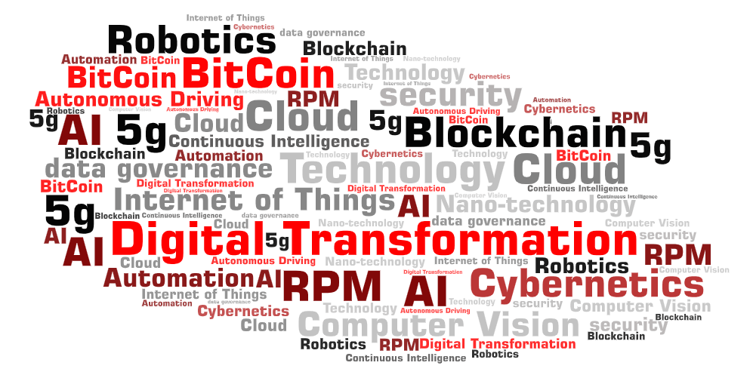


Slide 17

What is AI?
What is AI?
WHY DO I CARE?

Slide 18

Definition of AI
AI is a branch of computer science that deals with the development of machines that can perform tasks that typically require human intelligence such as visual perception speech recognition decision-making and language translation.
Additional definitions:
  Building intelligent entities or agents
  Making computers think or behave like humans
  Studying the human thinking through computational models
  Generating intelligent behavior, reasoning, learning.
Goal of AI:
Create machines that mimic human thoughts and emotions

Slide 19
History of AI
How old is AI?
1950: Mathematician and Scientist Alan Turing wrote a paper titled "Computing Machinery and Intelligence." Developed a test to determine if a machine could exhibit human-like intelligence.
1956 – John McCarthy organized a workshop at Dartmouth where the name of AI was officially adopted for the field and he coined the phrase Artificial Intelligence.
The early systems were successful on small problems but failed on larger ones.
Notes:
The concept of the Turing Test has since inspired various competitions and experiments, often referred to as Turing Test-like evaluations, where AI systems are assessed based on their ability to engage in conversation. These tests have been conducted in different forms, but the original Turing Test itself, as Turing described it in his 1950 paper, was a theoretical concept rather than an immediate practical experiment.

Slide 20
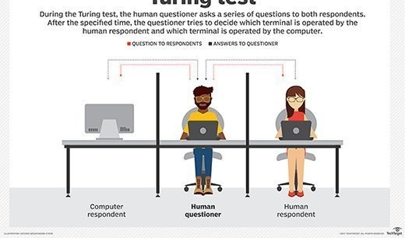
Turing Test
Human vs Computer
Notes:
The concept of the Turing Test has since inspired various competitions and experiments, often referred to as Turing Test-like evaluations, where AI systems are assessed based on their ability to engage in conversation. These tests have been conducted in different forms, but the original Turing Test itself, as Turing described it in his 1950 paper, was a theoretical concept rather than an immediate practical experiment.

Slide 21
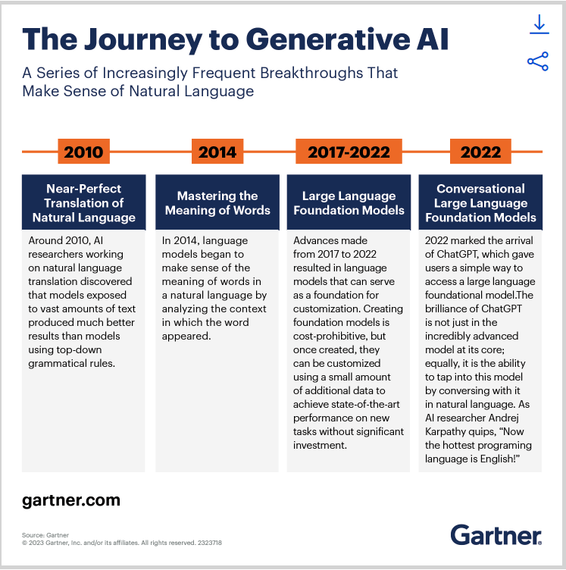
2022 - Arrival of CHATGPT
Generative AI
Focuses on creating or generating new content, data, or information. It involves using AI models and algorithms to produce content that is often creative, realistic, or useful. Generative AI applications include Text Generation, Image Generation, Music and Sound Generation, Data Augmentation, and Drug Discovery.
Other names that AI goes by
  Machine Intelligence
  Cognitive Computing
  Intelligent Automation
  Machine Learning
  Deep Learning
  Neural Networks
  Natural Language Processing (NLP)
  Computer Vision
  Robotics
  Autonomous Systems
  Expert Systems
  AI Assistants
  Strong AI
  Weak AI
  Machine Perception
Notes:
Artificial Intelligence (AI) is sometimes referred to by alternative terms or variations, depending on the context and the specific focus of the technology or application. Here are some other names and related terms for AI:
The word "generative" has its origins in the Latin language. It is derived from the Latin verb "generare," which means "to generate" or "to produce." In Latin, "generare" is related to the noun "genus," which means "birth," "origin," or "kind."

Slide 22
Where is AI going?
What is AI?
WHY DO I CARE?

Slide 23
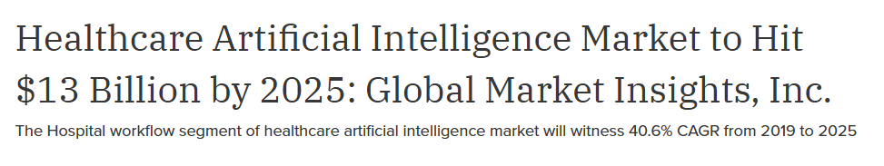

Slide 24
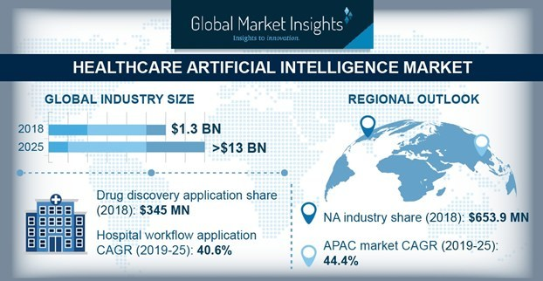

Slide 25
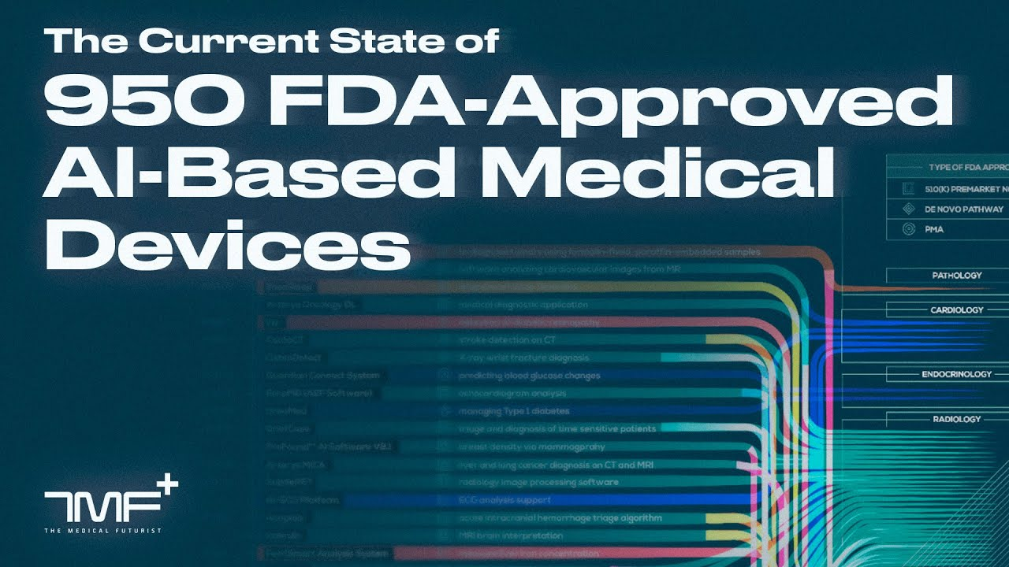

Slide 26

Cleared more than 1,000 healthcare AI algorithms
Created an open database for AI algorithms
HIMSS conference, AI was seen across many of the 1,400 vendors.
Key areas for non-clinical AI is being implemented:
  Revenue cycle management streamlining
  Managing Medical Records and Other Data
  Doing Repetitive Jobs
  Population health
  Health tracking apps
  Identifying and addressing gaps in health equity
  Hospital-wide monitoring include:
    Length of stay
    Bed turn over rates
    Early sepsis detection and readmissions
  Data analytics for key performance indicators
  Enabling better patient wellness and preventative care
  Health tracking apps to better monitor patient health
  Identifying people who may require physical follow up
Breakdown of FDA-Approved
algorithms by specialties:
  396 Radiology
  58 Cardiology
  14 Hematology
  10 Neurology
  7 Clinical chemistry
  7 Ophthalmic
  5 Gastroenterology & Urology
  5 General & Plastic Surgery
  4 Pathology
  4 Microbiology
  4 Anesthesiology
  4 General Hospital
  1 Orthopedic
  1 Dental
Notes:
FDA-Approved AI Algorithms by Specialty

Slide 27
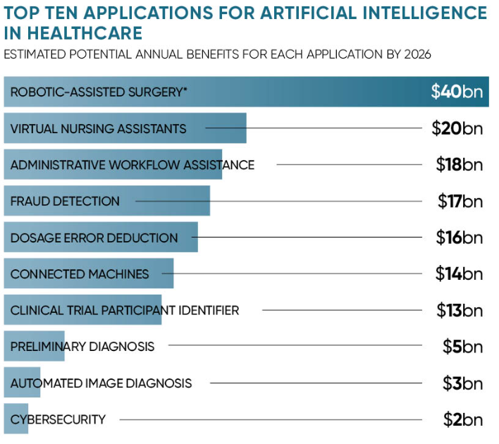
Showing you the Money
AI’s impact on healthcare is to automate administrative tasks. It is expected that this could result in $18 billion in savings for the healthcare industry as machines can help save time on administrative tasks.

Slide 28
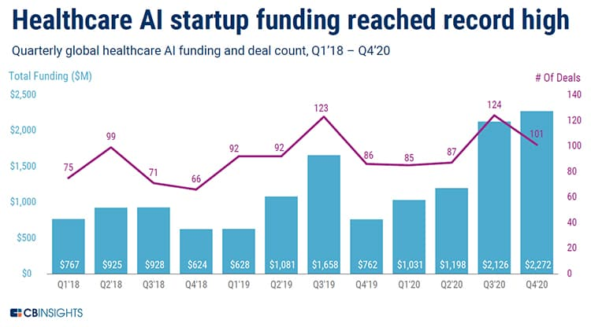

Slide 29
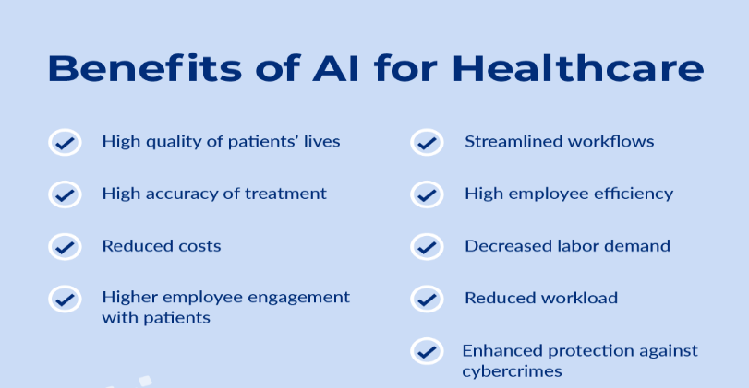

Slide 30
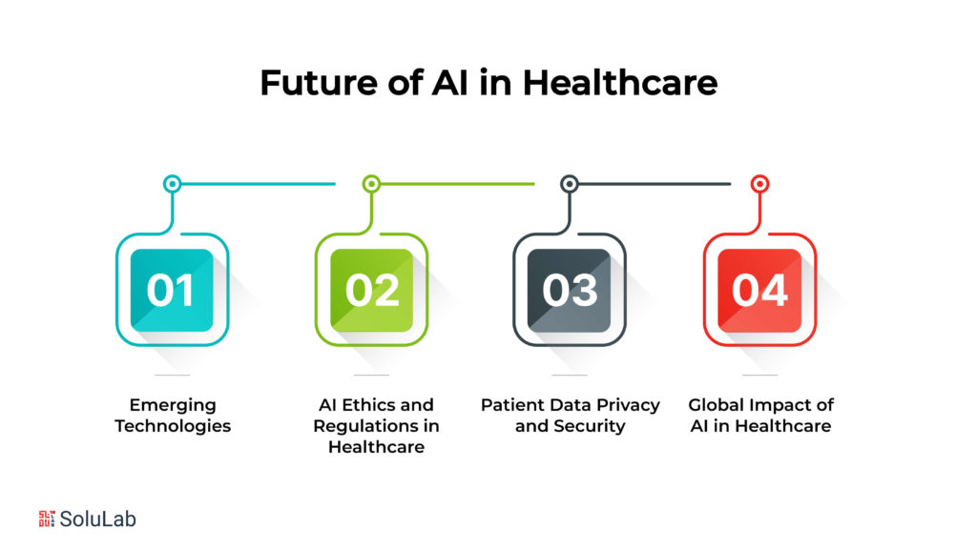

Slide 31
It’s Not Your Grandma’s CVO/MSO
What is AI?
WHY DO I CARE?

Slide 32

It’s Time to Reimagine the CVO/MSO
Rebrand the CVO/MSO:
“PRACTITIONER SOLUTION CENTER”
Remove the Administrative Burden
Paper Applications
Faxing
Emailing Fillable PDF’s
Printing Documents for Signatures
Missed Practitioner Engagement
Time to revenue missed
Need to be more then just credentialing.
Need to be the source of truth for all practitioner data.
Need to be provider enrollment
Need to be onboarding
Need to remove practitioner burden
Need to engage IT resources, get them involved
Much Much more than credentialing

Slide 33
PRACTITIONER SOLUTION CENTER
NUMBER ONE GOAL REMOVING PRACTITIONERS BURDEN
ONE STOP SHOP FOR ALL ANSWERS
Includes Administrative Tasks:
Onboarding
Practitioner Engagement
Hospital Credentialing/Recredentialing
Privileging
Payor Credentialing
Enrollment (Government and Commercial)
System setup and access
Integration
Data management
Compliance reporting
Medical Staff Office Support
Many, many, more opportunities…..

Slide 34
Credentialing Opportunities
Moving into a new frontier
Opportunities:
Automated Data Extraction
Credential Verification
Continuous Monitoring
Document Classification and Organization
Time Efficiency
Fraud, Waste, and Abuse Detection
Data Accuracy and Consistency
Decision Support
Machine Learning for Risk Assessment
Integration with Healthcare Systems
Routine tasks i.e. data entry
Human oversight is still critical
Not a replacement for the judgment and decision-making of experienced credentialing professionals.

Slide 35
Artificial Intelligence Implementation
Criteria for Success:
Big picture considerations first
Guardrails
Ethical use
Policies & Procedures
Best practices
Training sensitive data tools
Planned usage
Vendor agreements
Business model
Tracking regulations and use of AI
Compliance
Similar to any other new technology…..
- Remember what happened when everyone had a cell phone
"Hospital IT departments are woefully unprepared for this onslaught of AI“
- Julius Bogdan, VP and General Manager HIMSS Digital Health Advisory Team

Slide 36
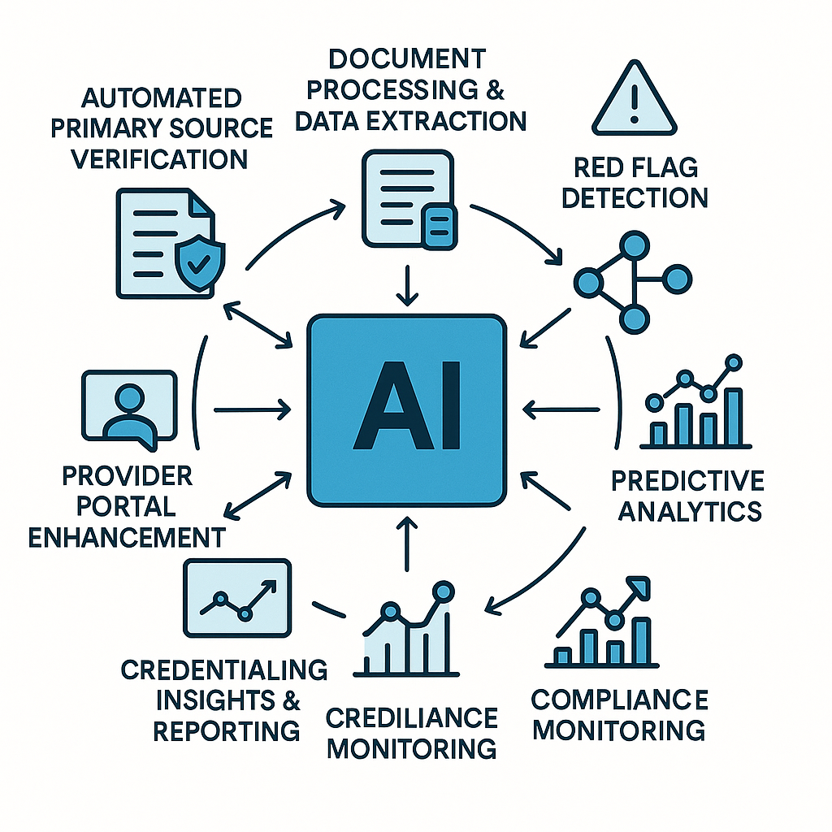
Digital Transformation
AI can improve hospital credentialing processes by increasing efficiency, accuracy, and compliance.
Examples:
1. Automated Primary Source Verification
2. Document Processing & Data Extraction
3. Red Flag Detection
4. Workflow Automation
5. Predictive Analytics
6. Compliance Monitoring
7. Provider Portal Enhancement
8. Credentialing Insights & Reporting
Notes:
AI can analyze provider data to flag inconsistencies, missing information, expired documents, or red flags like malpractice history or gaps in employment, helping teams act proactively.
By analyzing historical credentialing timelines, AI can predict bottlenecks and suggest improvements in staffing or process adjustments.
AI can analyze large datasets to provide trends, performance metrics, and audit readiness dashboards to leadership.

Slide 37
AI Headlines the Good
What is AI?
WHY DO I CARE?

Slide 38
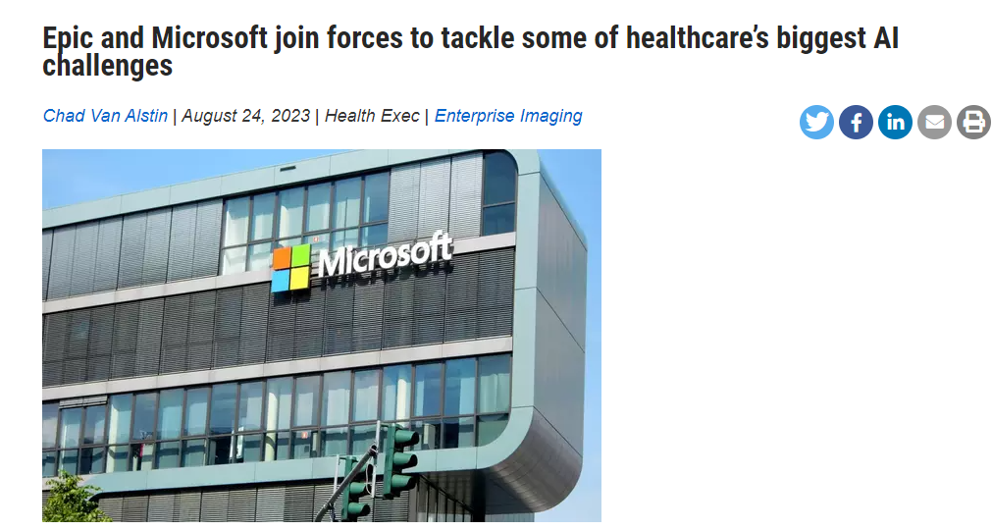
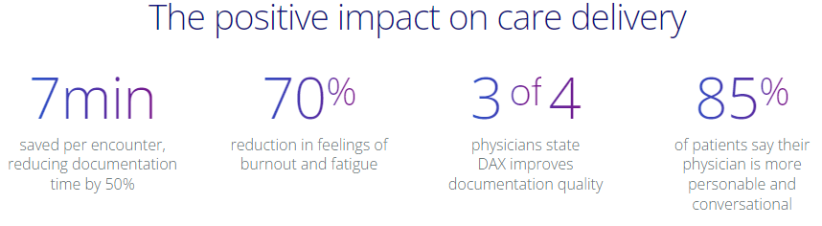
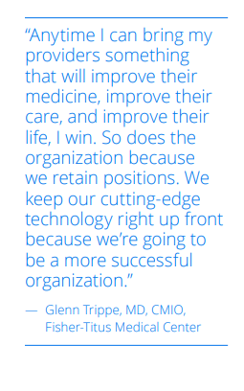
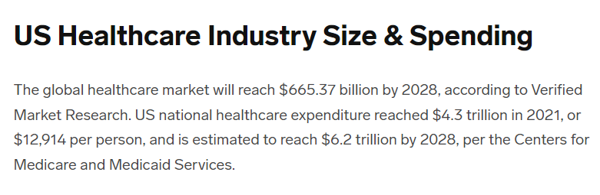
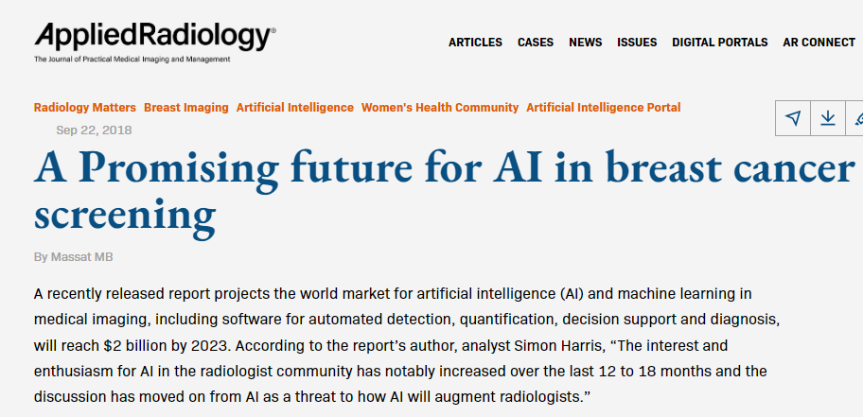
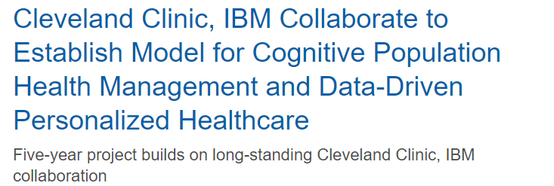
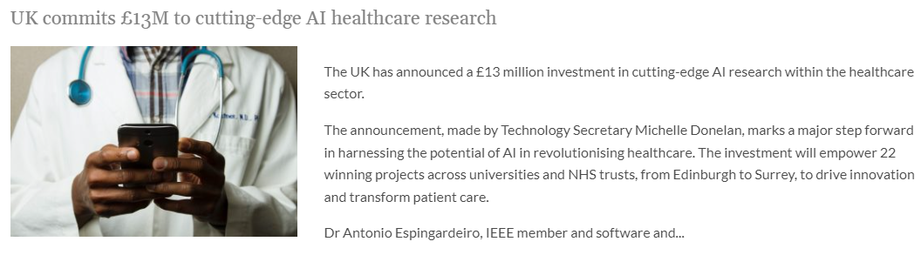
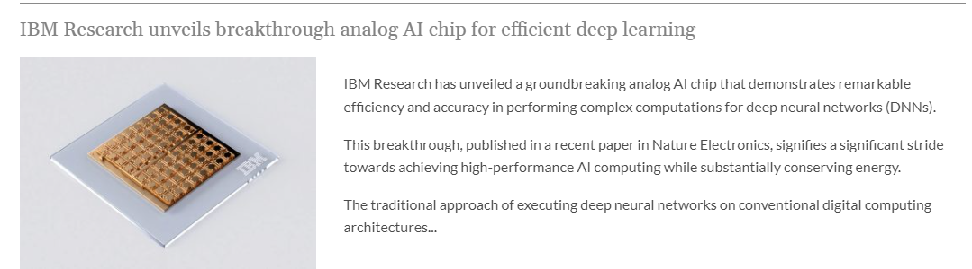
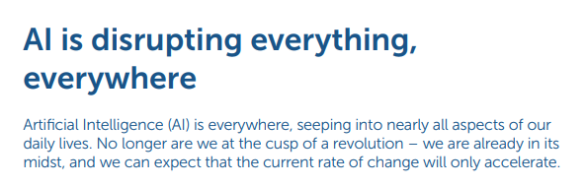

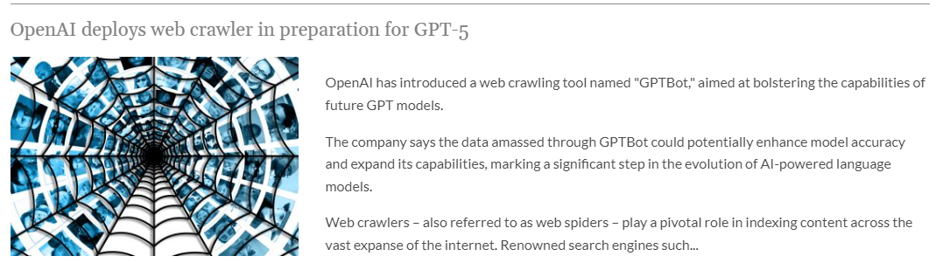
Notes:
Microsoft and Epic seem to be focused on how AI can improve care delivery. clinical insights and administrative tools across various Epic modules, promising a holistic transformation of healthcare practices.
The companies' ultimate goal is to streamline workflows, improve patient care delivery and bolster the efficiency of healthcare systems on a global scale – and its impact could be seen everywhere, considering Epic is used in 36 percent of U.S. hospitals. alleviate much of the clerical burden that contributes to physician unhappiness.
UK 13M equals 16 billion US dollars

Slide 39
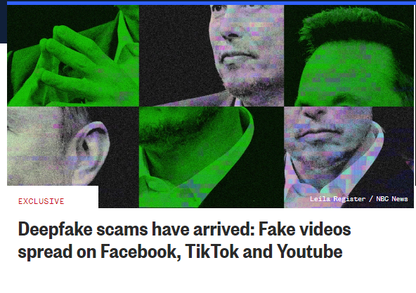
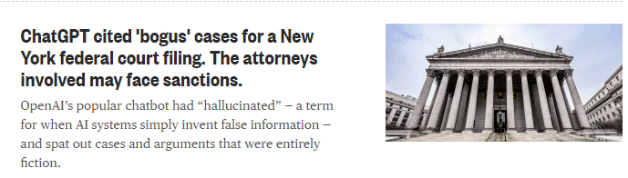
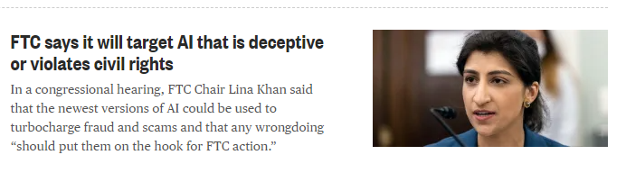
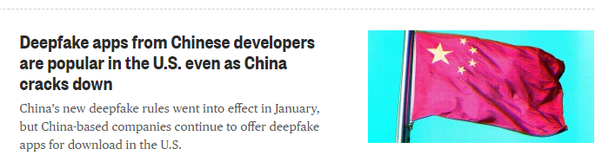
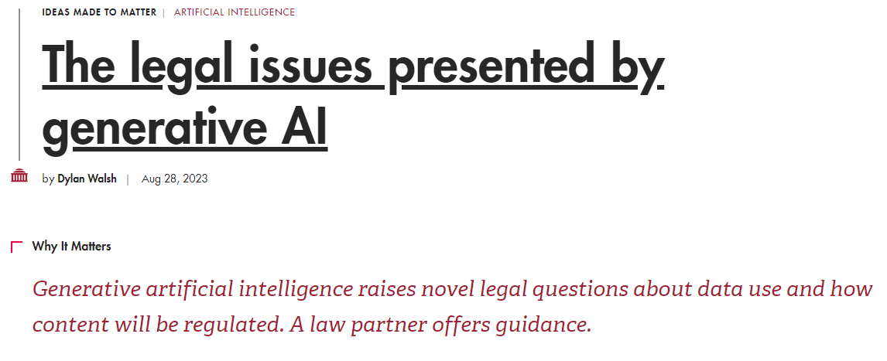
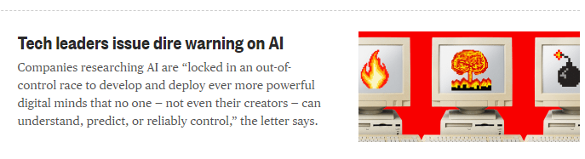
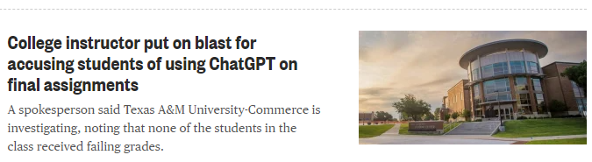
AI Headlines the Ugly

Slide 40
The Bottom Line
WHY DO I CARE?

Slide 41
The Bottom Line
AI is here to stay
Need to overcome Fear Factor
Reduces Human Error
Boost Outcomes
Improves Access
Data Privacy Challenges
Improves ROI
In medicine there is no universal method for all applications of AI, instead a large number of possible solutions for everyday problems no matter the size.
Notes:
While advancements like these can reduce human error and boost overall outcomes and consumer trust, many still question the practical applicability of AI in health care. Patients and caregivers alike fear that lack of human oversight and the potential for machine errors can lead to mismanagement of care, while data privacy remains one of the biggest challenges to AI-dependent health care.
Despite such concerns, the growing involvement of AI in health care is inevitable. But as these advancements suggest, the potential benefits might just outweigh the risks.

Slide 42
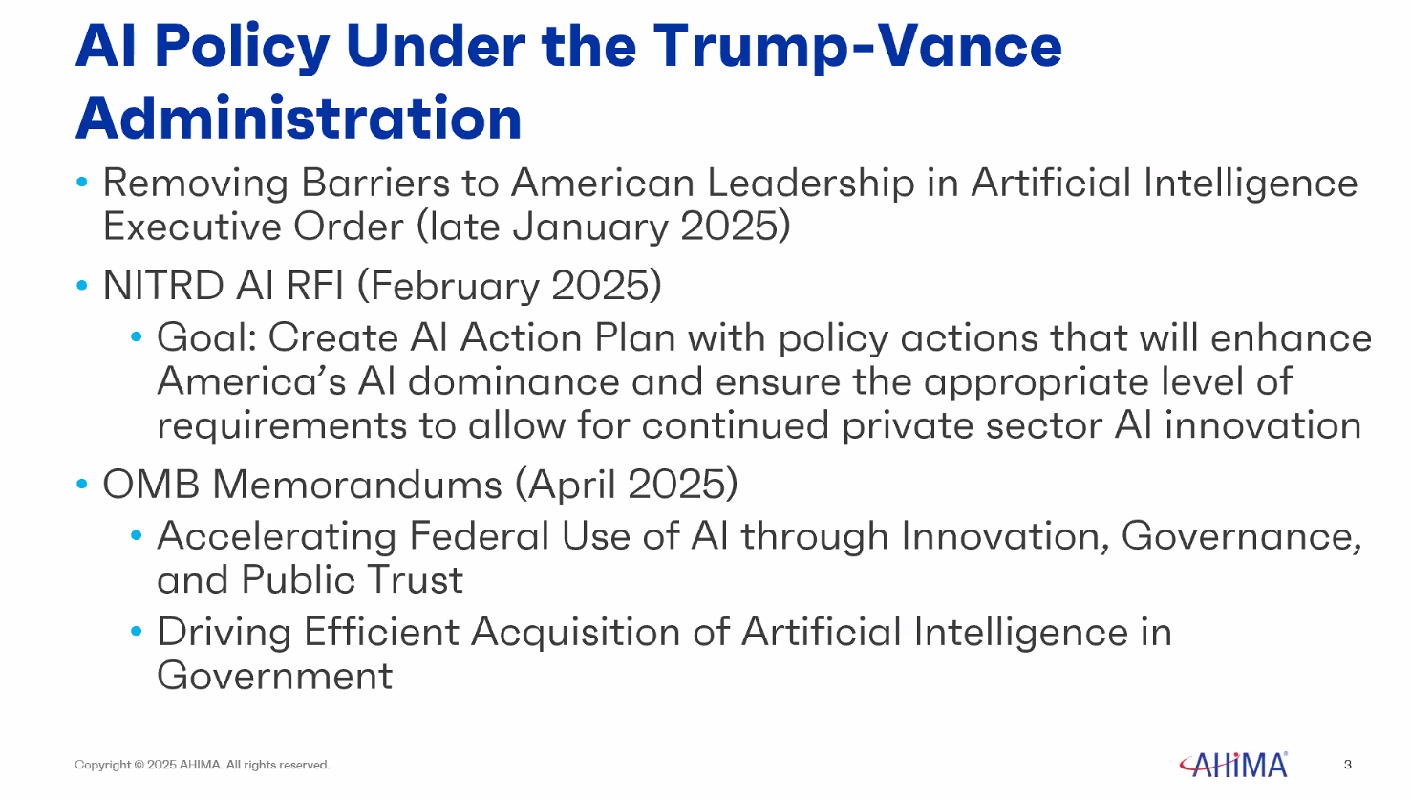

Slide 43
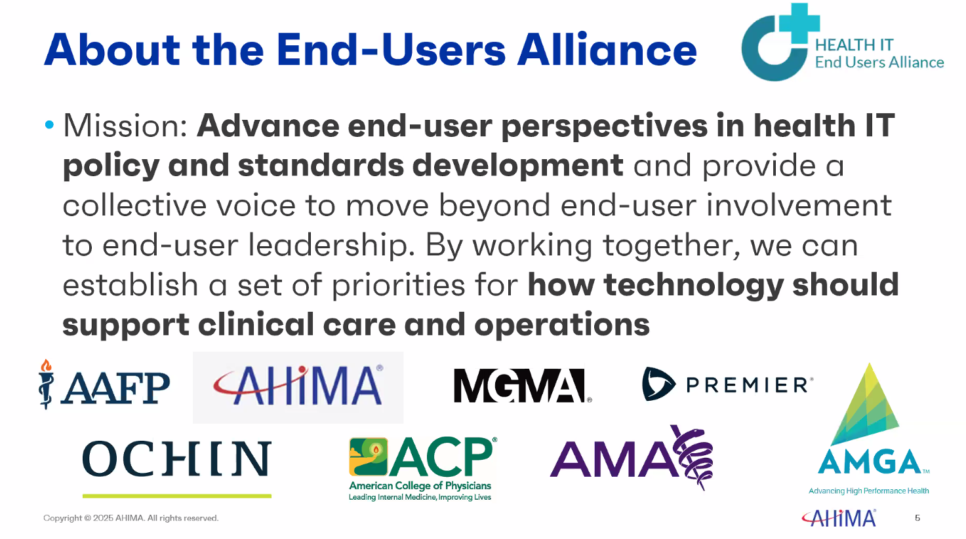

Slide 44
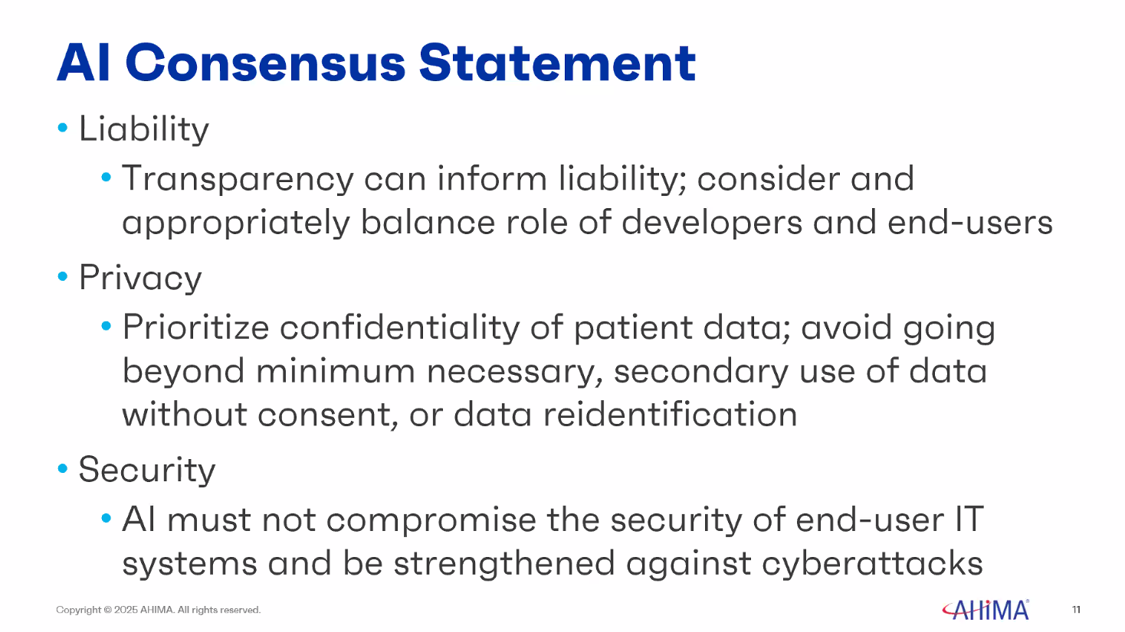
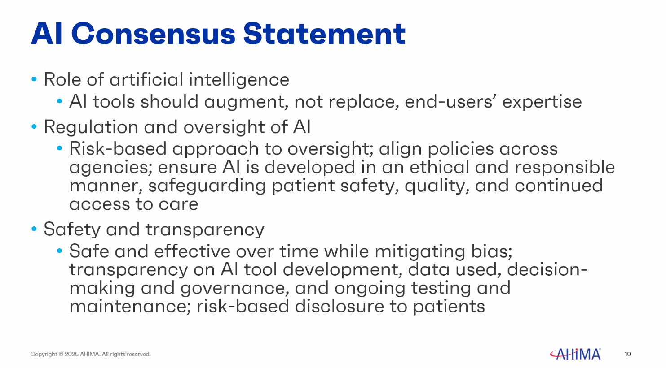

Slide 45
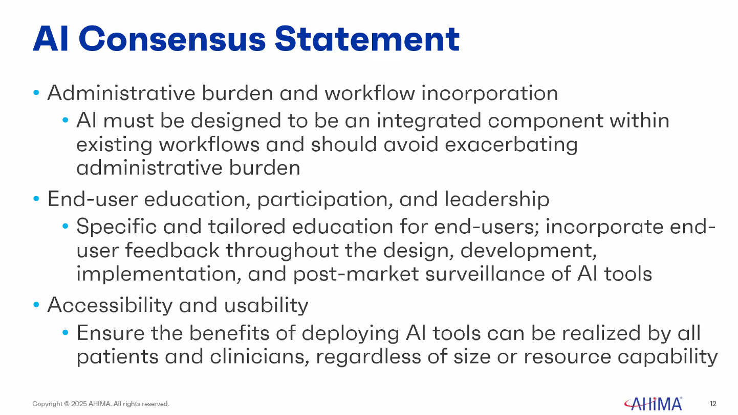


Slide 46

AI In Action

Slide 47


AI BluePrint Tool

Slide 48


Slide 49


Slide 50


Slide 51


Slide 52


Slide 53

“It is not the critic who counts; not the man who points out how the strong man stumbles, or where the doer of deeds could have done them better. The credit belongs to the man who is actually in the arena, whose face is marred by dust and sweat and blood; who strives valiantly; who errs, who comes short again and again, because there is no effort without error and shortcoming; but who does actually strive to do the deeds; who knows great enthusiasms, the great devotions; who spends himself in a worthy cause; who at the best knows in the end the triumph of high achievement, and who at the worst, if he fails, at least fails while daring greatly, so that his place shall never be with those cold and timid souls who neither know victory nor defeat.”
― Theodore Roosevelt

Slide 54
THE WHY!
REMEMBER WHY WE DO WHAT WE
DO AND WHY WE ARE ALL HERE !!!!

Slide 55





Notes:
I answered and my daughter says to me Olivia has had an accident she is being flown to by medivac to Johns Hopkins. She was at a family cookout and decided to try and climb the ladder to the slide, fell, and hit the back of her head knocking her unconscience.
Immediately I thought awesome I work there who can I call. Without skipping a beat I text Dr. Peter Hill, head of Emergency Medicine, gave him the details and in a matter of minutes he sent me a message back and ask what her name was and said don’t worry I’ve got you covered.

Slide 56





Slide 57

MAKE A NEW FRIEND AND SUPPORT EACH OTHER

Slide 58


Slide 59
GENERAL DISCLAIMER FOR THIS PRESENTATION
• Any pictures, images, short videos or trade names of equipment, companies or services should not be construed to indicate an endorsement by the MAMSS of any product or service derived from same.
• The information within this presentation is slated to facilitate discussions on various topics and related to the processing of credentialing applications and potential development for process improvements.

