Slide 1

Shadow of Deceit: The Swango Effect
Guardians of Patient Safety

Slide 2
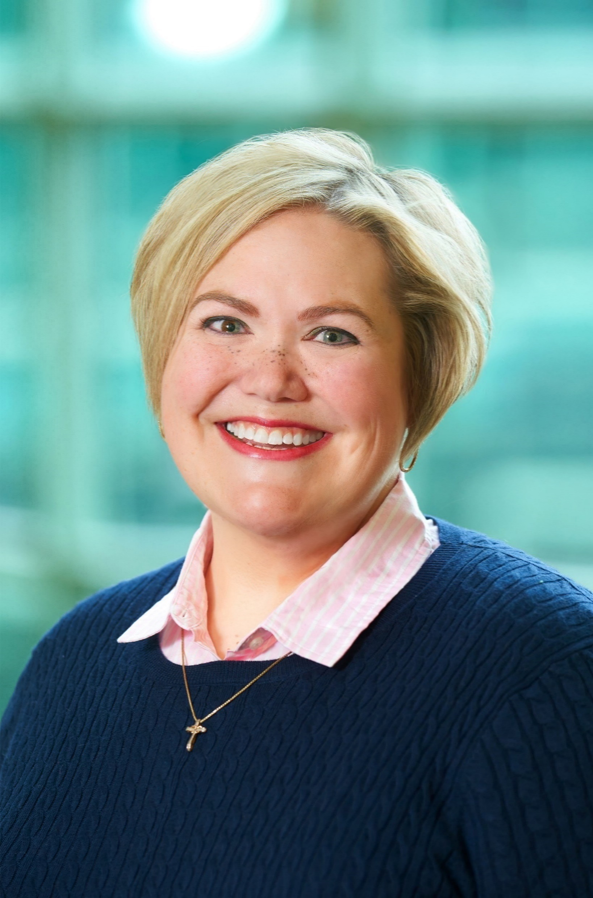
Sara Cameron, CPMSM, CPCS
Senior Director Professional Services & Senior Consultant
Sara Cameron serves as the Senior Director of Professional Services and a Senior Consultant at The Hardenbergh Group, bringing over 20 years of rich experience in healthcare administration, Medical Staff Services, and Graduate Medical Education. Throughout her career, she has partnered with large health systems to implement best practices in credentialing, privileging, peer review, professional development, and performance improvement.
Sara has made a significant impact by designing and implementing comprehensive professional practice evaluations and clinical peer review systems that enhance healthcare quality. Her efforts in establishing a central verification office enabled the standardization of credentialing practices across nine hospitals, leading to improved governance and efficiency. Through her innovative approach, she has fostered a culture focused on opportunities for improvement, effectively reducing complication rates, lengths of stay, and emergency department readmissions.
Additionally, Sara has been instrumental in transitioning organizations to electronic medical records and paperless credentialing processes. She has developed robust onboarding and orientation programs for physicians and medical staff leaders, ensuring they are well-equipped to tackle the challenges in healthcare.
A graduate of the NAMSS Leadership Certificate Program, Sara is an engaged leader within the National Association of Medical Staff Services (NAMSS), where she has held various volunteer and elected roles, including committee positions and board membership. Passionate about education, she has delivered extensive training sessions and authored several publications on medical staff leadership, making a lasting impact in the healthcare community.

Slide 3
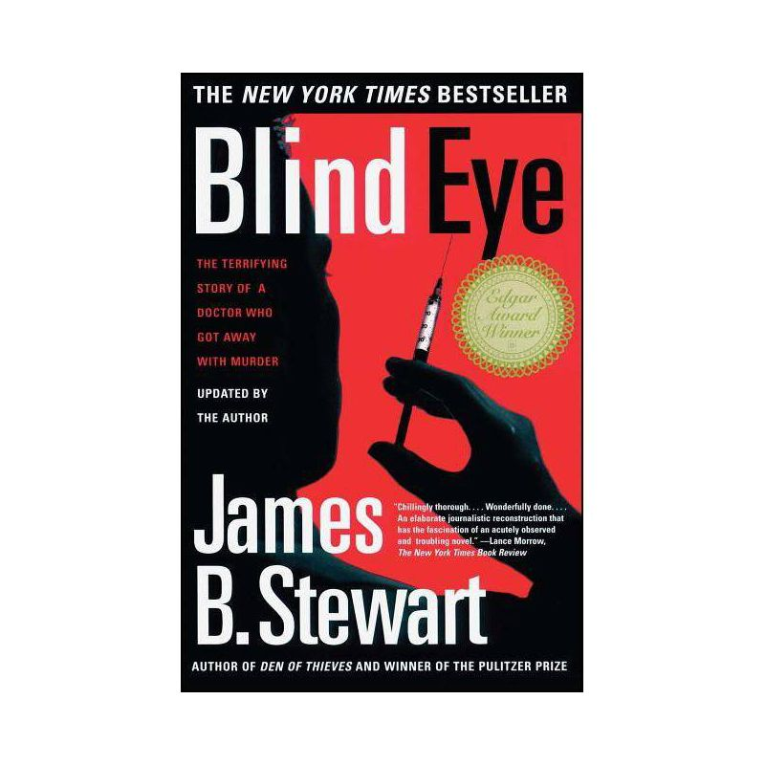
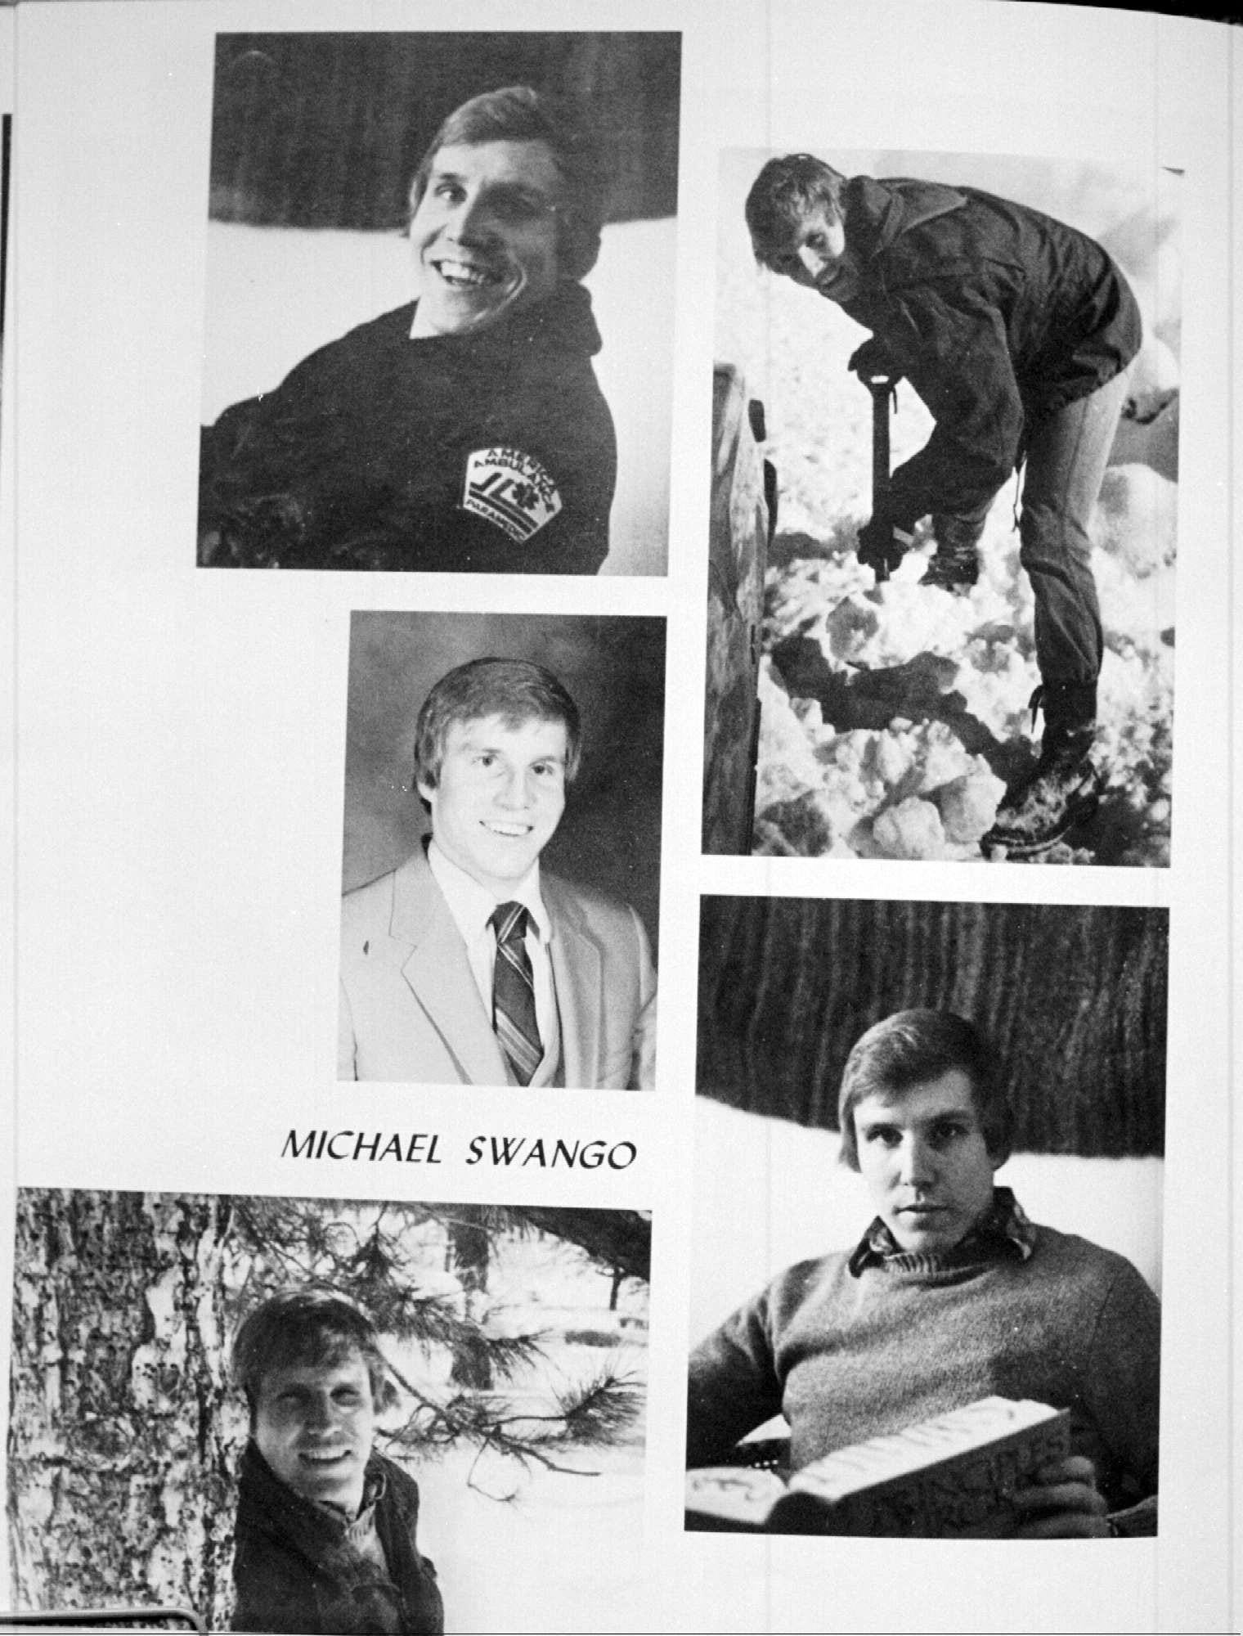
Notes:
When my new boss handed me Blind Eye on my first day in the medical staff office, she said, “if you want to understand what we do and why we do it, read this book.” Swango was the poster child at conferences on credentialing and patient safety. “He is why we do what we do.”

Slide 4
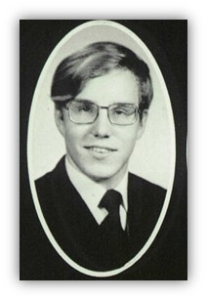
1954
Born James Michael Swango in Tacoma, Washington
1972
High school valedictorian in Quincy, Illinois

Slide 5
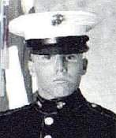
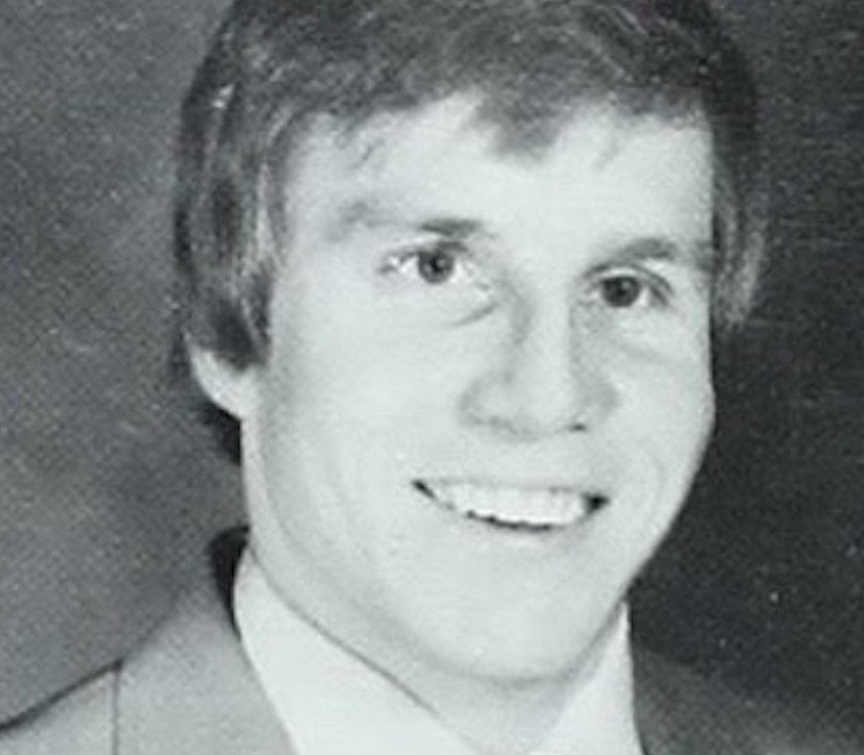
1976
Honorable discharge from the Marines
1979
Graduates summa cum laude from Quincy College.

Slide 6
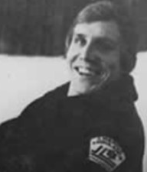
The Scrapbook Of Death
Swango seemed fascinated with death from the unbelievably tiny age of three. Growing up he was drawn to stories about the Holocaust, he loved to see pictures of the dead bodies in the concentration camps. He developed a hobby of collecting photos and clips of articles about gruesome accidents and crimes. His mother even assisted with his hobby by bringing any articles that she found to him.
Swango continued his scrapbook collections well into his adulthood. He was soon able to take his own photographs at the scene of accidents to add to his scrapbook. He once told his colleagues that his scrapbook would be a big help if he was arrested for murder. He said the scrapbook would aid in his insanity defense.
When he worked as an ambulance driver, his co-workers recalled a bizarre scene one night while he was on the job. Michael Swango was found atop a car in the midst of a horrible accident, he was trying to take pictures of the victims who were still inside the car. No doubt Swango wanted these pictures for his scrapbook of death.

Slide 7

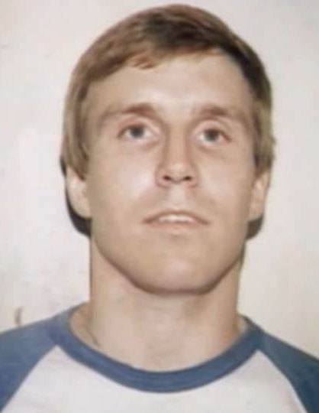
1983
Graduates from Southern Illinois University School of Medicine, where classmates nickname him “Double-0 Swango” and faculty raise concerns about his performance. Accepted into the neurosurgery program at Ohio State University Medical Center.

Slide 8

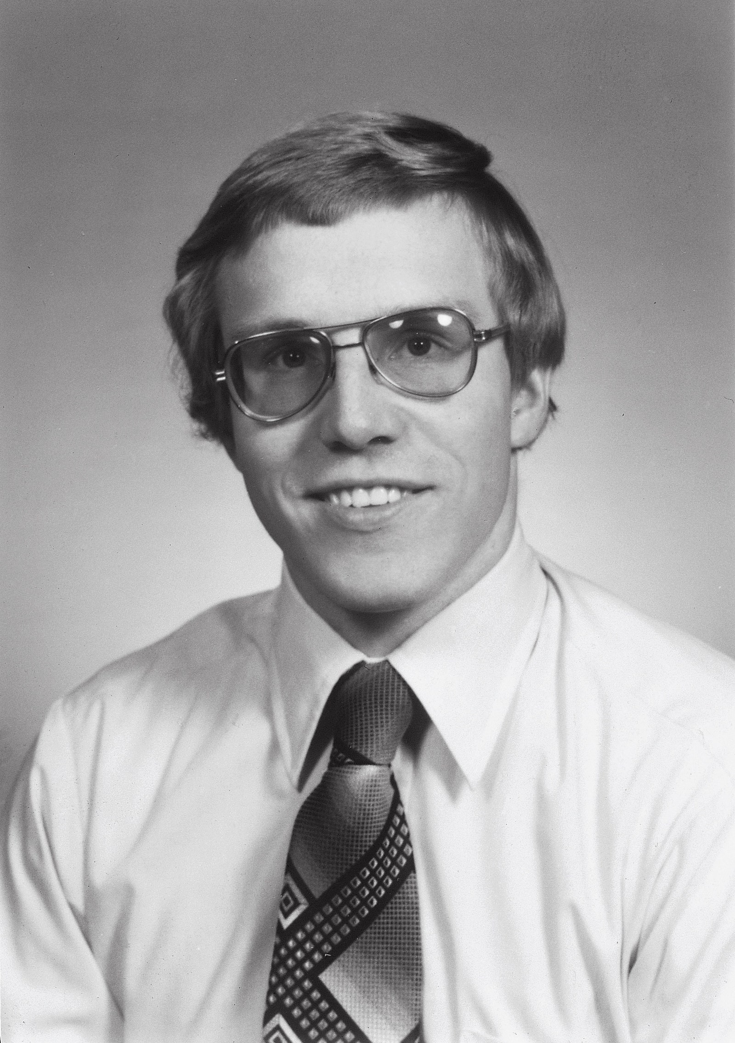
February 1984
A nursing student reports that Swango tampered with an IV just before the patient suffers a seizure and respiratory arrest. The patient survives, but nurses suspect Swango in five deaths on the ward. Hospital leaders conduct interviews and dismiss these suspicions.

Slide 9
March 1984
Ohio State recommends Swango for medical licensure. He completes his internship but is not invited to stay on for a neurosurgery residency.

Slide 10
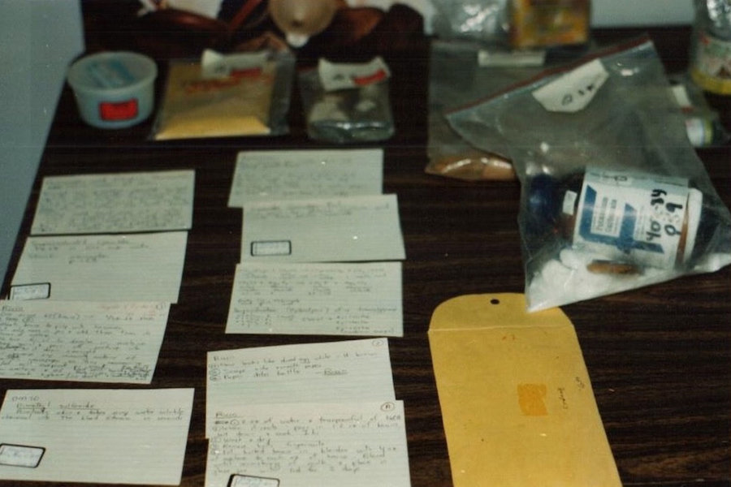
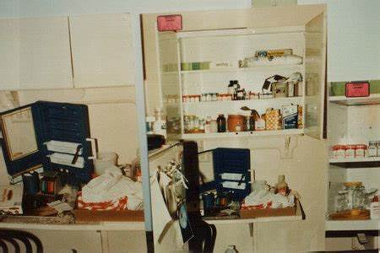
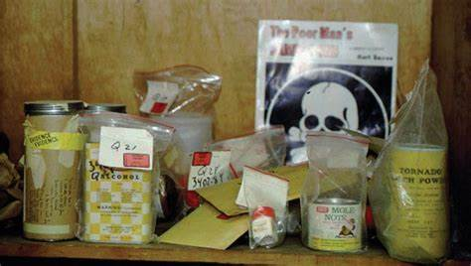
July 1984
Finds work as a paramedic in Quincy. Colleagues fall ill and suspect Swango of poisoning them. Police search his house and find a “mini-laboratory” of poisons, including handwritten recipes for ricin, botulism and supersaturated cyanide.

Slide 11
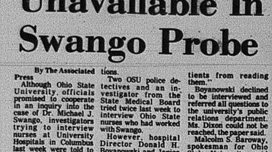
October 1984: Ohio State University police are joined by the Franklin County prosecutor and the state medical board in investigating Swango’s time at Ohio State. Despite suspicious stories, there is no hard evidence. No charges are brought.
February 1985: Ohio State law school dean James Meeks investigates the university’s handling of Swango during his internship. In a sharply worded report, Meeks concludes the hospital’s inquiry was “far too superficial.”

Slide 12
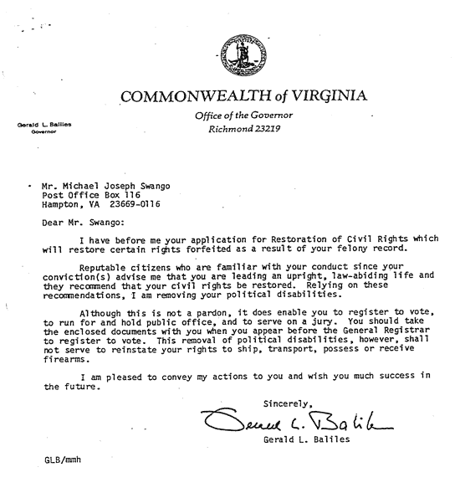
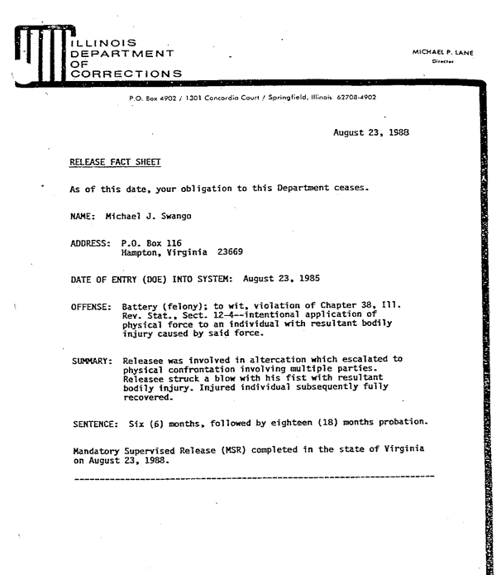
August 1985: Convicted in the nonfatal Illinois poisonings. He serves two years of a five-year sentence.
August 1987: Released from prison.

Slide 13
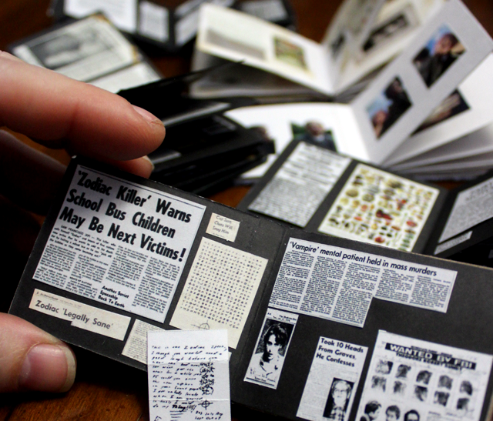

In 1989, Swango, now released from prison, found work as a counselor at the state career development center in Newport News, Virginia. He was forced out after being caught working on a scrapbook of disasters on work time. He then found a job as a laboratory technician for ATICoal in Newport News, Virginia, now Vanguard Energy, a division of CITA Logistics. During his time there, several employees sought medical attention with complaints of persistent and increasing stomach pains. The FBI questioned employees on several occasions several months after his resignation.

Slide 14
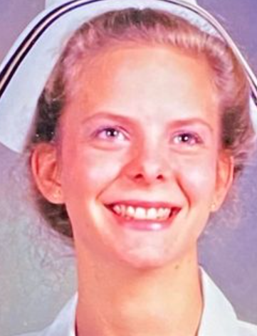
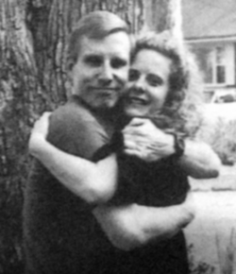
August 1991
Swango met 25-year-old Kristin Kinney, a nurse at Riverside Hospital when Swango signed up for an advanced-life-support class. The two fell in love, and planned to marry once they got settled.

Slide 15
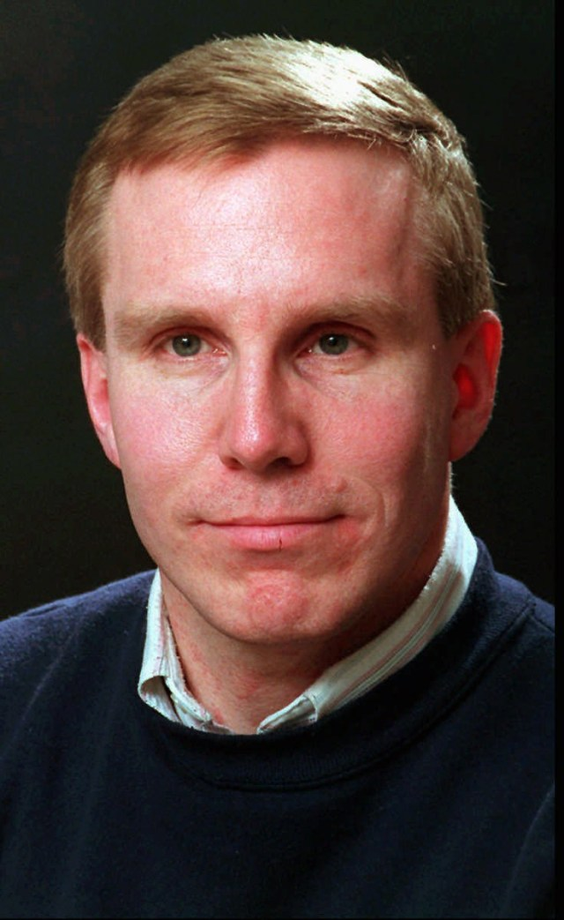
March 1992: Secures a residency at a university hospital in Sioux Falls, South Dakota, using forged documents.
Kristin Kinney accompanied him.
wango established a sterling reputation at Sanford, but in October made the mistake of attempting to join the American Medical Association (AMA). The AMA did a more thorough background check than the medical center, and found out about the poisoning conviction. That Thanksgiving Day, The Discovery Channel aired an episode of Justice Files that included a segment on Swango.

Slide 16
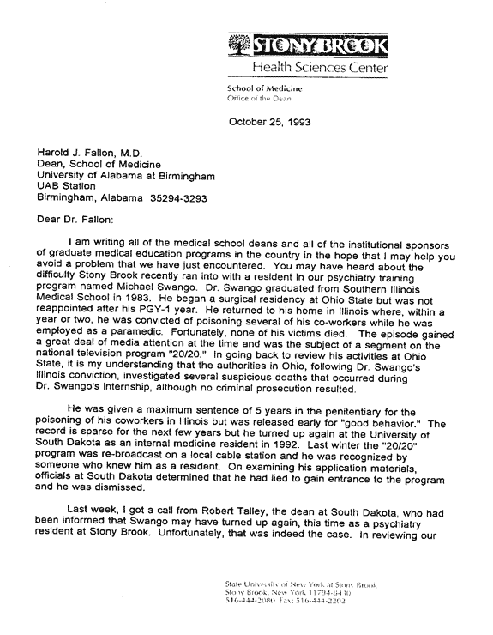
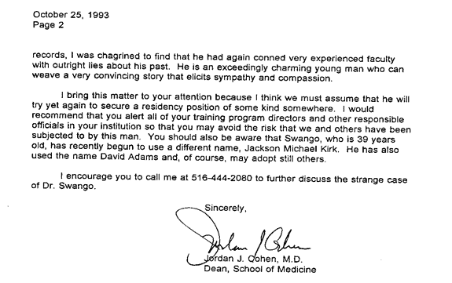
1993 - The AMA temporarily lost track of Swango, who managed to find a berth in the psychiatric residency program at the State University of New York at Stony Brook School of Medicine. His first rotation was in the internal medicine department at the VA Medical Center in Northport, New York. Once again his patients began dying for no explicable reasons.
Sanford's dean, Robert Talley, learned about Swango's whereabouts. Talley telephoned the dean at Stony Brook, Jordan Cohen. Under intense questioning from the head of Stony Brook's psychiatry department, Alan Miller, Swango admitted he had lied about his poisoning conviction in Illinois and was immediately fired. The public outcry resulted in Cohen and Miller being forced to resign as well before the year was out. Before he resigned, Cohen, learning from the past mistakes of other medical facilities, sent a warning about Swango to all 125 medical schools and all 1,000 teaching hospitals across the nation—effectively blackballing Swango from getting a medical residency in the United States.

Slide 17
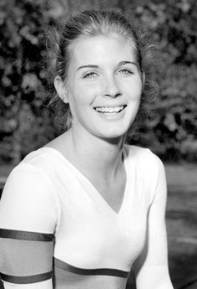
July 1993
Kristin Kinney takes her life after suffering for over a year with debilitating illness.
An autopsy revealed Kristin had long term cyanide poisoning.

Slide 18
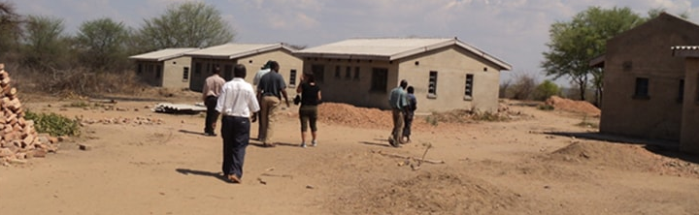
1994:
The FBI found out Swango was living in Atlanta and working as a chemist at a computer equipment company's wastewater facility. Soon after the FBI alerted the company, Swango was fired for lying on his job application. The FBI obtained a warrant charging Swango with using fraudulent credentials to gain entry to a VA hospital.
By that time, however, Swango had fled the country. In November 1994, he went to Zimbabwe and got a job at Mnene Hospital based on forged documents. There again, his patients began dying mysteriously. It took a year, however, for the poisonings to be traced to him, and he was arrested in Zimbabwe. He escaped from Zimbabwe before his trial date, and hid in Zambia. A year and a half later, in March 1997, he applied for a job at the Royal Hospital in Dhahran, Saudi Arabia, using a false resume.

Slide 19
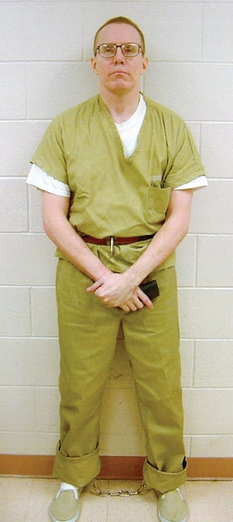
June 1997: Swango is hired by a hospital in Saudi Arabia. Returning to the U.S. to obtain a visa, he is arrested in a Chicago airport on federal fraud charges.
Faced with hard evidence of his fraudulent activities and the possibility of an extended inquiry into his time in Zimbabwe, Swango pleaded guilty to defrauding the government in March 1998. In July 1998, he was sentenced to 3.5 years in prison. The sentencing judge ordered that Swango not be allowed to prepare or deliver food, or have any involvement in preparing or distributing drugs.
July 2000: Days before Swango is to be released, federal investigators charge him in the 1993 deaths of three of his VA hospital patients whose exhumed remains have been found to contain poisons.

Slide 20
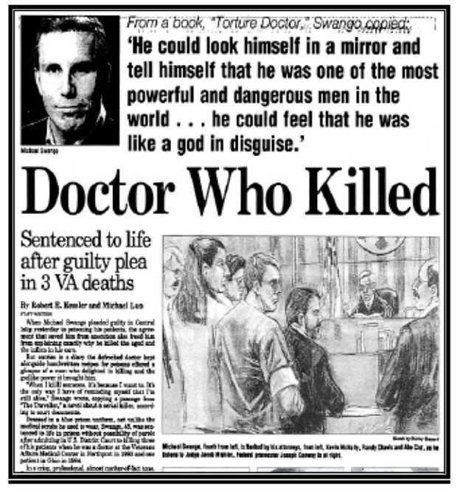
Sept. 2000: Swango pleads guilty to the three New York slayings and is sentenced to three life sentences without parole.
Oct. 2000: Swango pleads guilty in Columbus to the 1984 slaying of 19-year-old Cynthia McGee, a Dublin native who died at University Hospital while recovering from an automobile accident.

Slide 21
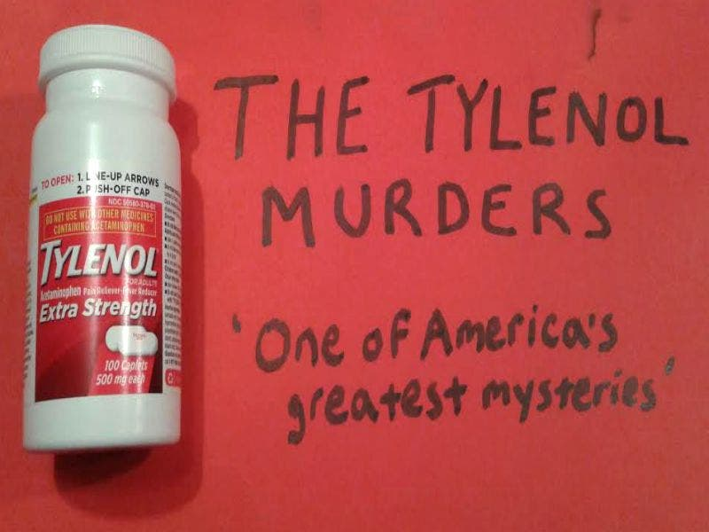
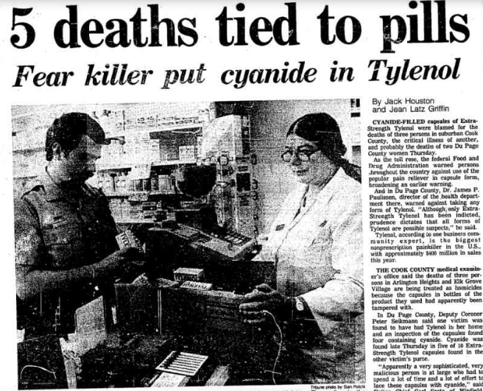

Slide 22
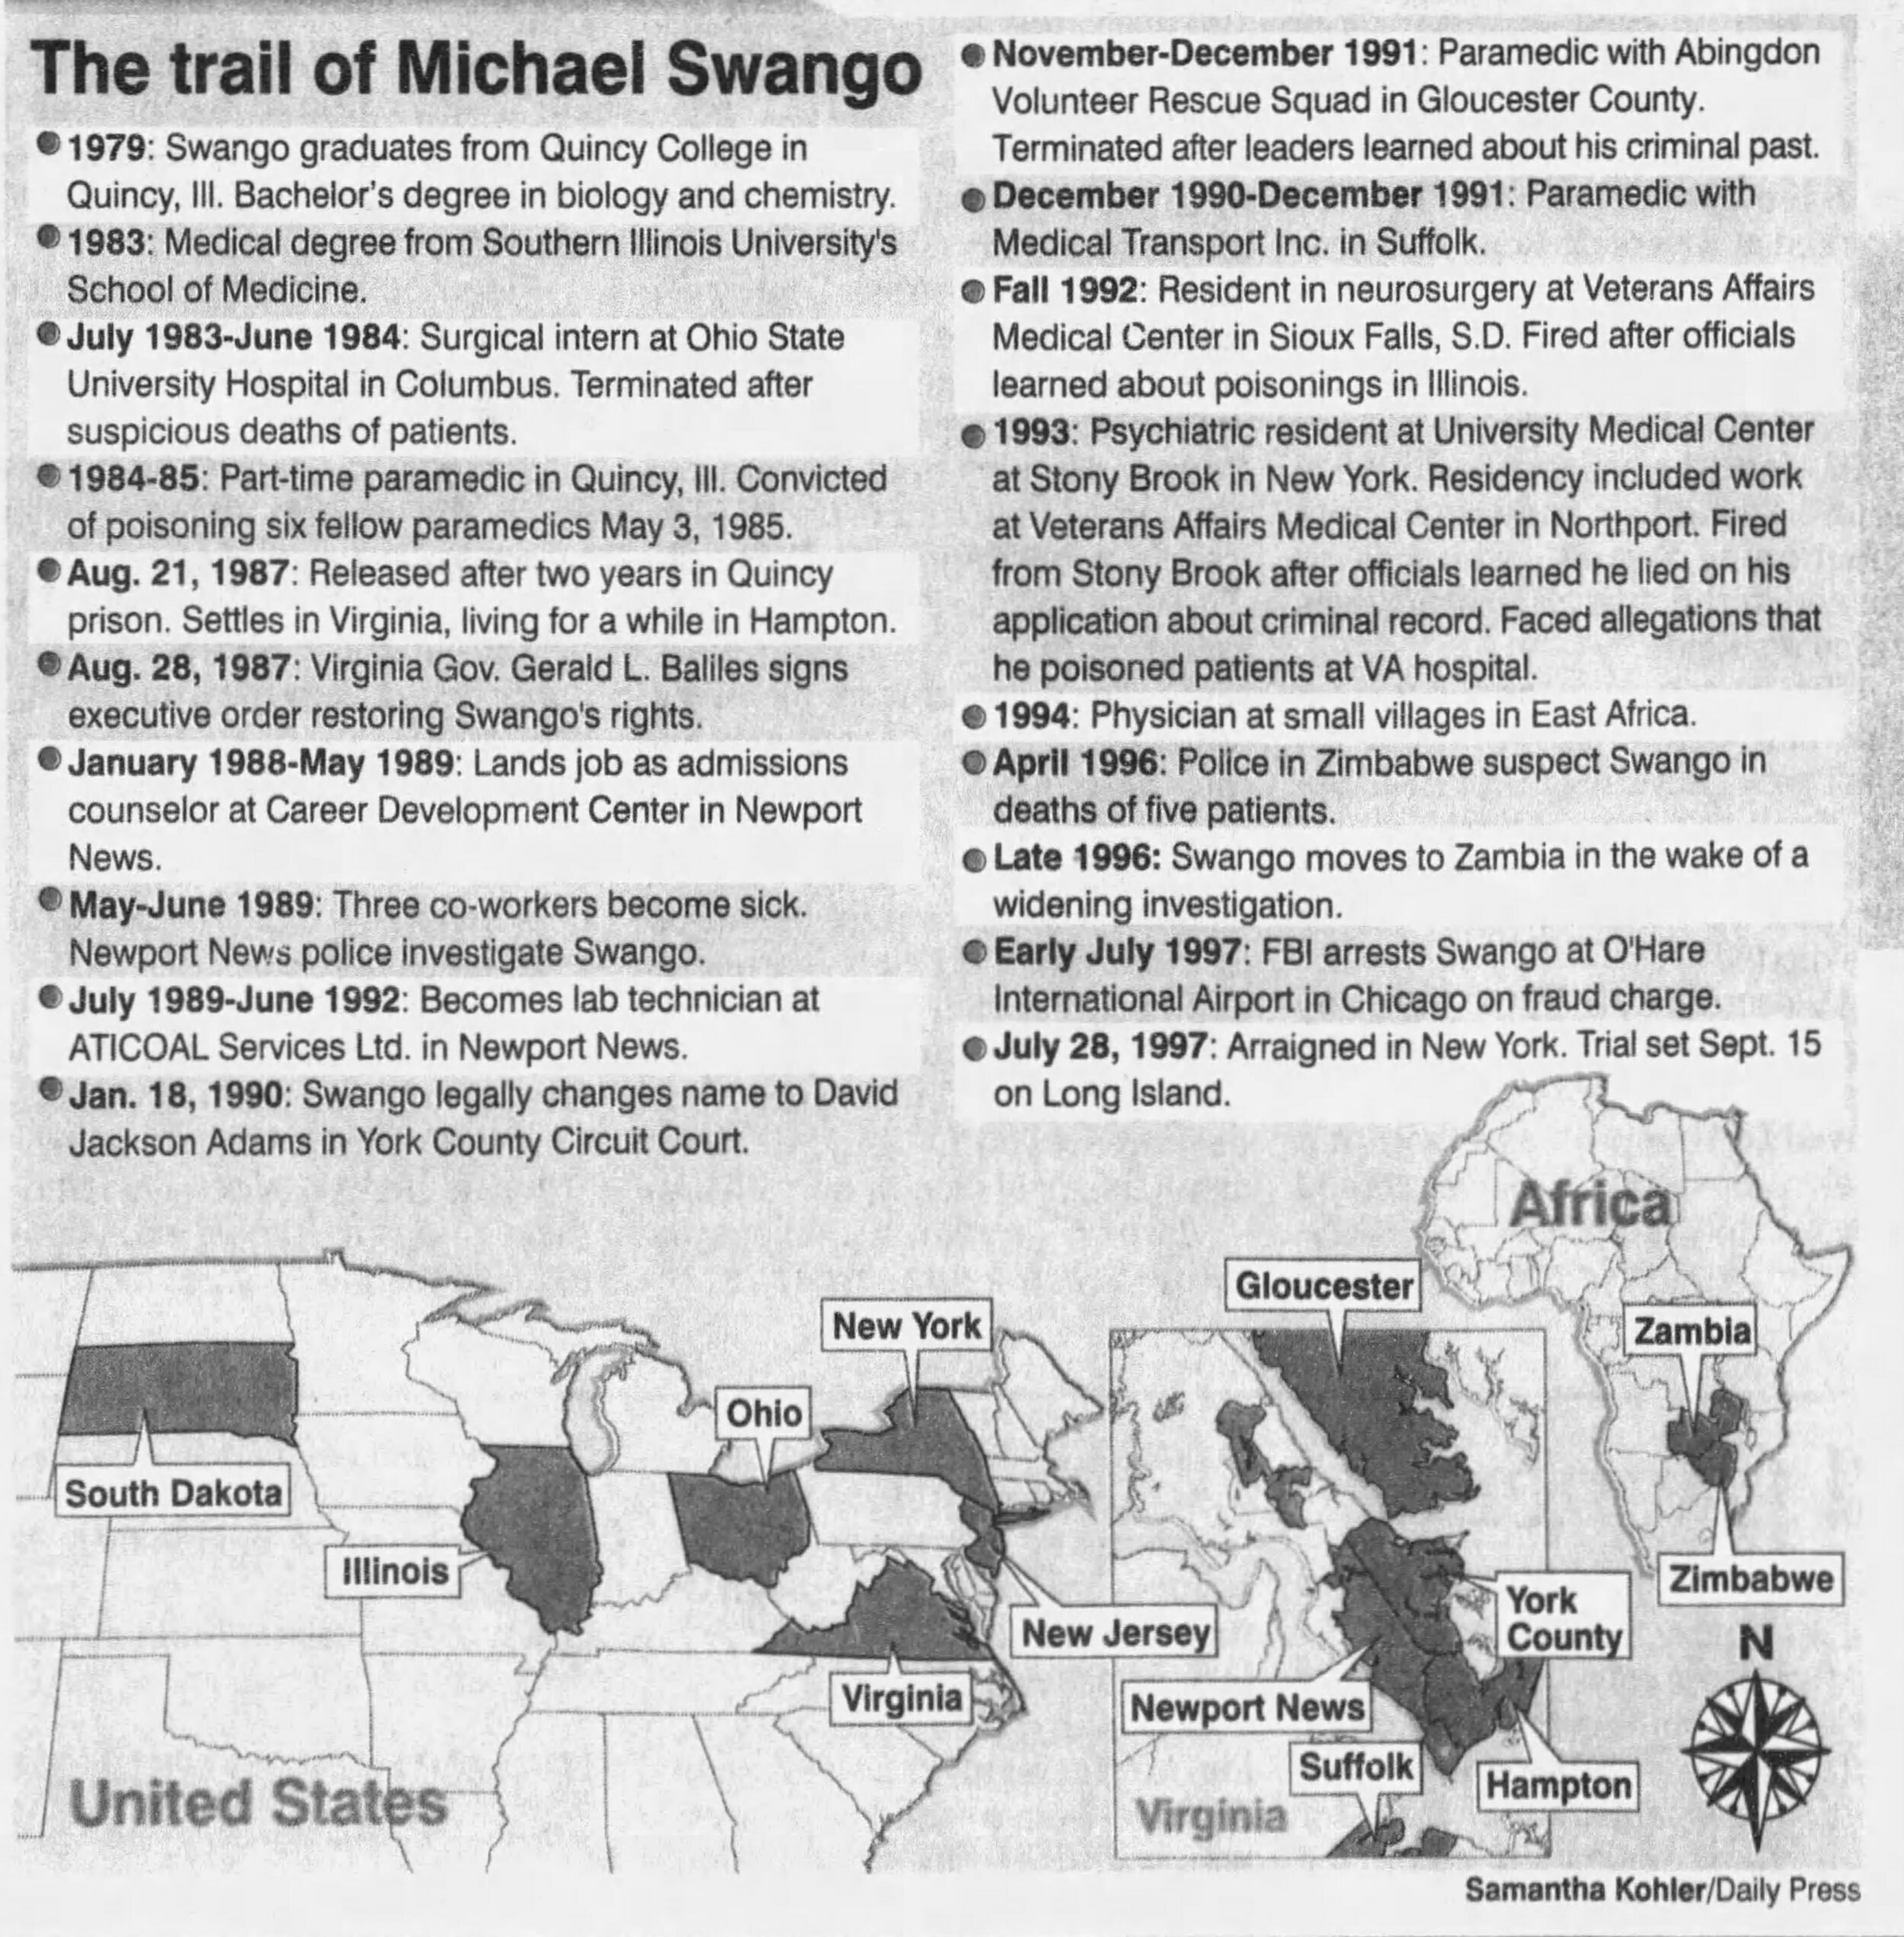

Slide 23



KEEPING THE SWANGOS OF THE WORLD OUT OF OUR HOSPITALS
What impact did Swango have on our profession? What changed? How is healthcare safer through his violent proclivities?
In the 1980’s and early 1990’s hospitals had no clear system in place to prevent dangerous doctors from harming their patients. Even after prison, Swango was able to obtain numerous medical jobs.
THE EVOLUTION OF THE GATEKEEPERS OF PATIENT SAFETY: AS MPS, WE MUST ASK THE HARD QUESTIONS
Does your facility have a mechanism in place that would catch him today?
Even more importantly, do you have a process that identifies outliers early enough to intervene?
Does your medical staff office have the expertise and staffing it needs to manage such a daunting responsibility? When your medical staff quality processes are fine-tuned, they can identify opportunities before they become bad outcomes.

Slide 24


Notes:
When the book was handed to me, I smiled from ear to ear and told her I had already read it. In fact, I was quite familiar with Michael Swango. No, I was not a well-prepared new hire who had researched the industry. The 21-year-old version of me quickly blurted out, “Yeah, my parents are friends with him.” That’s when my new boss sat down. At which point I backpedaled, explaining, well, no longer friends, but friends a long time ago. My mom would call them casual acquaintances.
Back when Michael Swango was a medical student at SIU, shadowing as an EMT, my mother lived in a small apartment above the ambulance service. This is where she met Swango’s EMT partner, who would later become my father. I grew up hearing my medical professional parents, friends, and family discuss their friend Mike; his peculiarities, his odd fascination with mass casualty disasters, and the fact that he killed people with poison. Although my parents’ friendship with him ended in the mid 1980’s before any of his crimes were discovered, I’d grown up in the circle of a serial killer. And now I have stumbled upon a career for which he is the mascot.

Slide 25




Slide 26


Let’s Chat!
SCameron@HardenberghGroup.com

